Slide 1

NYSE: LOAR
LOAR HOLDINGS
INC.
Niche Aerospace & Defense Components
Buy Recommendation — Long-Term Compounder
$57.27
Share Price
$5.2B
Market Cap
$90 avg
Analyst Target
+63%
NEELEY EQUITY RESEARCH CLUB | APRIL 2026
Upside
Notes:
Will – Presenting
Loar Holdings is a capital-light manufacturer of highly-engineered, sole-source aerospace & defense components operating in niche markets with minimal
competition. Its acquire-and-optimize strategy creates a durable compounding engine.

Slide 2

Team 3
Lilly Jamail
Daniel Vasquez
William Cecil
Nate Gust
Ben Tran
Jacob Garfunkel
NEELEY EQUITY RESEARCH CLUB | APRIL 2026
Notes:
Will - Presenting

Slide 3
Agenda
5. Industry Tailwinds
6. Valuation
4. Acquire & Optimize Playbook
1. Business Overview
2. Financial Performance
3. Growth Drivers
7. Key Risks
NEELEY EQUITY RESEARCH CLUB | APRIL 2026
Notes:
Will - Presenting

Slide 4
INVESTMENT THESIS
BUY
01
Sole-Source Moat
~80% of revenue from sole-source contracts
Customers rarely switch suppliers due to lengthy FAA/DOD re-qualification processes (2–5 years). Pricing power is structural.
NEELEY EQUITY RESEARCH CLUB | APRIL 2026
Notes:
Will

Slide 5
INVESTMENT THESIS
BUY
02
Aftermarket Mix = Recurring Cash
55% of revenue is aftermarket; the highest-margin, most recurring segment. Aging global fleets and OEM production delays extend aftermarket tailwinds.
NEELEY EQUITY RESEARCH CLUB | APRIL 2026
Notes:
Will

Slide 6
INVESTMENT THESIS
BUY
03
Proven M&A Compounding
7 acquisitions since 2017. Management targets 40%+ Adj. EBITDA margins on acquired businesses. LMB Fans & Harper Engineering are accretive within 12 months.
NEELEY EQUITY RESEARCH CLUB | APRIL 2026
Notes:
Will

Slide 7
INVESTMENT THESIS
BUY
04
Defense Hypergrowth
Defense revenue +51% YoY in Q2 FY2025. Global defense budgets at multi-decade highs driven by geopolitical tensions provide a durable secular tailwind.
NEELEY EQUITY RESEARCH CLUB | APRIL 2026
Notes:
Will

Slide 8
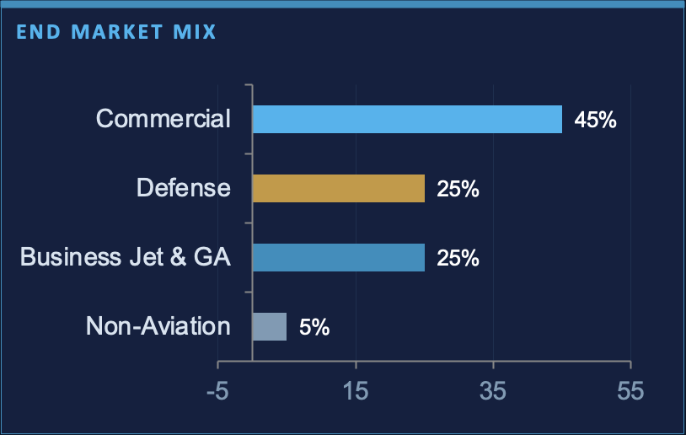
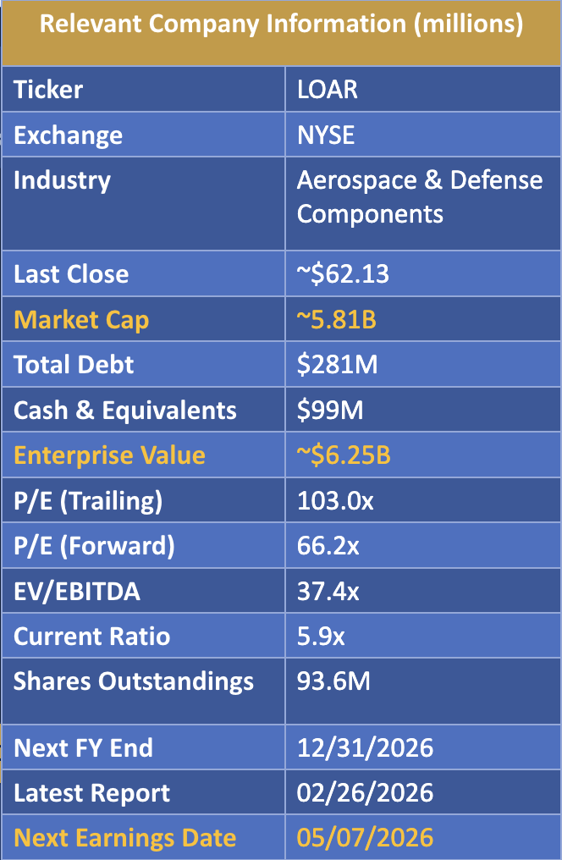
BUSINESS OVERVIEW
Founded 2017 | IPO April 2024 | HQ: White Plains, NY | CEO: Dirkson R. Charles | ~1,500 Employees
Loar designs, manufactures, and sells highly-engineered aerospace & defense components for commercial aircraft, business jets, general aviation, and military platforms — operating through an asset-light, decentralized acquire-and-optimize model.
~89% SOLE-SOURCE CONTRACTS — FAA-CERTIFIED, PLATFORM-EMBEDDED, 20–30 YEAR LIFECYCLE
NEELEY EQUITY RESEARCH CLUB | APRIL 2026
Notes:
Lilly – Presenting
Loar designs, manufactures, and sells highly-engineered aerospace & defense components for commercial aircraft, business jets, general aviation, and military platforms. The company operates through an asset-light, decentralized model with a disciplined acquire-and-optimize playbook.

Slide 9
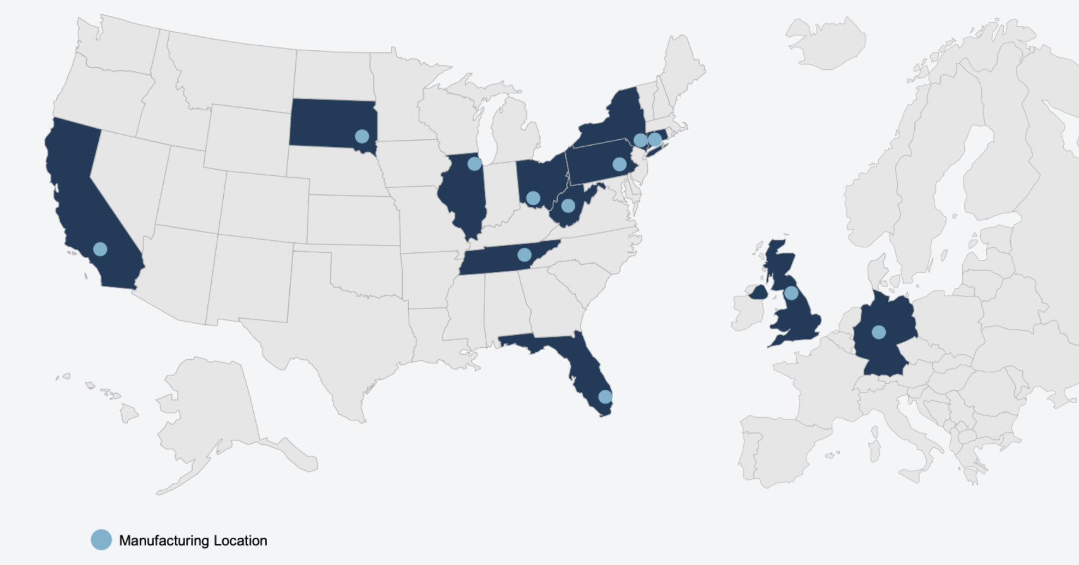



BUSINESS OVERVIEW
Founded 2017 | IPO April 2024 | HQ: White Plains, NY | CEO: Dirkson R. Charles | ~1,500 Employees
GLOBAL MANUFACTURING FOOTPRINT
KEY PRODUCT CATEGORIES
Fluid/thermal management systems
Lighting & indicators
Interior systems
Structural components
Escape systems
Connectors & power distribution
Manufacturing Location
Composite panels & ducts
CEO VISION | Dirkson R. Charles:
~89% SOLE-SOURCE CONTRACTS
"Our mandate is to create a strategic global alliance of companies specializing in the design and manufacture of aerospace and defense components — acquiring, integrating, and optimizing for long-term value creation."
NEELEY EQUITY RESEARCH CLUB | APRIL 2026
Notes:
Lilly – Presenting
Loar designs, manufactures, and sells highly-engineered aerospace & defense components for commercial aircraft, business jets, general aviation, and military platforms. The company operates through an asset-light, decentralized model with a disciplined acquire-and-optimize playbook.

Slide 10
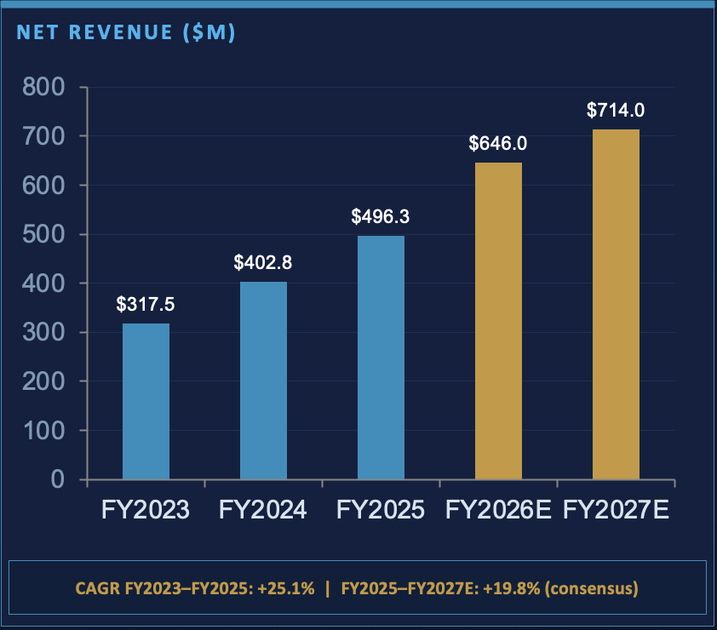
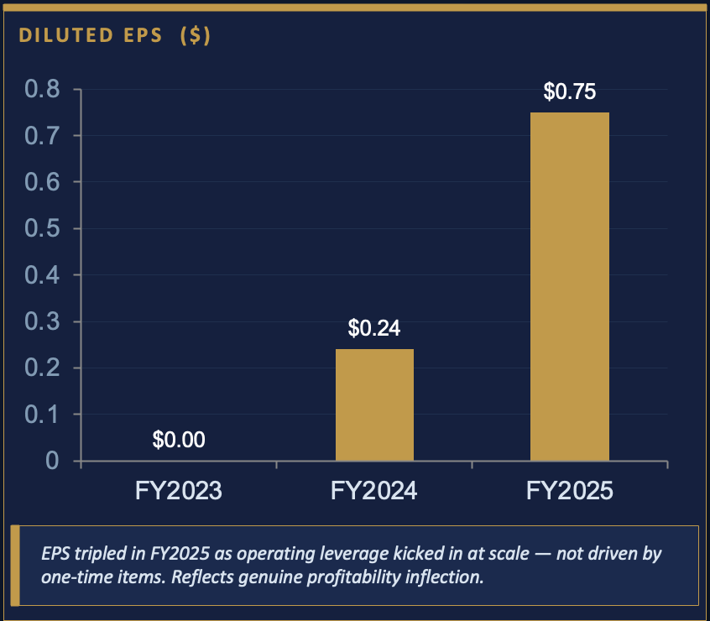
FINANCIAL PERFORMANCE
Record FY2025 Results | NYSE: LOAR
NEELEY EQUITY RESEARCH CLUB | APRIL 2026
Notes:
Lilly - Presenting

Slide 11
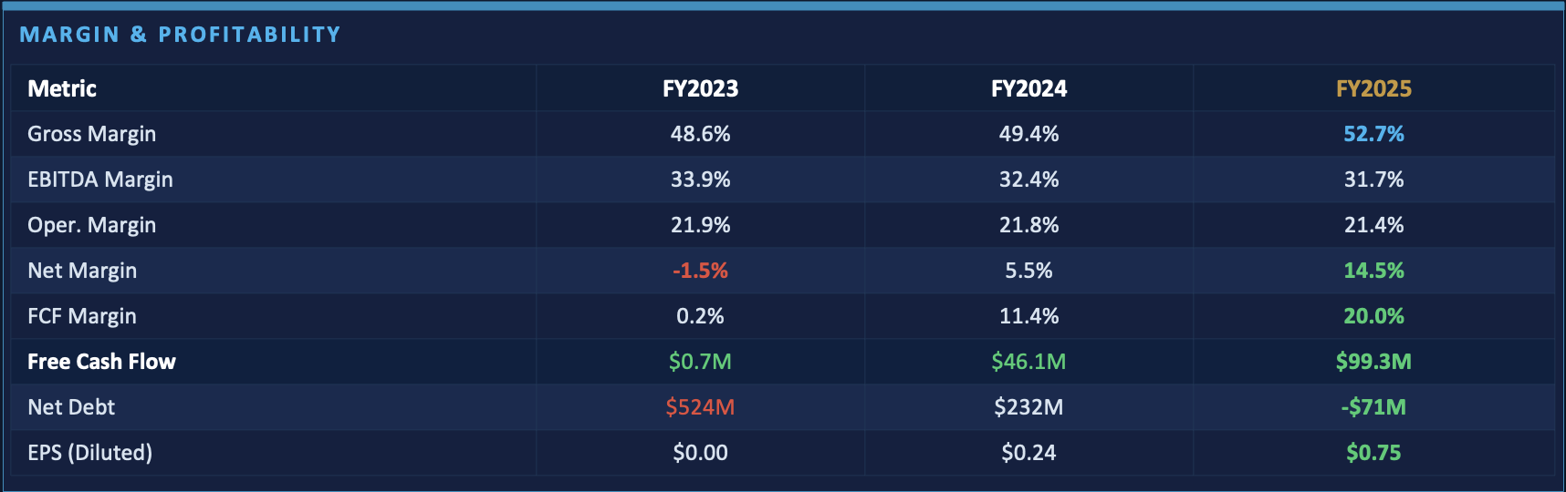
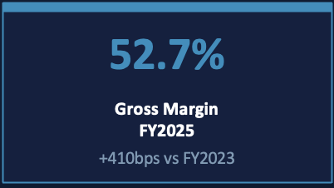
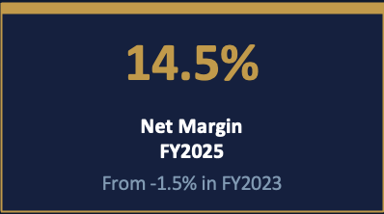
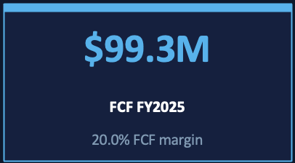
FINANCIAL PERFORMANCE
Margin & Profitability
NEELEY EQUITY RESEARCH CLUB | APRIL 2026
Notes:
Lilly - Presenting

Slide 12
GROWTH DRIVERS
Quarterly Revenue Momentum ($M)
$149.7M
$123.1M
$126.8M
$131.8M
$110.4M
$114.7M
$150M
$100M
$50M
Q4 '24
Q1 '25
Q2 '25
Q3 '25
Q4 '25
Q1 '26E
Q4 FY2025 Revenue +19.3% YoY | 6 Consecutive Quarters of Record Sales
$0M
NEELEY EQUITY RESEARCH CLUB | APRIL 2026
Notes:
Nate presenting
“Revenue growth here is very consistent and that’s the key takeaway.
LOAR goes from about $110M in Q4 ’24 to $131M in Q4 ’25, with steady increases quarter over quarter.
Then Q1 ’26 steps up further to about $150M, showing an acceleration from that base.
On a year-over-year basis, Q4 was up 19.3%, and this marks six straight quarters of record revenue.
So what the numbers are showing is a business that’s not just growing, but doing it in a very repeatable and predictable way, which ties directly back to their acquisition and optimization strategy.”

Slide 13
GROWTH DRIVERS
Quarterly Revenue Momentum ($M)
Aging Commercial Fleet
Avg. aircraft age >10 yrs; slower OEM ramp → extended aftermarket cycles → higher spares demand.
Defense Budget Surge
US DoD + NATO allies at multi-decade highs. LOAR defense revenue +51% in Q2'25 YoY.
M&A Pipeline
LMB Fans & Motors + Harper Engineering add ~$150M+ run-rate revenue. 40%+ EBITDA margin target.
Market Share Gains
Mission-critical sole-source position means LOAR grows with platform volume; no price competition.
NEELEY EQUITY RESEARCH CLUB | APRIL 2026
Notes:
Nate presenting
LOAR’s growth is being driven by four really clear tailwinds.
First, the aging commercial fleet—with aircraft averaging over 10 years old, that extends aftermarket cycles and directly increases demand for spare parts.
Second, defense spending—with U.S. and NATO budgets at multi-decade highs, LOAR’s defense revenue was up 51% year-over-year in Q2 ’25, which is a major growth driver.
Third, the M&A pipeline—recent acquisitions are adding over $150 million in run-rate revenue, and importantly, at targeted 40%+ EBITDA margins.
And lastly, market share gains—because these are mission-critical, sole-source components, LOAR grows with platform volume without pricing pressure.
So overall, you have both macro tailwinds and company-specific execution all pushing growth in the same direction.”

Slide 14
ACQUIRE & OPTIMIZE PLAYBOOK
THE LOAR M&A FLYWHEEL
Identify
1
Target niche aerospace/defense businesses with sole-source content, aftermarket mix >50%, and defensible IP.
Acquire
2
Buy at disciplined valuations. 7 acquisitions to date. Recent: LMB Fans & Motors, Harper Engineering, Beadlight Ltd.
Optimize
3
Apply Loar operating system: lean manufacturing, procurement leverage, SG&A rationalization → expand margins to 40%+ EBITDA.
Compound
4
Higher cash flow funds the next acquisition. Recurring aftermarket revenue creates durable, multi-year compounding.
NEELEY EQUITY RESEARCH CLUB | APRIL 2026
Notes:
Nate presenting
LOAR’s strategy is built around a very repeatable M&A flywheel that drives both margin expansion and long-term compounding.
It starts with identifying niche aerospace and defense businesses that have three key characteristics: sole-source positioning, meaning high pricing power… a majority aftermarket revenue mix, which creates stability and recurring cash flow… and defensible intellectual property.
From there, they acquire these assets at disciplined valuations, which is critical because the value creation really comes post-acquisition. They’ve already completed seven deals, including LMB Fans & Motors and Harper Engineering.
The real step-change happens in the optimize phase, where LOAR applies its operating system—things like lean manufacturing, procurement efficiencies, and SG&A rationalization. That’s what drives margins up toward 40%+ EBITDA, which is well above typical peers.
And finally, that higher cash flow feeds back into the system through compounding, allowing them to reinvest into new acquisitions. So instead of one-time value creation, this becomes a self-reinforcing cycle of growth and margin expansion over time

Slide 15
ACQUIRE & OPTIMIZE PLAYBOOK
RECENT ACQUISITIONS
Company
Year
Focus
Status
LMB Fans & Motors
2026
Environmental control components
Accretive within 12 months
Harper Engineering
2025
Aerospace structural parts
Net income accretive 2027
Beadlight Ltd.
2025
Lighting systems (UK)
International expansion
Prior acquisitions (4)
2017–24
Various niche components
Fully integrated
Target: 40%+ Adj. EBITDA per Acquisition — Proven Across All 7 Deals
NEELEY EQUITY RESEARCH CLUB | APRIL 2026
Notes:
Nate presenting
Starting with LMB Fans & Motors in 2026, this deal focuses on environmental control components, and management expects it to be accretive within 12 months, which shows how quickly they’re able to integrate and improve performance.
Then Harper Engineering in 2025, which operates in aerospace structural parts, is expected to be net income accretive by 2027—so slightly longer ramp, but still clearly value-creating.
Beadlight Ltd., also acquired in 2025, adds lighting systems and expands LOAR’s international footprint, which is important for diversifying revenue and accessing new markets.
And if you look at the prior four acquisitions from 2017 to 2024, those are already fully integrated, which reinforces that this isn’t a one-off capability—it’s a repeatable process.
The key takeaway is that across all seven deals, LOAR is consistently targeting and achieving 40%+ adjusted EBITDA per acquisition, which ties directly back to the optimization phase and validates the strength of their playbook.”

Slide 16
INDUSTRY TAILWINDS
$922B
3.2%
5.55%
Global A&D Revenue (2024)
Aftermarket MRO CAGR
A&D Materials Market CAGR
Top 100 A&D companies
2026–2035 projection
2026–2035 to $49B
PwC
Aviation Week / Deloitte
Industry Reports
NEELEY EQUITY RESEARCH CLUB | APRIL 2026
Notes:
LOAR is operating in a very large aerospace and defense market. The top 100 A&D companies generated about $922 billion of revenue in 2024, which shows the total end market is massive.
The key for LOAR is that a lot of its opportunity comes from the aftermarket, where maintenance, repair, and overhaul demand is projected to grow at about 3.2% annually from 2026 to 2035.
The A&D materials market is expected to grow faster at 5.55% annually, reaching about $49 billion by 2035. So the industry is clearly growing, but the growth profile is steady, which means valuation depends heavily on LOAR continuing to outgrow the broader market.

Slide 17
INDUSTRY TAILWINDS
Aging Fleet Dynamics
Defense Spending at Multi-Decade Highs
Global commercial aircraft average age >10 years. Boeing/Airbus production delays (737 MAX, A320neo) keep older jets in service longer, driving sustained aftermarket demand for spare parts.
NATO members accelerating toward 2% GDP target. US DoD FY2026 budget request at ~$850B. Loar's defense revenue grew +51% in Q2'25 and +30% in Q1'25 YoY.
OEM Supply Chain Constraints = Aftermarket Benefit
Geopolitical Tailwind Structural
Production ramp issues at major OEMs shift airline purchasing toward secondary parts suppliers — benefitting niche component makers like Loar with qualified sole-source inventory.
Russia-Ukraine war + Indo-Pacific tensions = sustained allied defense modernization. Not a cycle — a structural multi-year ramp. Loar is embedded in legacy and new-build platforms.
NEELEY EQUITY RESEARCH CLUB | APRIL 2026
Notes:
This slide shows why LOAR can grow faster than the overall industry. The global commercial fleet is aging, with average aircraft age above 10 years, and production delays at Boeing and Airbus are keeping older planes in service longer.
That supports demand for spare parts and aftermarket components. At the same time, OEM supply chain constraints push airlines toward qualified secondary suppliers, which benefits companies like LOAR that provide specialized, sole-source parts.
Defense is another strong piece of the story, with the U.S. DoD FY2026 budget request around $850 billion and NATO members moving toward the 2% of GDP target.
LOAR’s defense revenue growth of 51% in Q2 2025 and 30% in Q1 2025 shows that these tailwinds are already showing up in the business.

Slide 18
VALUATION
ANALYST PRICE TARGETS (3/3 Analysts: BUY / OUTPERFORM / OVERWEIGHT)
52-Wk Low
$54.59
Current
$57.27
Citi Target
$83
RBC Target
$90
MS Target
$97
52-Wk High
$99.67
+63% Upside to Avg. Target ($90)
NEELEY EQUITY RESEARCH CLUB | APRIL 2026
Notes:
LOAR is currently trading around $56, very close to its 52-week low of $53.16, while the 52-week high is almost $100.
The analyst targets are well above the current price, with Citi at $83, RBC at $90, and Morgan Stanley at $97. The average target is around $90, which implies about 63% upside from the current level.
What matters here is the spread between where the stock trades now and where analysts think it can go.
The market price is at a new low, while analyst expectations are still closer to the old high, so the stock is being valued much more conservatively today despite positive analyst ratings but also serves as a good entry point.

Slide 19
VALUATION
VALUATION MULTIPLES
Metric
LOAR
Peers
Premium justified by sole-source moat, 52.7% gross margin, defense hypergrowth, and M&A optionality.
EV/EBITDA
44.5x
~25x
P/E (TTM)
73.7x
~45x
EV/Revenue
14.1x
~8x
FCF Yield
1.9%
~3.5%
NEELEY EQUITY RESEARCH CLUB | APRIL 2026
Notes:
This is the most important valuation slide. LOAR trades at 44.5x EV/EBITDA, while peers trade around 25x. On earnings, LOAR trades at 73.7x P/E, compared to peers around 45x.
On revenue, it trades at 14.1x EV/Revenue, compared to peers around 8x. That shows investors are still paying a major premium for LOAR’s business model.
The premium is supported by its sole-source moat, 52.7% gross margin, defense growth, and M&A optionality. But because the multiples are so far above peers, the stock depends on LOAR proving that its growth and margins deserve that premium.
The lower 1.9% free cash flow yield, compared to peers around 3.5%, also shows that investors are paying more for each dollar of cash flow today.

Slide 20
KEY RISKS
Valuation Premium
HIGH
M&A Integration Risk
HIGH
Bear: P/E of ~74x vs. peer avg ~45x. Any earnings miss could trigger significant multiple compression. Bears note estimated fair P/E of ~27x.
Bear: Recent LMB and Harper deals create near-term earnings uncertainty. RBC trimmed target from $92 → $90 citing execution risk.
Mitigant: High multiple is partly a function of early-stage net income ramp — EBITDA multiples are more reasonable at 44.5x vs. peers.
Mitigant: Management has integrated 7 of 7 acquisitions successfully, all achieving 40%+ EBITDA targets. Track record is strong.
NEELEY EQUITY RESEARCH CLUB | APRIL 2026
Notes:
Ben

Slide 21
KEY RISKS
Customer Concentration
MED
OEM Production Cycle
MED
Bear: Heavy reliance on a limited set of OEM and DoD customers. Loss of any major contract could materially impact revenue.
Bear: A Boeing/Airbus production rate increase could reduce aftermarket demand as newer aircraft replace older, more maintenance-intensive fleets.
Mitigant: Sole-source contracts create switching costs. Multi-year LTAs with blue-chip customers (Boeing, Airbus, DoD) provide visibility.
Mitigant: OEM ramp is gradual and multi-year. Loar also participates in new platform builds — revenue grows either way.
NEELEY EQUITY RESEARCH CLUB | APRIL 2026
Notes:
Ben

Slide 22
KEY RISKS
Macro / Defense Budget Cuts
LOW
Small Cap Liquidity
LOW
Bear: A geopolitical de-escalation or US defense budget reduction could slow defense segment growth.
Bear: ~$5.2B market cap and ~1.2M avg daily volume. Institutional position-building can be slow. Bid/ask spreads may widen.
Mitigant: Defense spending is structurally elevated. Even in a drawdown, legacy fleet sustainment remains a priority for years.
Mitigant: Goldman Sachs Conviction List inclusion and 22.6% insider ownership improve institutional credibility.
NEELEY EQUITY RESEARCH CLUB | APRIL 2026
Notes:
Ben

Slide 23
RECOMMENDATION
BUY
Price Target: $90 | Current: $55.26 | Upside: +63%
Price
Price
$55.26
$55.26
Market Cap
WHY BUY NOW
Market Cap
$5.2B
$5.2B
Stock near 52-week lows — disconnected from fundamentals
P/E (TTM)
P/E (TTM)
73.7x
73.7x
EV/EBITDA
EV/EBITDA
44.5x
44.5x
FY2025 revenue: $496M (+23% YoY); FCF: $99M (+115% YoY)
Gross Margin
Gross Margin
52.7%
52.7%
FCF Margin
FCF Margin
Consensus FY2026 target: $646M revenue, $257M EBITDA
20.0%
20.0%
Avg Target
Avg Target
$90
$90
Upside
Upside
Loar is a rare compounding machine in a niche with structural barriers to competition.
The pullback from $99 to $55 is an opportunity for patient investors.
+63%
+63%
Notes:
Ben

Slide 24
RECOMMENDATION
BUY
Price Target: $90 | Current: $55.26 | Upside: +63%
Price
$55.26
WHY BUY NOW
Market Cap
$5.2B
Goldman Sachs Conviction List — 3/3 analysts rated Buy
P/E (TTM)
73.7x
EV/EBITDA
44.5x
$11.3M insider buying at 52-week lows (Chairman + Directors)
Gross Margin
52.7%
Net debt dramatically reduced: $524M → $(71M) cash-net in 3 years
FCF Margin
20.0%
Avg Target
$90
Upside
Loar is a rare compounding machine in a niche with structural barriers to competition.
The pullback from $99 to $55 is an opportunity for patient investors.
+63%
Notes:
Ben
Citigroup, Morgan Stanley, and RBC Capital Markets are the analysts

Slide 25

Conclusion, CTA, + Q&A
BUY
What else do you need to know before you take flight with LOAR?
NEELEY EQUITY RESEARCH CLUB | APRIL 2026

Slide 26
Conclusion, CTA, + Q&A
BUY
NEELEY EQUITY RESEARCH CLUB | APRIL 2026

