Slide 1

By William Bonnett

Slide 2

SECTOR AND INDUSTRY
Communications Sector
Wireless Telecommunications Industry (of 5)

Slide 3
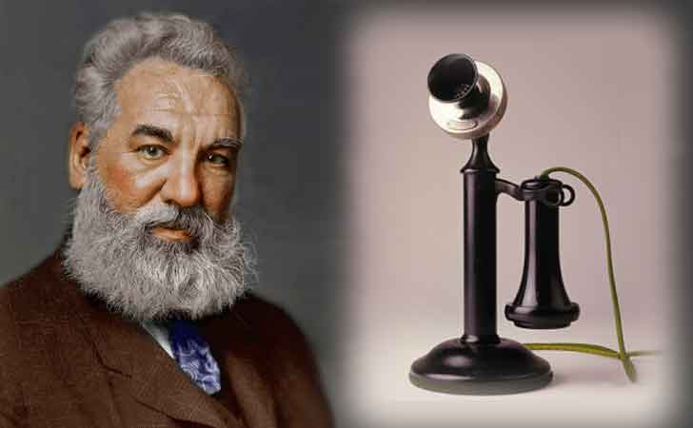

History
Founded in 1983
One of the top largest global Telecom
HBO, Warner Bros., WB Games, Verizon Wireless (licenses and properties), Alltel, Unicel, Aline Vault

Slide 4
3-Year Performance
 | 2023 | 2022 | 2021
Net Profit Margin | 14.2% | 16.4% | 13.1%
Return on Assets | 59.9% | 59.7% | 38.6%
EPS | $2.40 | $2.64 | $3.04
Dividends per Share | $1.11 | $1.35 | $2.08
Sales per Share | $17.50 | $16.94 | $23.65

Slide 5
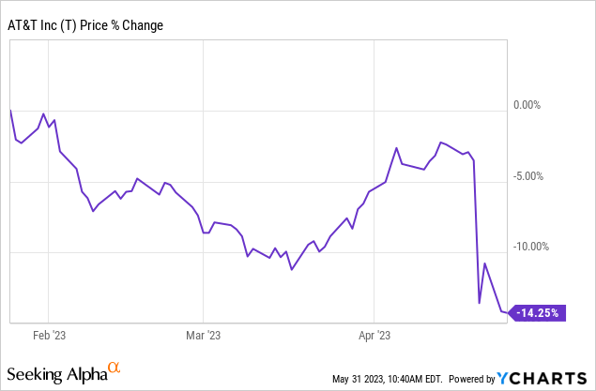
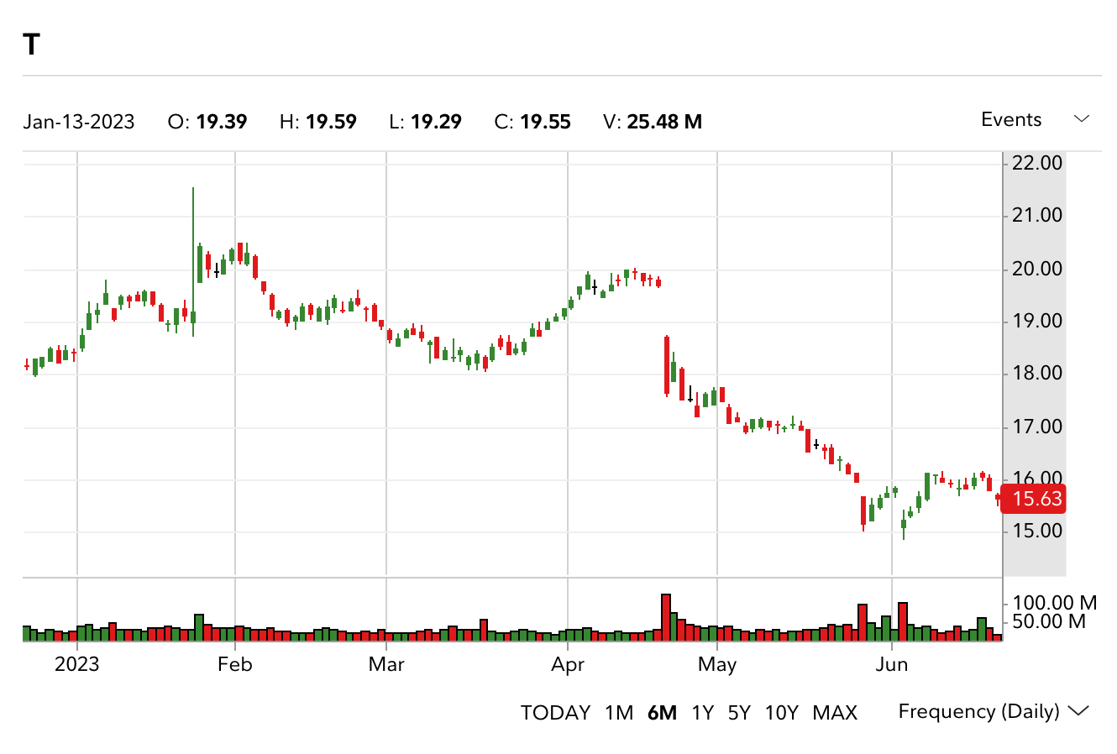
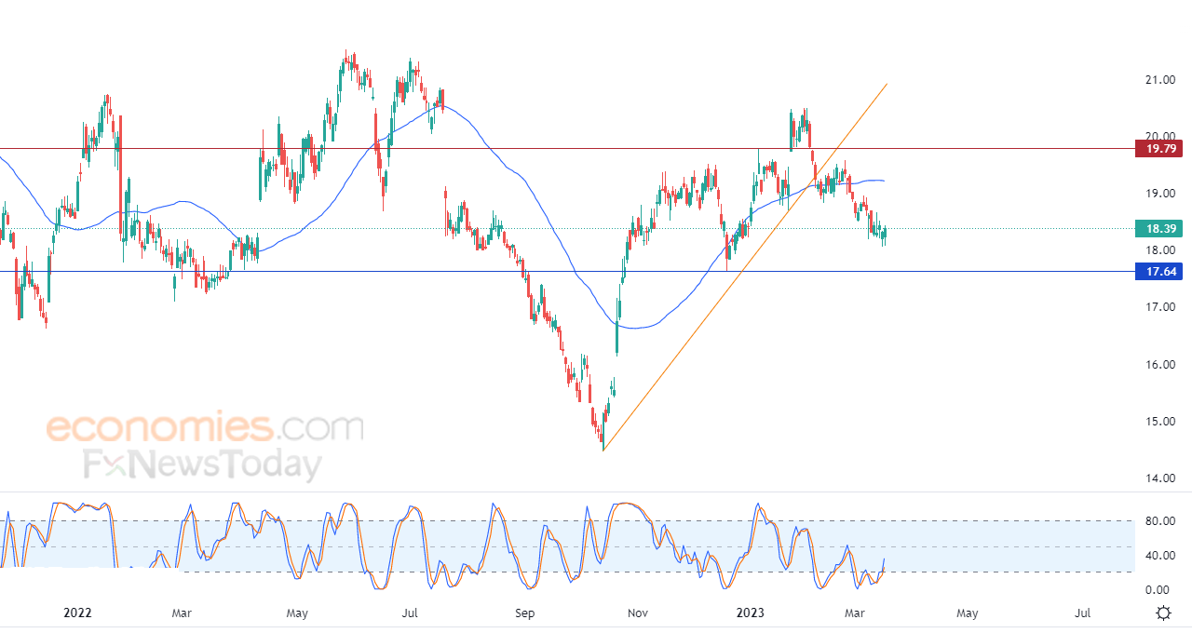
Performance Chart

Slide 6
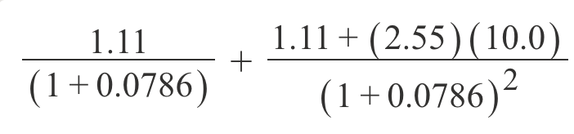

Security Valuation
Fair Market Value
$23.9
Current Value
$15.58
Percent Difference
42.15%

Slide 7


BUY? SELL? HOLD?

Slide 8

NYSE:T

