Slide 1


Fibonacci Play
Carlos Corado

Slide 2

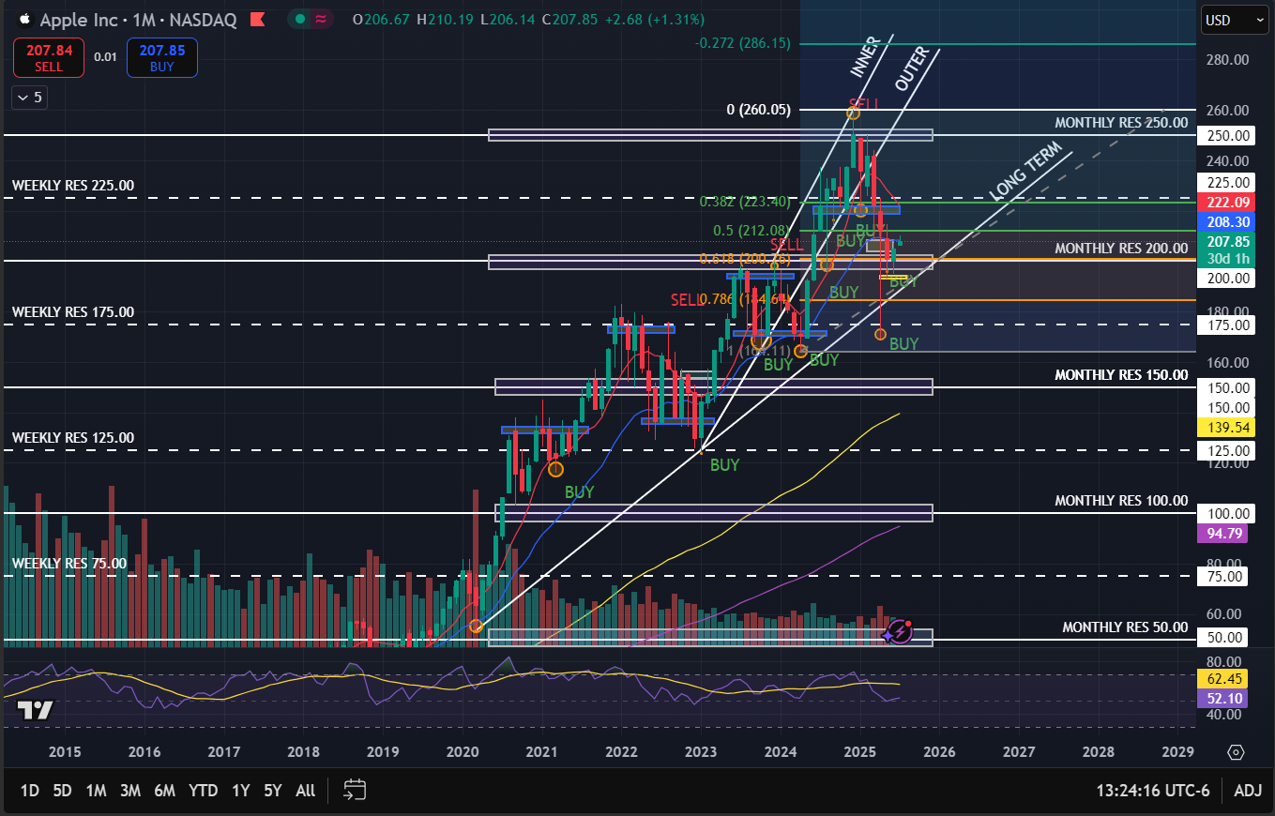
MONTHLY
TREND ANALYSIS
Bullish, with higher highs and lower lows on the long term
Observations
Fibonacci level .618 right around the $200 level indicating a major support level
RSI in the middle, gives enough space for further upside
The stock tested the 0.5 Fibonacci level, which acts as resistance. A news catalyst can break it easily

Slide 3
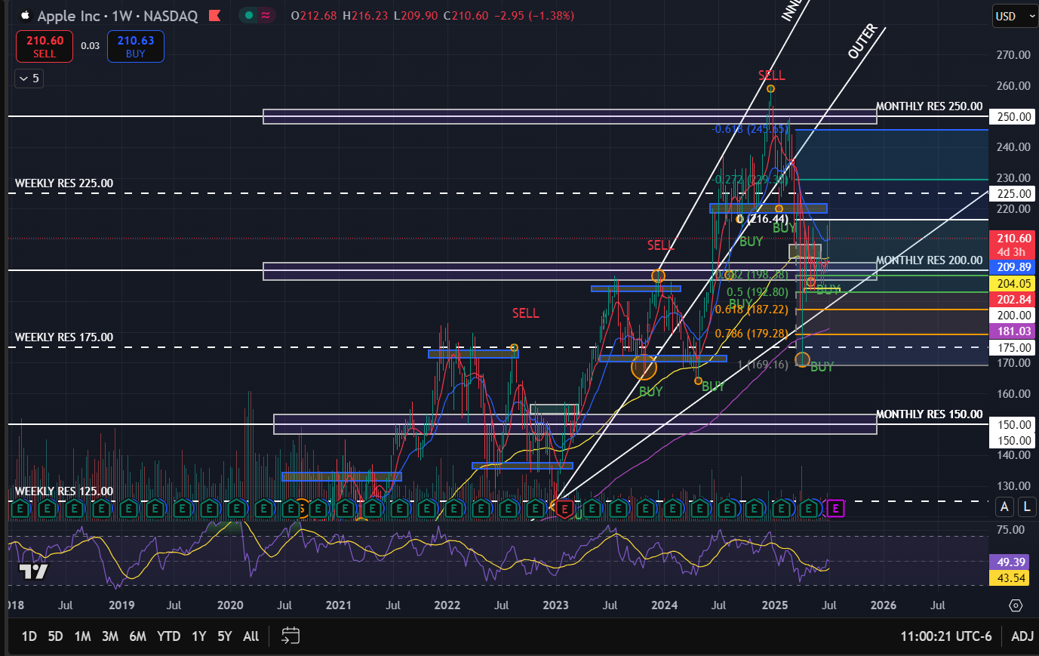
WEEKLY
Trend Analysis
The trend remains bullish, with higher highs and lower lows on the long term. However, there has been some consolidation above the 200$ level for the past months
Observations
The stock price found support on the $200 level and the Fibonacci support levels 0.382 and 0.5 (weekly), which is the golden zone to buy
watch for the 100 EMA & $200 price level to act as support for any pullback
Currently resting on the 21 EMA
RSI not oversold, enough space for further upside
Momentum can lead the price to reach the resistance level at $225

Slide 4
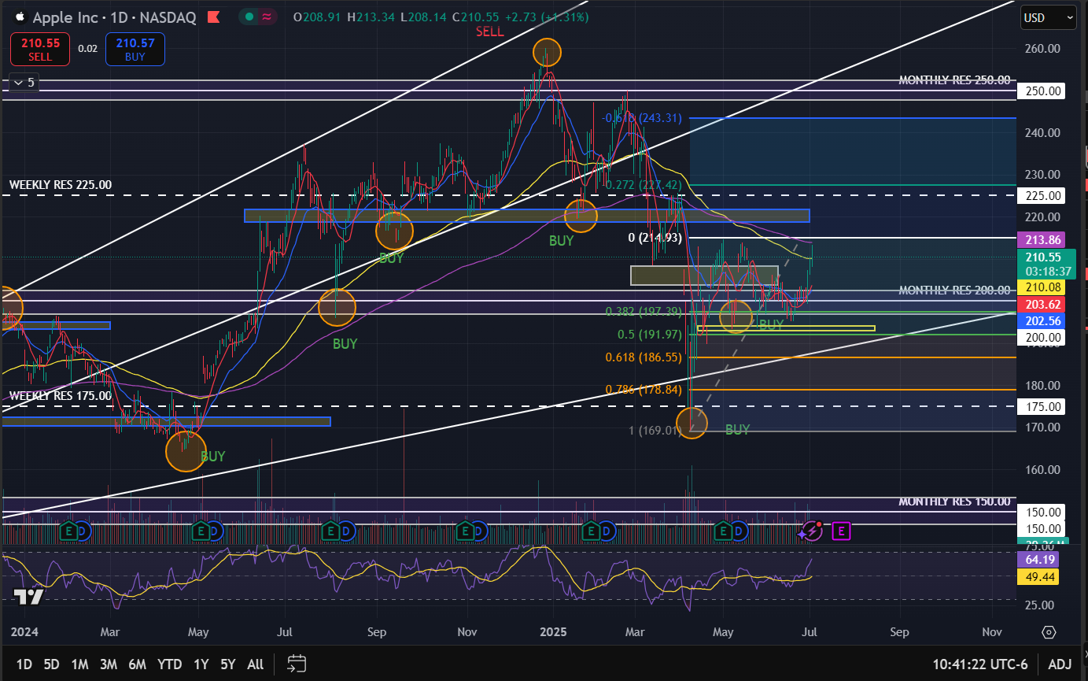
DAILY
Observations
8 SMA crossing over 21 EMA, bullish indicator
Gap needs to be filled, another signal for further upside
200 EMA acting as resistance
The stock pulled back to the golden zone, a good opportunity to buy for the short term
RSI not yet oversold
Investment recommendation
BUY

Slide 5
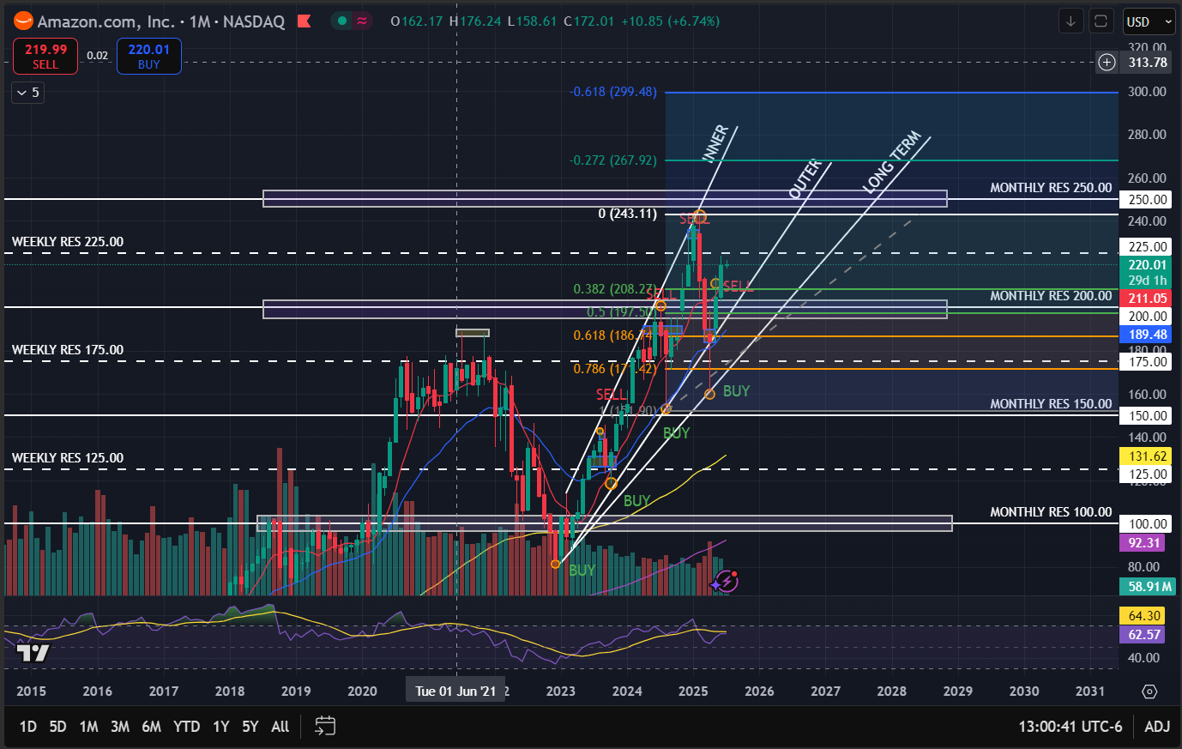
MONTHLY
Trend analysis
Bullish, with higher highs and lower lows on the long term
observations
Closely following the 8 SMA towards the upside
May find resistance at 225 level and may bounce back finding support at the outer trend line, near the $200 price level
If $225 broken, next price target around the $250 area right where the Fibonacci 0 level is located

Slide 6
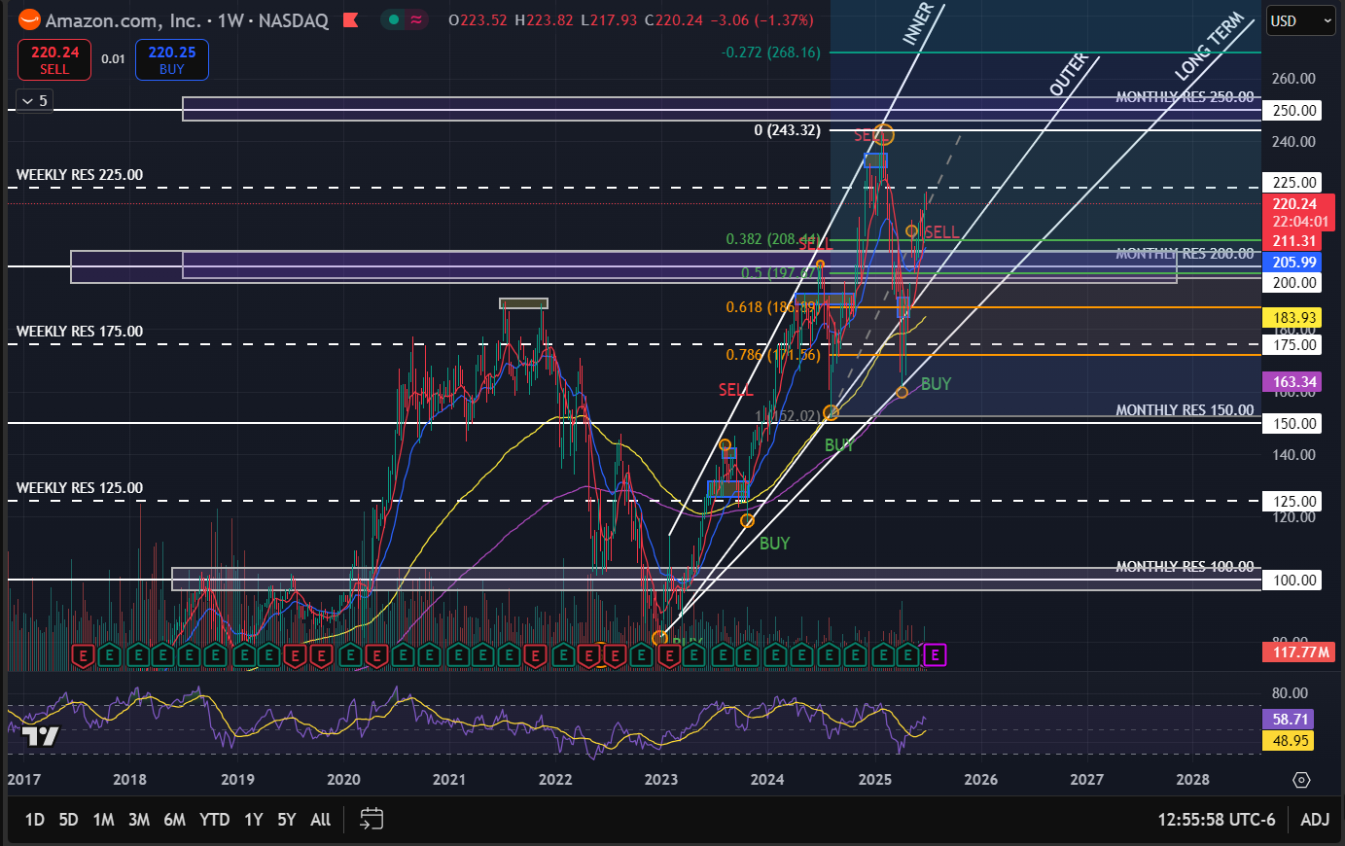
WEEKLY
Trend analysis
Businesses need new investment opportunities but are using old or outdated tools and services
Observations
Gapped up on May 5th above the $200 support level
$200 level major support, fund buying pressure in that area as it has also the 0.5 and 0.382 golden area of the Fibonacci retracement
8SMA crossing over 21 EMA, indicated bullish upside move, with the price closely following the 8 SMA
Recently found resistance at the $225 level, if pull back can find support at the 0.382 Fibonacci level

Slide 7
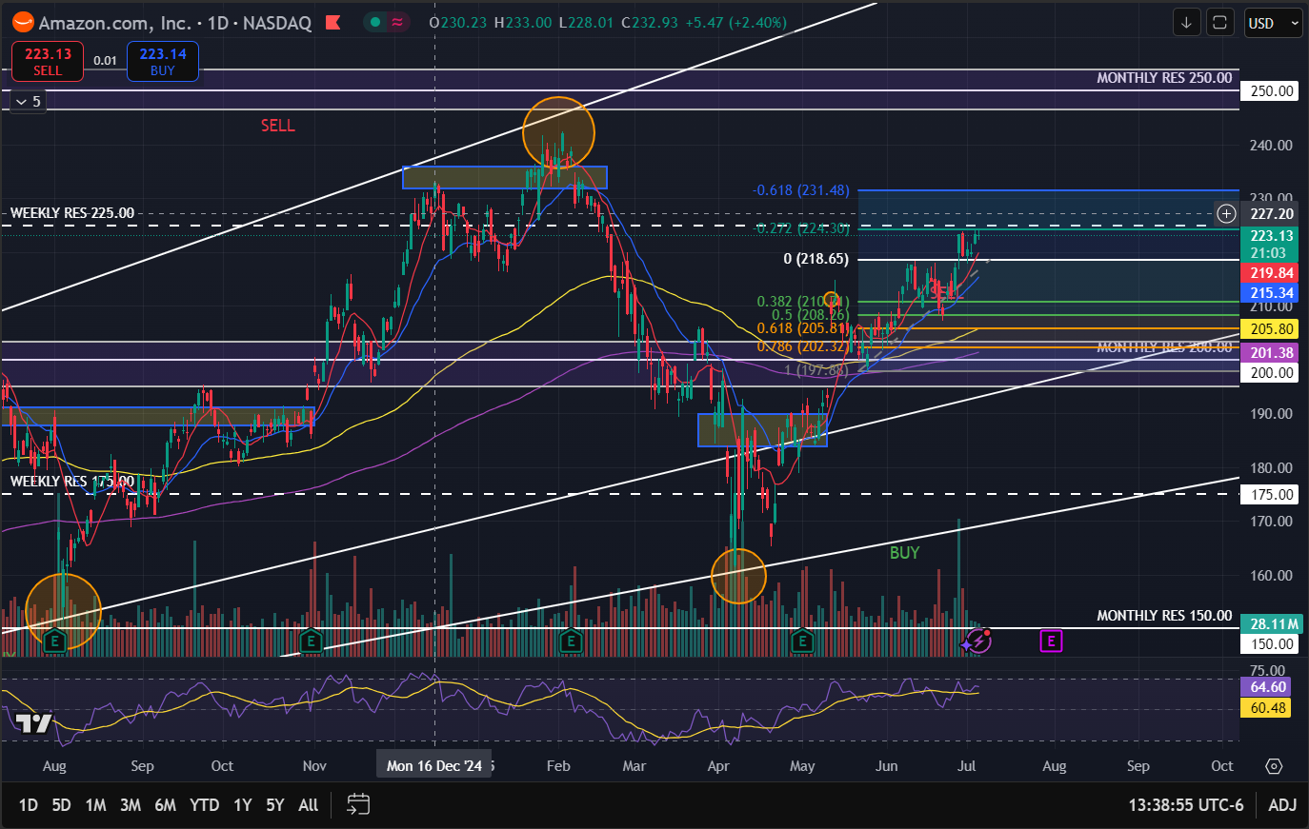
DAILY
OBSERVATIONS
Closely following the 8 SMA and 21 EMA
On June 23rd the stock found buying pressure right at the 21 EMA and the 0.5 Fibonacci level
Found resistance at the $225 level and the -0.272 , investors may take profit, and the price may pull back and find a possible support level at the 0 Fibonacci level
RSI is in the high 60’s, not yet oversold, major catalyst could push the stock to the upside with a price target of low 230’s, right where the -0.618 Fibonacci level is situated
Investment recommendation
HOLD

Slide 8
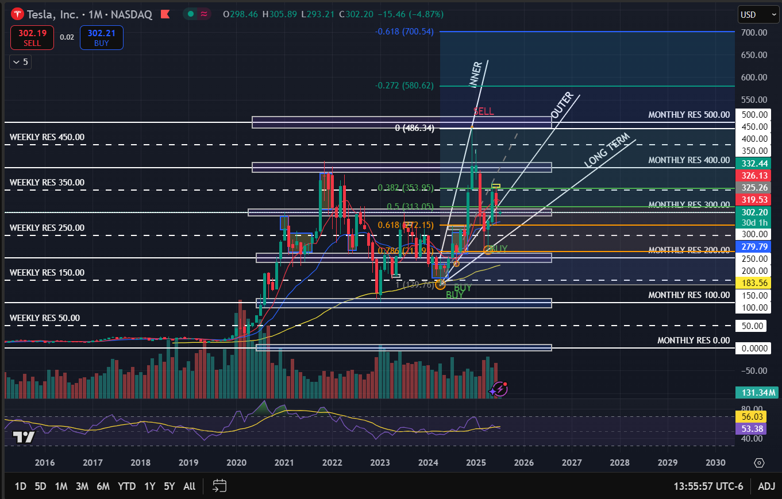
MONTHLY
Trend Analysis
Bullish, lower lows with upside move on the long term
OBSERVATIONS
The stock is resting on the $300 support level, right by the 0.5 Fibonacci level, which is further support by the 21 EMA coming closer , which could indicate a good moment to buy from a technical standpoint
Found major resistance at the $250 level, right where the 0.382 Fibonacci level is located
RSI not oversold yet, enough space for further upside

Slide 9
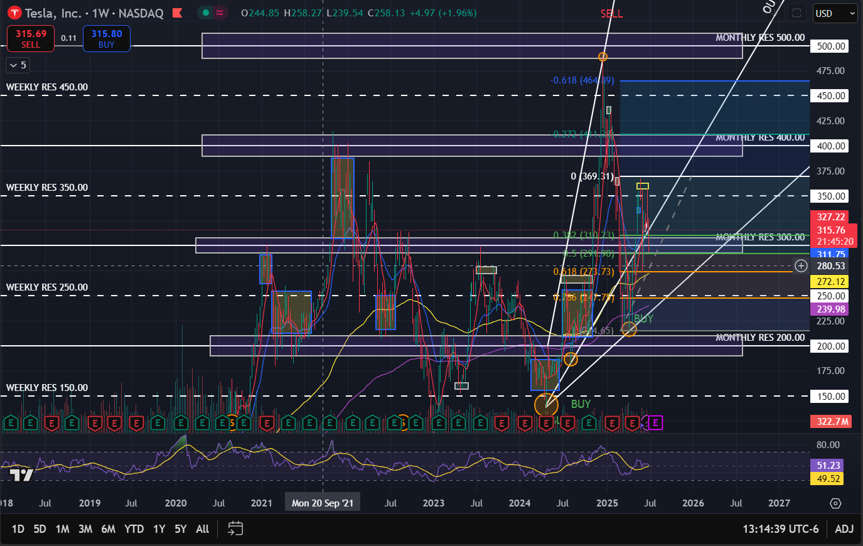
WEEKLY
TREND ANALYSIS
Bullish, lower lows with upside move on the long term
Observations
Week of June 2nd 8 SMA crossed over the 21 EMA, bullish indicator
Major resistance at $300 level, right where the golden zone of the Fibonacci is located
A lot of volatility, the stock has been moving sideways
RSI in the middle for either a move to the upside or downside

Slide 10
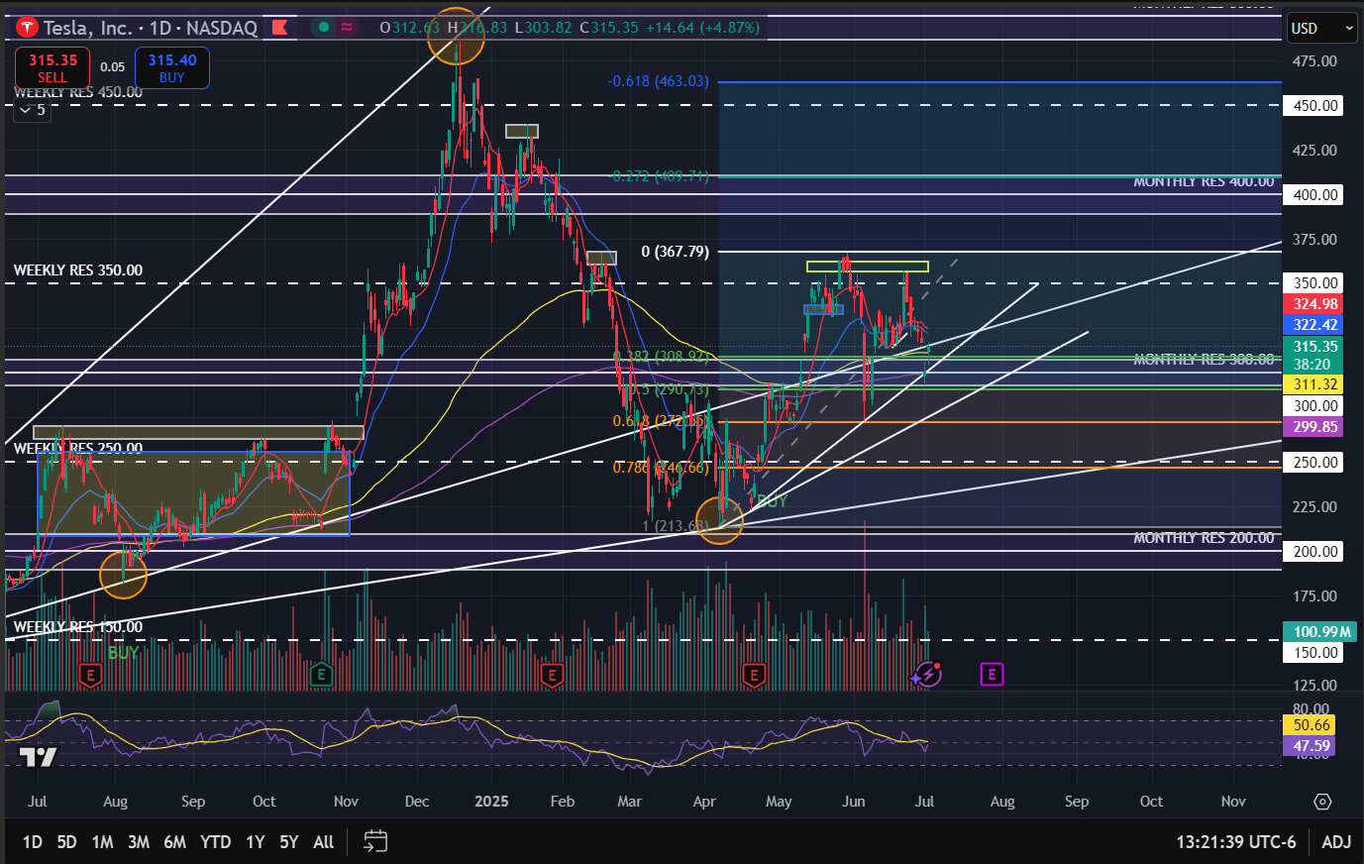
DAILY
OBSERVATIONS
8 SMA crossed below 21 EMA, which indicates a bearish price action
Double top pattern formation, neckline was broken further, indicating movement to the downside, trying to reach a support level
Price currently lying at the $300 area, right on the 0.5 Fibonacci level and 200 EMA
If support is broken, the next support may be found at the 0.618 Fibonacci level
High increase in volume
INVESTMENT RECOMMENDATION
BUY
*High volatility

Slide 11
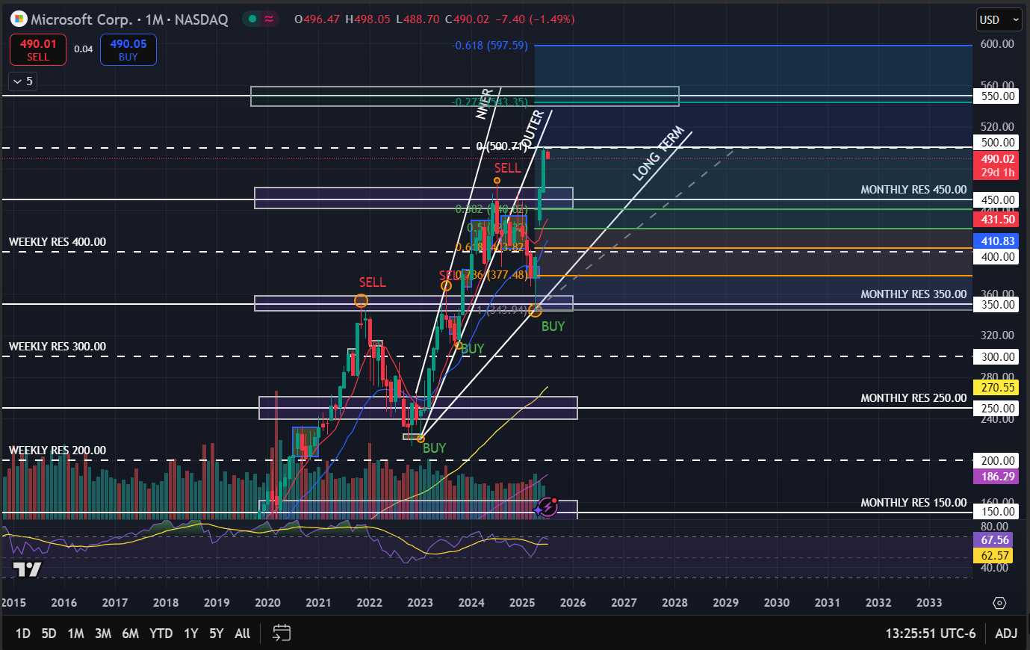
MONTHLY
TREND ANALYSIS
Bullish, with higher highs and lower lows following an upward trend over the long term
observations
The price reached a major resistance level at $500, and started to pull back
Major gap up from 4 months ago, and saw high buying pressure right at the Fibonacci golden zone
RSI in the high 60’s not oversold yet but pretty near, it can start to see some pull back

Slide 12
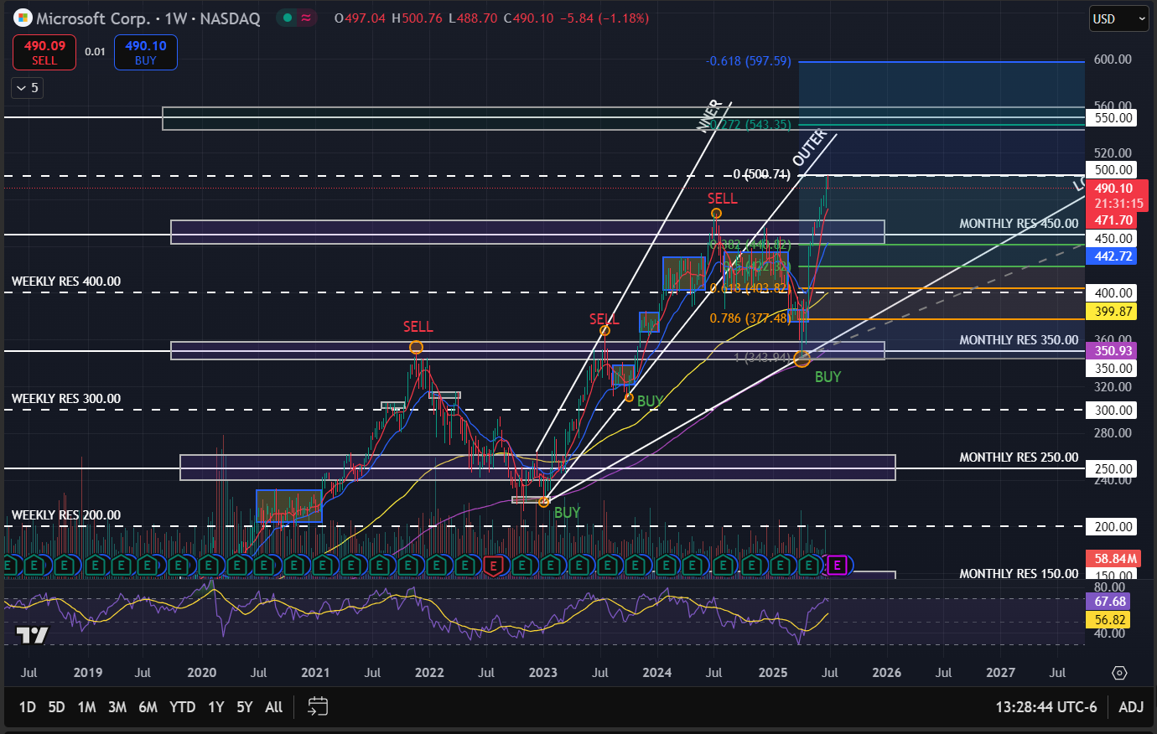
WEEKLY
Trend analysis
Businesses need new investment opportunities but are using old or outdated tools and services
OBSERVATIONS
Late May we saw a bullish crossover of the 8 SMA over the 21 EMA
Broke the 450 support level, and found resistance at the $500 level
RSI is high, not yet oversold but enough space for a technical pullback back to $450
Not enough news catalysts and volume for a further upside to the -0.272 Fibonacci level close to the $550 level

Slide 13
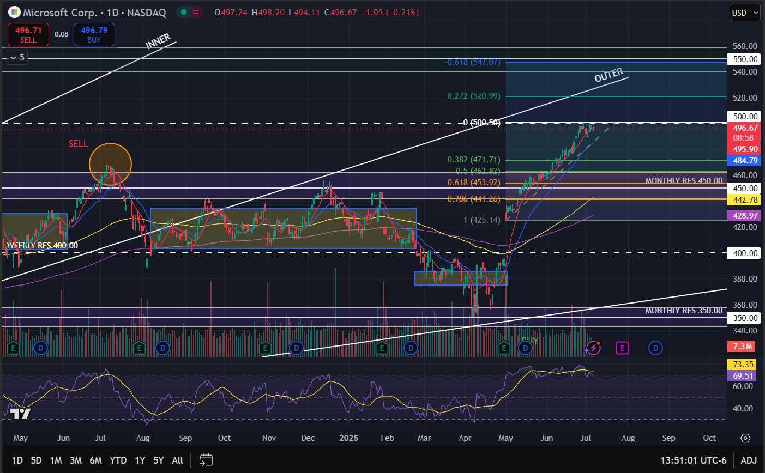
DAILY
Observations
Late April, bullish crossover of the 8 SMA over the 21 EMA
Gap up that rallied and beat the $450 resistance level Rally closely following the 8 SMA to the upside
Rally found resistance at the $500 level
RSI in the high 60s right around the oversold, another indicator for a technical pullback
If pull back, may find support at the 0.5 and 0.382 Fibonacci area. Major support at $450 right where the 0.618 Fibonacci level is located
INVESTMENT RECOMMENDATION
HOLD

Slide 14
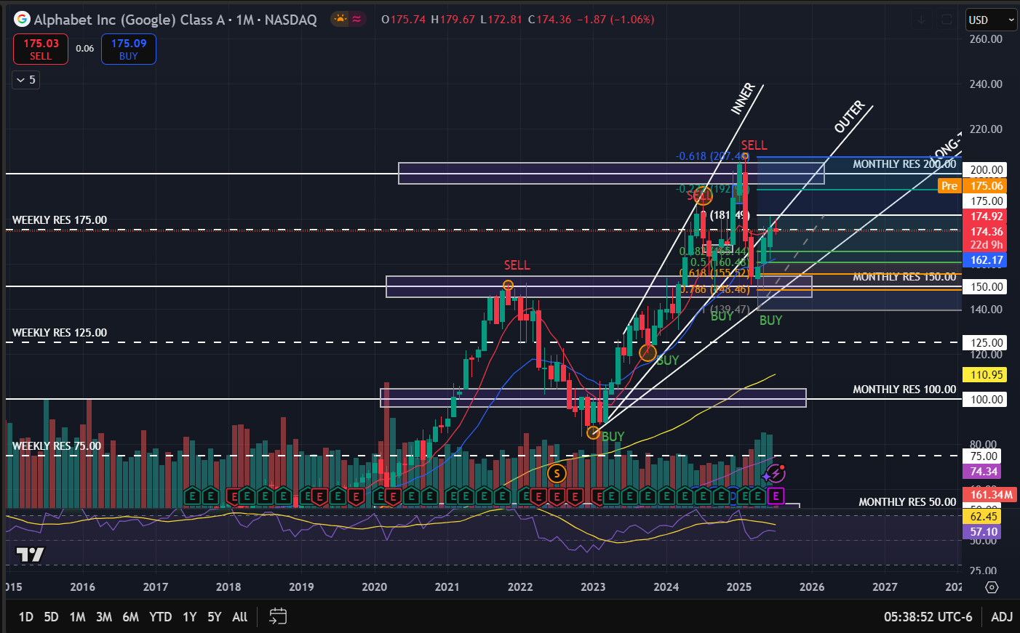
MONTHLY
Trend analysis
Bullish with higher highs and lower lows, outer upward trendline broke in March 2025, still bullish on the long term
Observations
Found a new low and support at the $150 mark
Bounced off the outer trend line and is currently on the 175 support level
If there is any pull back, it may find major support and buying pressure at the Fibonacci golden zone (between 0.5 and 0.382) which is further supported by the 21 EMA
After pull back, the stock can see itself going all the way to the $200 resistance level, with the first take profit at 192 as indicated by the -0.272 Fibonacci level

Slide 15
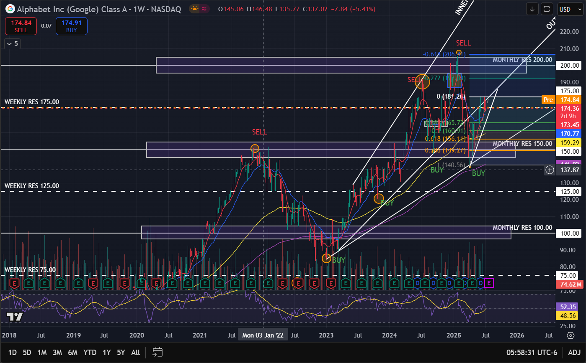
WEEKLY
TREND ANALYSIS
Lower lows with higher highs, following an inner trend to the upside
Observations
Bullish 8 SMA crossover over the 21 EMA, mid June
Bounced off the 0.5 Fibonacci level and the upward inner trend line, that same candle stick is an bullish engulfing with high volume indicating further upside
The RSI is in the middle, which gives enough space for a further upside between the $200 resistance level and the -0.272 Fibonacci level

Slide 16
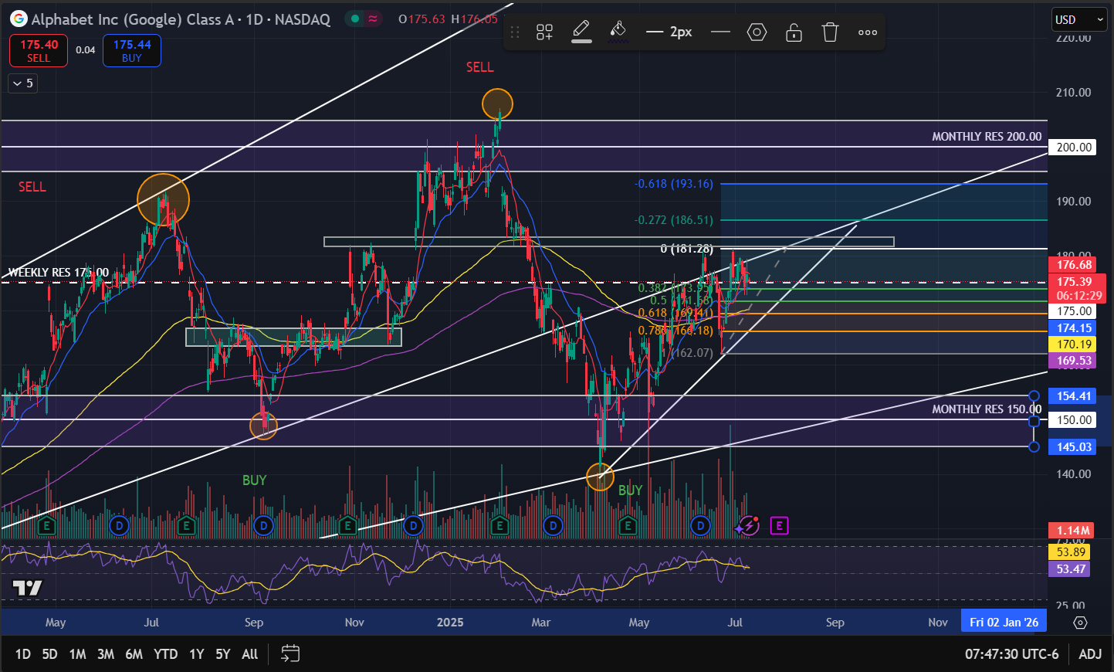
DAILY
OBSERVATIONS
Hammer candlestick formation at the bottom of the previous swing low, bounced off the upward inner trend line
Currently on the weekly $175, now acting as support for the consolidation phase, this support level is further enhanced by the 0. 5 Fibonacci level and the 21 EMA
Bullish crossover 8 SMA over the 21 EMA, first day of July
Investment recommendation
BUY

