Slide 1
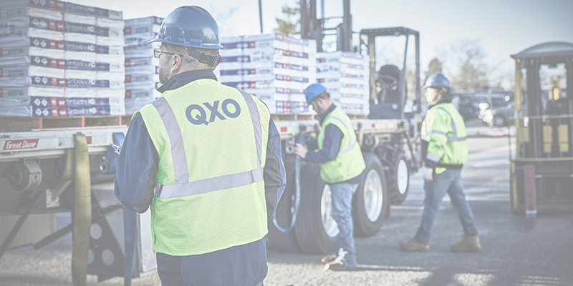
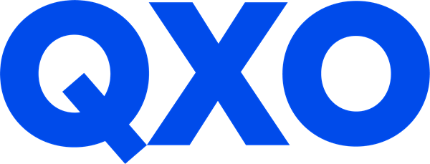

QXO, INC. NYSE: QXO
BUY
Dustin Feng, William Everitt
Sofia Rosinski, Mitchell Curran Josue Beltran, Jose Del Pozo
Neeley Equity Research Club
April 30, 2026
1
Notes:
Josue
“Good afternoon, everyone. Today, we’ll be presenting our analysis on QXO, Inc., a rapidly growing player in the building products distribution space.
Over the next 15 minutes, we’ll walk you through QXO’s business, industry positioning, and ultimately our investment perspective.”

Slide 2

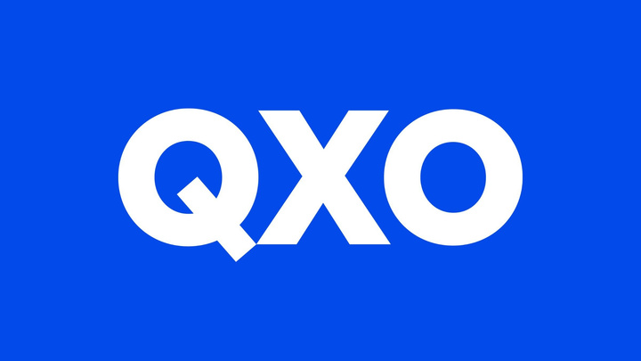
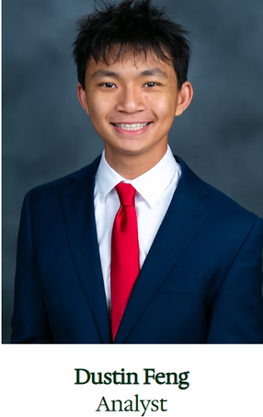
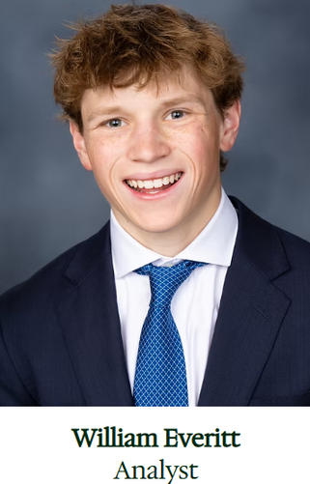


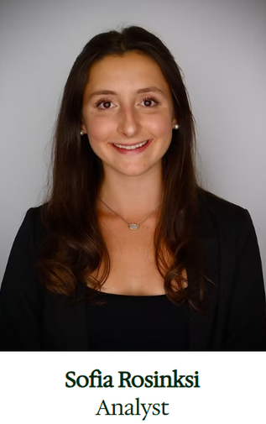

Meet the Team
Notes:
Josue
"Each member focused on a key part of the pitch—from company overview and industry analysis to valuation and investment thesis.
This allowed us to build a comprehensive, bottom-up understanding of QXO and ensure each section connects into a clear recommendation.”

Slide 3


AGENDA
  Company Overview​
  Management & Leadership​
  Industry Analysis and TAM​
  Investment Thesis​
  Valuation​
Notes:
Josue
"Here’s a quick look at how we’ll structure the presentation.
We’ll start with a company overview to establish what QXO does and how it operates. Then we’ll cover management and leadership, followed by an industry and total addressable market analysis.
From there, we’ll move into our investment thesis and finish with financials and valuation to support our conclusion.”

Slide 4

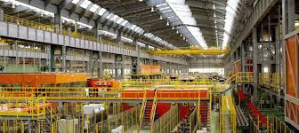
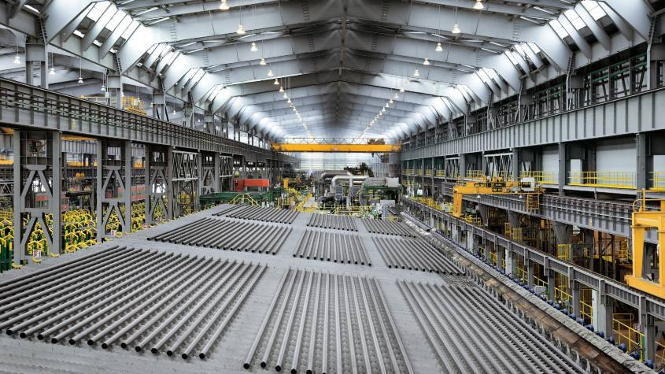
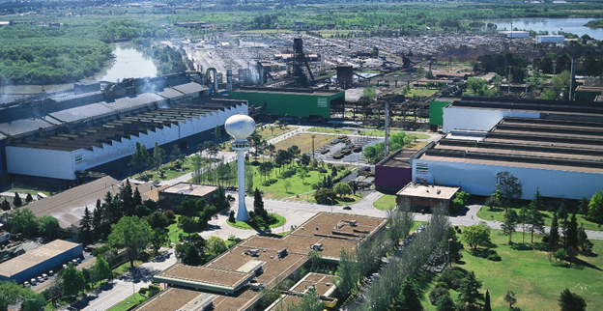
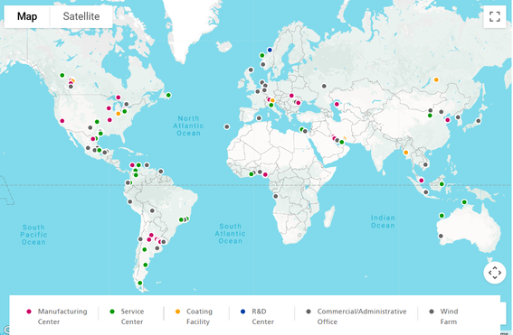
Welcome to QXO
Headquarters:
Greenwich, CT
QXO is the second-largest publicly traded building products distributor in North America. Through Beacon, Kodiak, and pending TopBuild, QXO distributes and installs roofing, waterproofing, insulation, lumber, and complementary building products to contractors, homebuilders, and commercial customers across all 50 U.S. states and 7 Canadian provinces — operating 1,150 locations and a fleet of 10,000+ vehicles.
Important Company Information
Ticker | QXO
Exchange | NASDAQ
Industry | Industrial Distribution
Last Close (04/29/26) | $19.61
Market Cap (Basic) | $14.22B
Market Cap (Fully Diluted) | $33B (1.66B Shares)
Cash | $2.36B
Total Debt (Standalone) | $3.1B
Pro Forma Total Debt | $9.1B (Post-TopBuild)
Enterprise Value | $16.9B (Standalone)
Current Ratio | 1.36
Total Debt / Adj, EBITDA | 3.3x Standalone / 3.6x PF
Combined EV | ~ $50B
Credit Rating | BB (S&P)
Next Fy end | December 31, 2026
Latest Report | 2025 Q4 – Feb 25ᵗʰ 2026
Next Earnings Date | 2026 Q1 – May 14ᵗʰ ²⁰²⁶
Locations Post TopBuild: 1,150
Fleet: 10,000+ Vehicles
EBITDA
QXO + Beacon
ADJ. EBITDA value
~ $900 Million
+ Kodiak
ADJ. EBITDA value
+$120 Million
  #1 position in Waterproofing
  #1 position in Insulation Distribution
  #2 position in Lumber and other Building Materials
  #2 position in Roofing Distribution
+ TopBuild (18% adj. EBITDA Margin)
ADJ. EBITDA value
+$1.1 Billion
QXO
Pro Forma Combined ADJ. EBITDA
$2.1-2.3 Billion
Notes:
Josue
QXO is the second-largest publicly traded building products distributor in North America, with a strong presence across the U.S. and Canada
XQO's earning power is hard to ignore. The business generates substantial and growing EBITDA, reflecting both strong margins and operational efficiency at scale.
Following its recent acquisition, QXO is expected to generate over $2 billion in adjusted EBITDA—positioning it as a dominant consolidator in a highly fragmented industry.”
QXO's growth isn't the only compelling factor, its also scale and integration capacity: over 1,100 locations, a fleet of more than 10,000 vehicles, and leading market positions across multiple product categories.

Slide 5
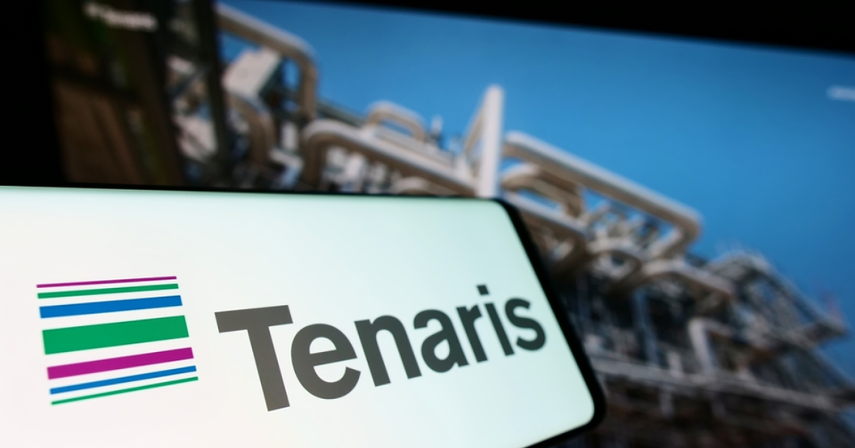
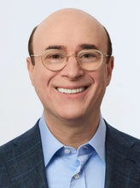
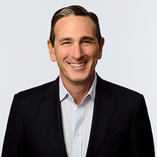
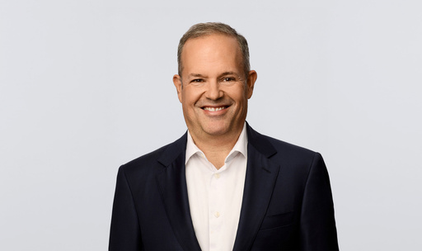
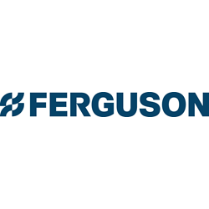
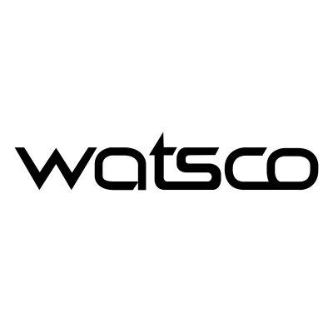


Company Overview
Sales Breakdown 2025
Management Team
CEO: Brad Jacobs
Founded XPO (freight brokerage → global logistics, ~$18B rev), spun out GXO and RXO. Built multiple $10B+ businesses from scratch. Launched QXO in 2024 with equity commitment and institutional anchor investors.
President: Ihsan Essaid
Former XPO executive; operational background in logistics and distribution M&A; integration.
CSO: Matt Fassler
Former Goldman Sachs analyst; deep sector expertise in home improvement/building products.
Residential Roofing
Non-Residential Roofing & Waterproofing
Complementary Products + Technology
Volume
Volume
Volume
$3,307M
48.3%
$1,884M
27.5%
$1,652M
24.2%
Competitors
Market
Cap
EV/EBITDA
51.13B
20.83
17.88B
24.48
8.48B
17.15
9.93B
17.15
Notes:
Josue
“QXO's operations span roofing, insulation, and specialty materials.
From a revenue mix standpoint, the business is heavily weighted toward roofing and exterior products, with additional exposure to insulation and complementary building materials—providing both residential and commercial end-market diversification.
Leadership is a core part of the story. The company is led by Brad Jacobs, whose track record in scaling businesses through M&A underpins QXO’s roll-up strategy in a fragmented market.
On the competitive side, QXO's largest competitor is Ferguson with a market cap of 51.3b, followed by Watsco, Builder's FirstSource and IBP, while still facing a long tail of smaller regional players.
The key takeaway is that QXO combines scale, acquisition-driven growth, and experienced leadership to consolidate market share in an otherwise fragmented industry.”

Slide 6
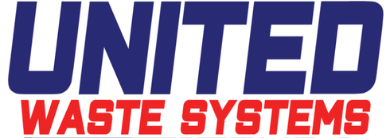
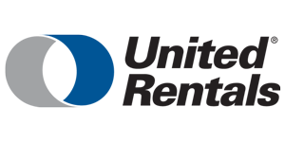
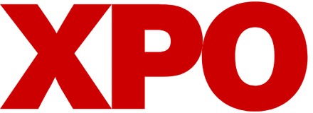



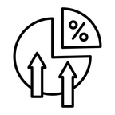
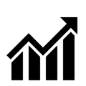
The Brad Jacobs Story
Prior Companies
Jacobs Playbook
Target a massive, fragmented market
Buy scaled platforms at fair price
Result
Standardize systems and operations
  Start-up → 5ᵗʰ Largest Solid Waste Business
  47.6% Annualized return
  1997 exit = 2.5B
  Fragmented rental market → Largest equipment rental company
  2.2x S&P Outperformance (1997-2007)
  Built through M&A, tech, and spin-offs
  24.4% Annualized return (2011-2024)
Lift margins through tech, pricing, and procurement
Generate FCF, delever, and repeat
“There is no faster way that I know of to scale a business up to something that is tens of billions of dollars in size, other than M&A. If it is done sensibly and well, M&A is the cheat code.”
“There is no part of building products that is off the table for us.”
Brad Jacobs
Source: GA-Courteany Special situations fund white paper, February 2025; company commentary
Notes:
William

Slide 7






Jacobs Equity Unlock
QXO
Jacobs Equity Unlock
Scale + FCF + Deleveraging + Re-rate
$18.1B+
$2.1B+
$300M
$4.2B–$5.0B
Pro Forma Revenue
Pro Forma Adj. EBITDA
EBITDA Synergies
TopBuild 2026–2030 Cumulative FCF
QXO + Beacon + Kodiak + TopBuild
~12% combined margin; TopBuild ~18% margin
Expected by 2030
60%–70% FCF conversion
Why TopBuild Changes the Story
The 3-Phase Equity Unlock
Scale + Leadership
1
Scale
#1 insulation, #2 roofing, #1 waterproofing,
and #1 / #2 in LBM in key geographies
Combined platform exceeds $18B of revenue and $2B of EBITDA, creating a higher-margin, multi-category building-products leader.
Platform Reach
2
FCF Expansion & Deleveraging
~1,150 locations and ~28,000 employees
across North America
~$300M of synergies by 2030, strong free cash flow, and debt paydown lower interest expense and lift cash available to equity.
Higher-Margin Mix
3
Stabilized LFCF Re-rate
TopBuild adds an integrated installation +
distribution model with ~18% EBITDA margins
Upside depends on growing stabilized LFCF — not just re-rating Year 1 cash flow. Premium specialty-distribution peers support a higher multiple once integration and deleveraging are proven.
Accretive
Peer Framework
Immediately and materially accretive
to QXO's earnings profile
Traditional building-products comps
Premium specialty distributors
~11x–18x P/FCF
~22x–30x P/FCF
How the Stock Works
Valuation Logic
Transaction & Capital Structure
Illustrative Year 1 LFCF
Stabilized LFCF Upside Case
Deal consideration:
$505 cash or 20.2 QXO shares per TopBuild share
~$0.9B
$1.5B–$2.0B+
Mix:
~45% cash / ~55% stock
Sources:
$7.9B new stock, $6.0B new debt, $1.0B preferred draw, plus cash on hand
$300M synergy capture
TopBuild 2030 guide:
$9B–$10B revenue,
$1.7B–$2.0B EBITDA
Lower interest
from deleveraging
Continued M&A and
strong FCF conversion
TopBuild holders expected to own:
~19% of the combined company (assuming 55% stock)
Debt paydown comes from:
post-interest cash flow
Target leverage over time:
low-to-mid 3x EBITDA
Combined company EV in QXO materials: ~ $50B.
Source: QXO investor presentation and script (April 19–20, 2026); company filings. Values illustrative and rounded where noted.
Notes:
William

Slide 8
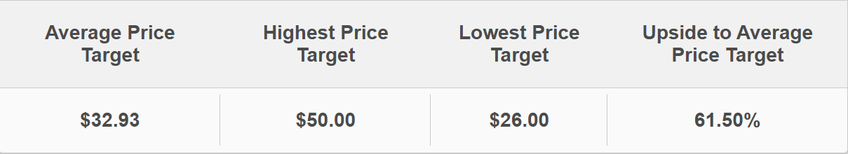
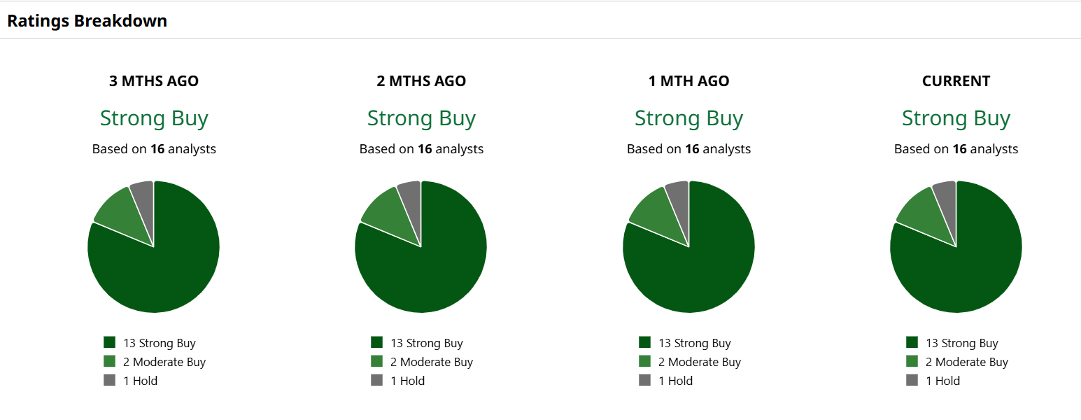
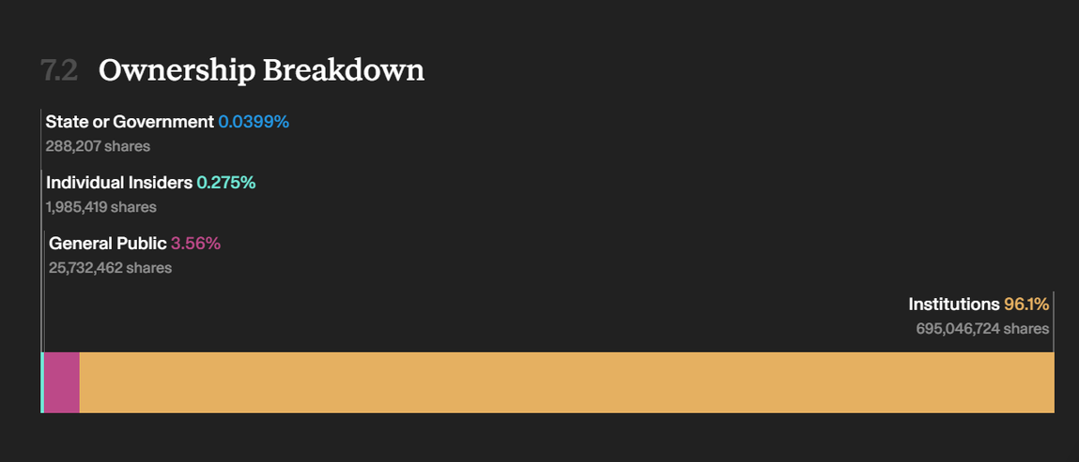
Notes:
Dustin
Starting with what Wall Street thinks about QXO — the analyst community is unanimously bullish. We have 16 analysts covering the stock, and every single one rates it a Strong Buy. What’s particularly compelling is the consistency — that Strong Buy consensus hasn’t wavered over the past three months. This isn’t a recent momentum call; it’s a sustained, high-conviction view from professionals who’ve done the work.
On price targets, the average sits at $32.93, implying roughly 61.5% upside from current levels. The most bullish analyst has a $50 target, and even the most conservative has a $26 floor — so across the board, the street sees meaningful appreciation from here.
Flipping to ownership — approximately 96% of shares are held by institutions. That’s significant because institutional investors like mutual funds, pension funds, and hedge funds have strict due diligence processes before they deploy capital. When 96% of your shareholder base is made up of those players, it signals that the people with the most resources and information are betting heavily on this company. Insider ownership is relatively small but present, which also shows some management alignment. The key takeaway here is that this isn’t a retail-driven, speculative trade — it’s a stock with deep institutional conviction behind it.”

Slide 9
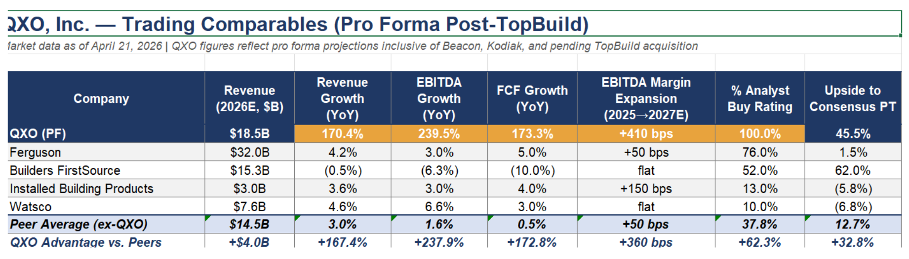
Competition
Notes:
Dustin
Now let’s look at how QXO compares to its peers. This is a pro forma comps table, meaning QXO’s numbers incorporate the pending TopBuild acquisition alongside prior deals — Beacon and Kodiak — which is why the growth figures look so dramatic at first glance.
The 170% revenue growth and 240% EBITDA growth are acquisition-driven, not organic —
QXOs large scale benefits them in the building products industry and that flows directly into margins. Hence the +410 basis points of projected EBITDA margin expansion versus just +50 for the peer average. this leads to a huge fcf growth of 173.3% that dwarfs peers
The street is clearly treating QXO as a category apart from the competition.

Slide 10
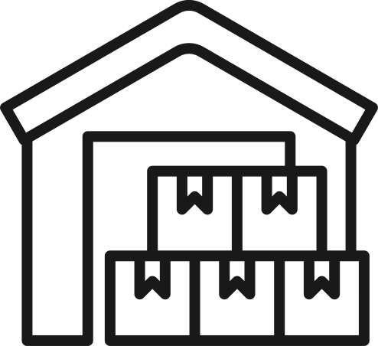

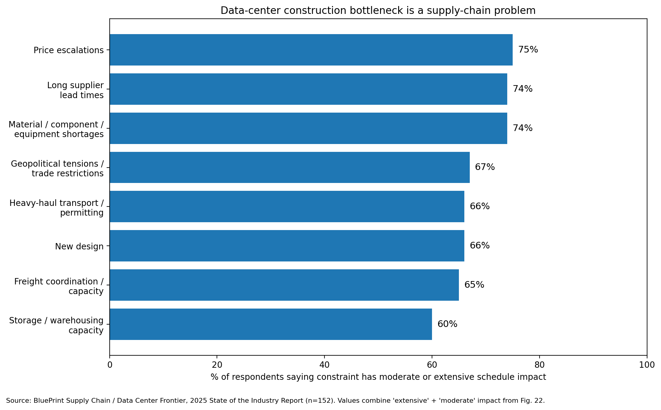
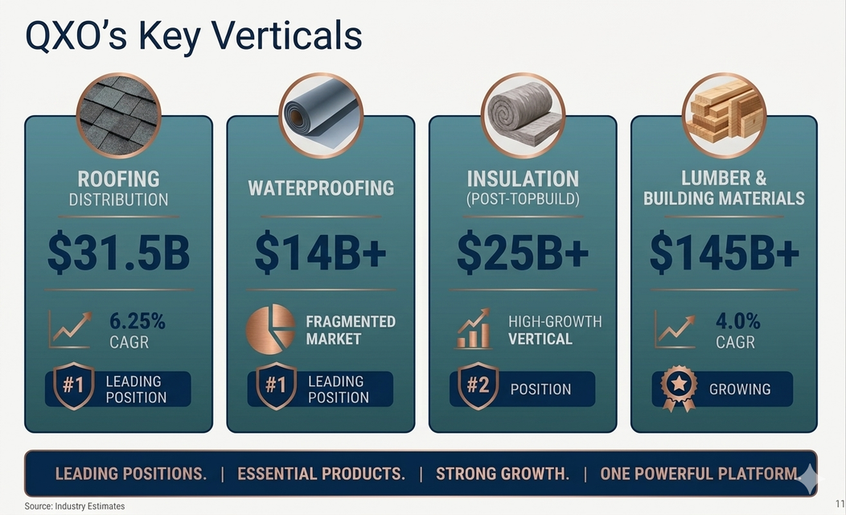
US industry overview
$800B+
~4-7M
Industry Tailwinds
U.S. building products distribution (includes distribution, direct sales, installed products, and adjacent construction categories)
Structural undersupply is driving sustained demand for new construction & repair/remodel activity (40-yr median age)
Scale & Procurement
Demand Drivers
Total Addressable Market
  Larger distributors benefit from purchasing leverage, better inventory availability, and freight efficiency.
  QXO’s scale can improve vendor terms, service levels, and working capital turns.
  Re-roofing drives the majority of roofing demand; rate resilient
  Lower interest rates unlock unguided revenue
  Countless untapped fragmented local markets = long runway for consolidations
Market Growth & Demand Drivers
Sources: MarketDataForecast, Freedonia Group, Mordor Intelligence, Brookings/AGC, Cushman & Wakefield (2025-2026)
Notes:
Dustin
Lets move onto the macro backdrop. QXO is operating in an $800 billion-plus building products distribution market, underpinned by a structural housing undersupply of 4 to 7 million units and a 40-year median home age driving constant repair and remodel activity. These are long-cycle tailwinds that don’t evaporate quickly.
Scale is the key structural advantage in this industry — larger distributors win on vendor pricing, inventory availability, and freight efficiency, all of which QXO is now positioned to leverage as one of the biggest players in the space.
QXO holds the number one position in roofing distribution and waterproofing, and number two in insulation post-TopBuild — across markets totaling over $70 billion. Lumber and building materials represents another $145 billion opportunity where they’re still growing. The strategy is straightforward: use scale and acquisitions to dominate a highly fragmented industry before competitors can replicate it.“​​​​​​​​​​​​​​​​

Slide 11


Investment Thesis
QXO
Investment Thesis
U.S. Economy and Macro
3 Acts and Roadmap
TAM
  7M unit housing shortage
  AI data center insulation and infrastructure boom
  Non-residential = rate-resilient
  Potential lower-rate tailwind
  Act 1: $11B Beacon Acquisition (closed Apr ‘25)
  Act 2: $2.25B Kodiak Acquisition (Feb ‘26)
  Act 3: $17B TopBuild Acquisition announced (Apr ‘26; expected close Q3 ‘26)
  Long-term roadmap: $50B revenue / $7.5B EBITDA
  $300B current verticals
  $800B TAM
  Fragmented; no cross-vertical leader
  $18B = ~6% of current $300B vertical TAM
    ~2% of broader $800B industry TAM
Fundamentals (Cash-Flow)
Our thesis
  TopBuild FCF: $4.2–$5.0B cumulative ‘26–‘30
  Illustrative EBITDA path: ~$2.1B pro forma → ~$3B+ with TopBuild growth + synergies → $7.5B
  $300M synergy target
QXO is building a Jacobs-led consolidation platform in the fragmented building-products distribution industry. The TopBuild deal adds scale, higher margins, and a strong free cash flow engine. As QXO integrates Beacon, Kodiak, and TopBuild, captures ~$300M of synergies by 2030, and uses post-interest cash flow to reduce debt, the company can materially improve its earnings quality and financial flexibility. If management executes, QXO can transition from a leveraged roll-up into a scaled, higher-margin building-products compounder that self-funds growth, reduces leverage, and creates value for equity holders.
Key risk: Simultaneous integration of Beacon, Kodiak, and TopBuild while carrying elevated leverage.
Source: QXO investor materials and company filings; peer-multiple framework illustrative. Pro forma financials exclude TopBuild synergies unless otherwise noted.
Notes:
William

Slide 12
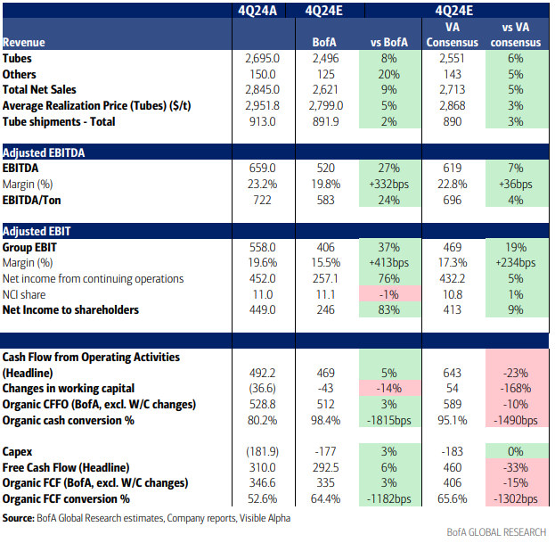
Recent Performance – 4Q24 Review
  Earnings beat: +7% vs consensus
  Key Metrics
    Revenue: 2.85b (+5% vs expected)
    EBITDA Margin: 23.25% (vs. Expected 22.8)
    Dividend Increased: $0.83 per share
  Strong Balance Sheet: USD3.64bn of net cash
Notes:
Mitchell

Slide 13
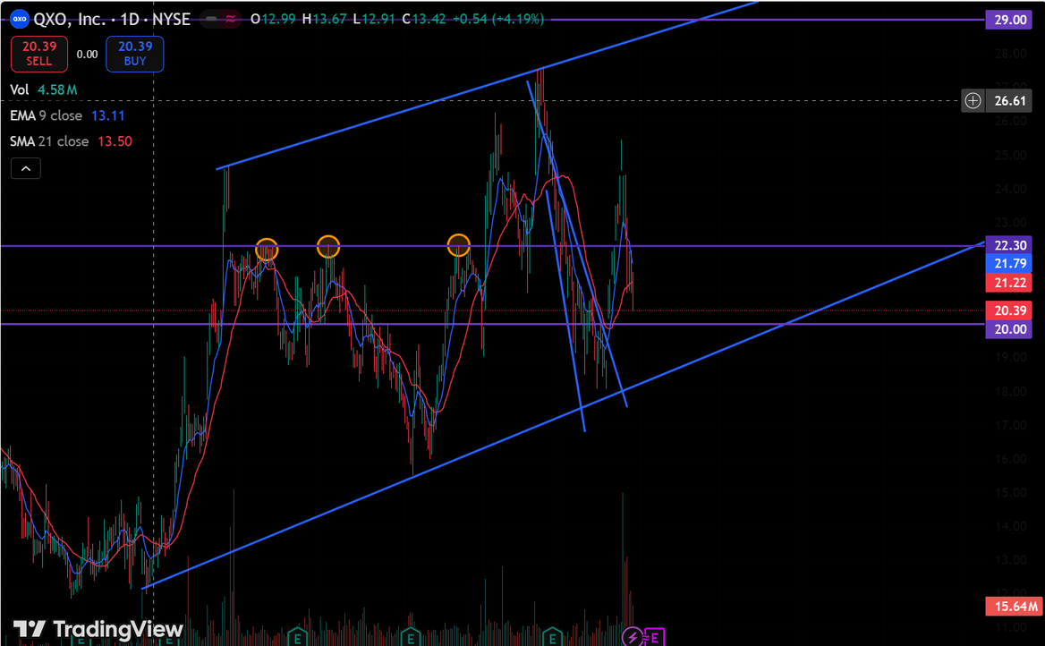
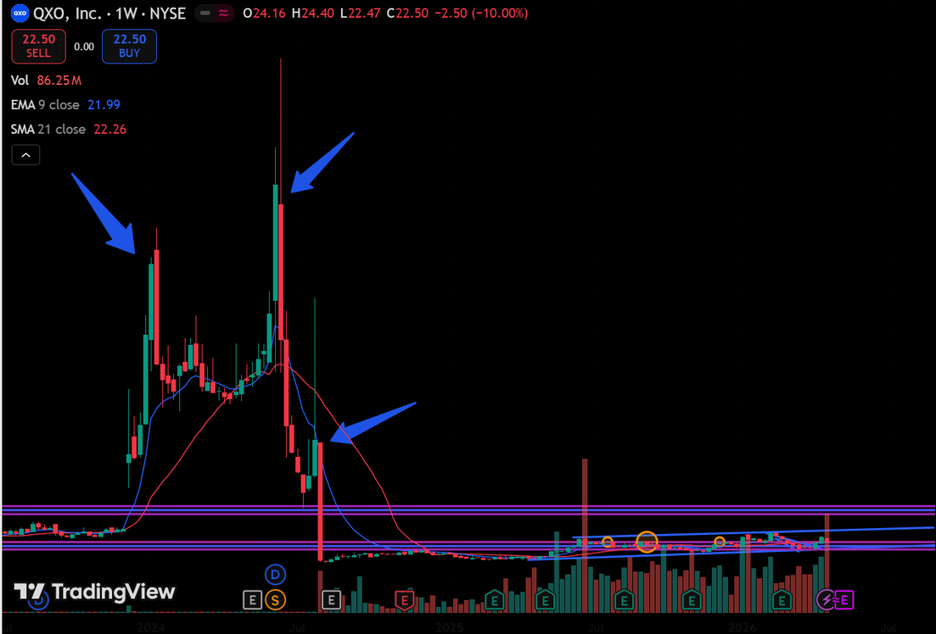
Technical Analysis
Short-term support at $20.00
Dec 2023: Jacobs takeover announced
SilverSun shell repurposed into QXO vehicle; stock re-rates on Jacobs' track record (XPO, GXO, RXO, United Rentals)
June 2024: Float squeeze to ~$290
8-for-1 reverse split + <1% free float creates short-term supply shock; implied valuation briefly exceeded $90B with zero operating revenue
Broke the Down trend on the ceasefire announcement. Broke 22.30 resistance, lost over the past few days. Earnings May 12ᵗʰ = Big catalyst
July 2024: -82% dilution reset
Private placement shares registered with SEC unlock float; stock repriced to ~$11, closer to $5B cash value
Notes:
Mitchell

Slide 14
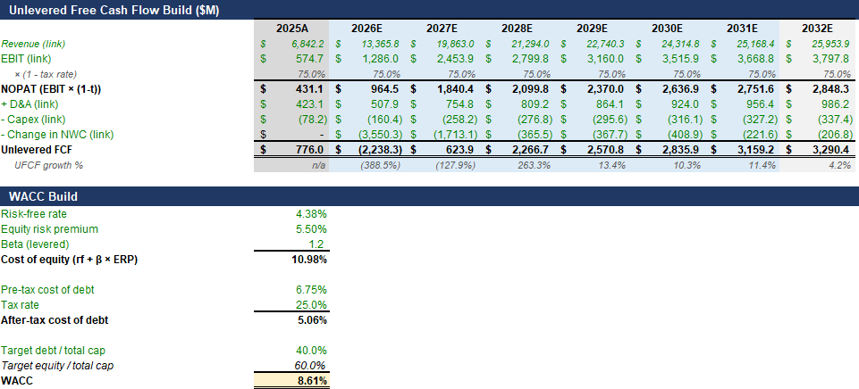
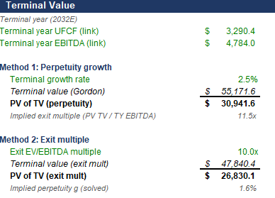
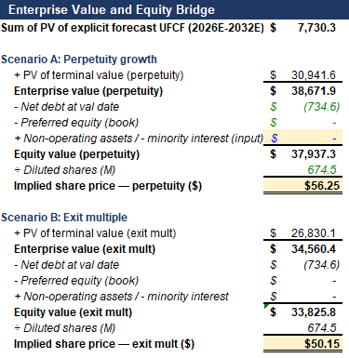
DCF Valuation
14
Notes:
Jose

Slide 15
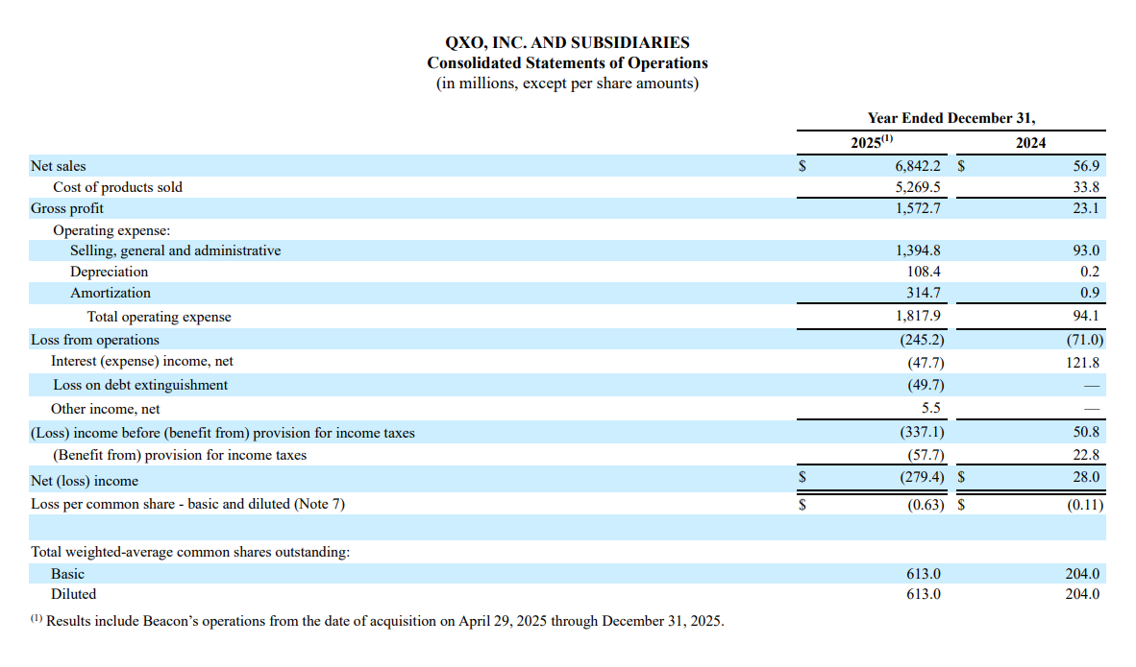
Income Statement
Notes:
Here is the projections we did for our DCF, as we mentioned in our investment thesis we see revenue growing each year due to higher prices and optimized operations, leading to an increase in its EBITDA and cash flow, also important to mention its big increase in capital expenditures in the future like environmental and health efforts, new mill factories and power plants gloabally”
15

Slide 16
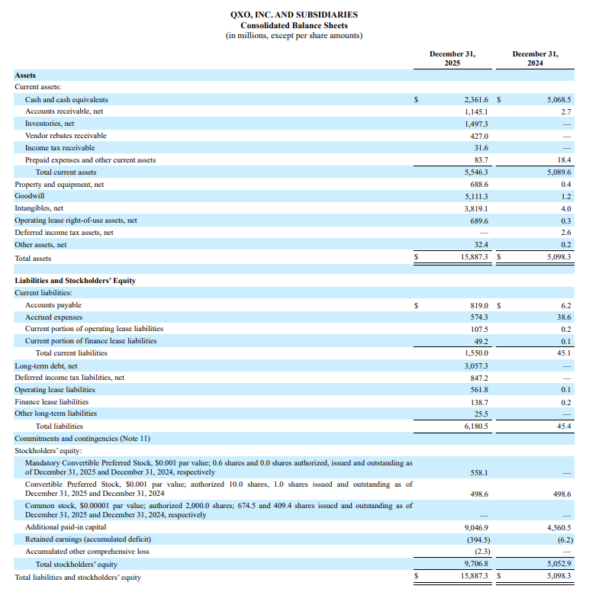
Balance Sheet
Notes:
Here is the projections we did for our DCF, as we mentioned in our investment thesis we see revenue growing each year due to higher prices and optimized operations, leading to an increase in its EBITDA and cash flow, also important to mention its big increase in capital expenditures in the future like environmental and health efforts, new mill factories and power plants gloabally”
16

Slide 17
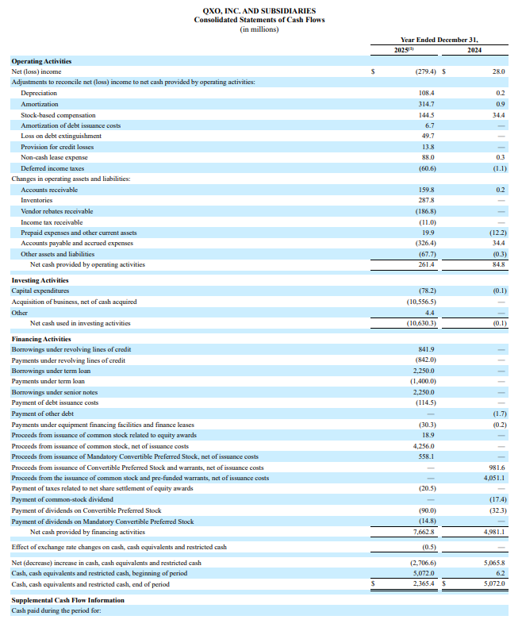
Cash Flow
Notes:
Here is the projections we did for our DCF, as we mentioned in our investment thesis we see revenue growing each year due to higher prices and optimized operations, leading to an increase in its EBITDA and cash flow, also important to mention its big increase in capital expenditures in the future like environmental and health efforts, new mill factories and power plants gloabally”
17

