Slide 1



Real Estate Sub-Sector
Report by Carlos Corado
July 2025

Slide 2

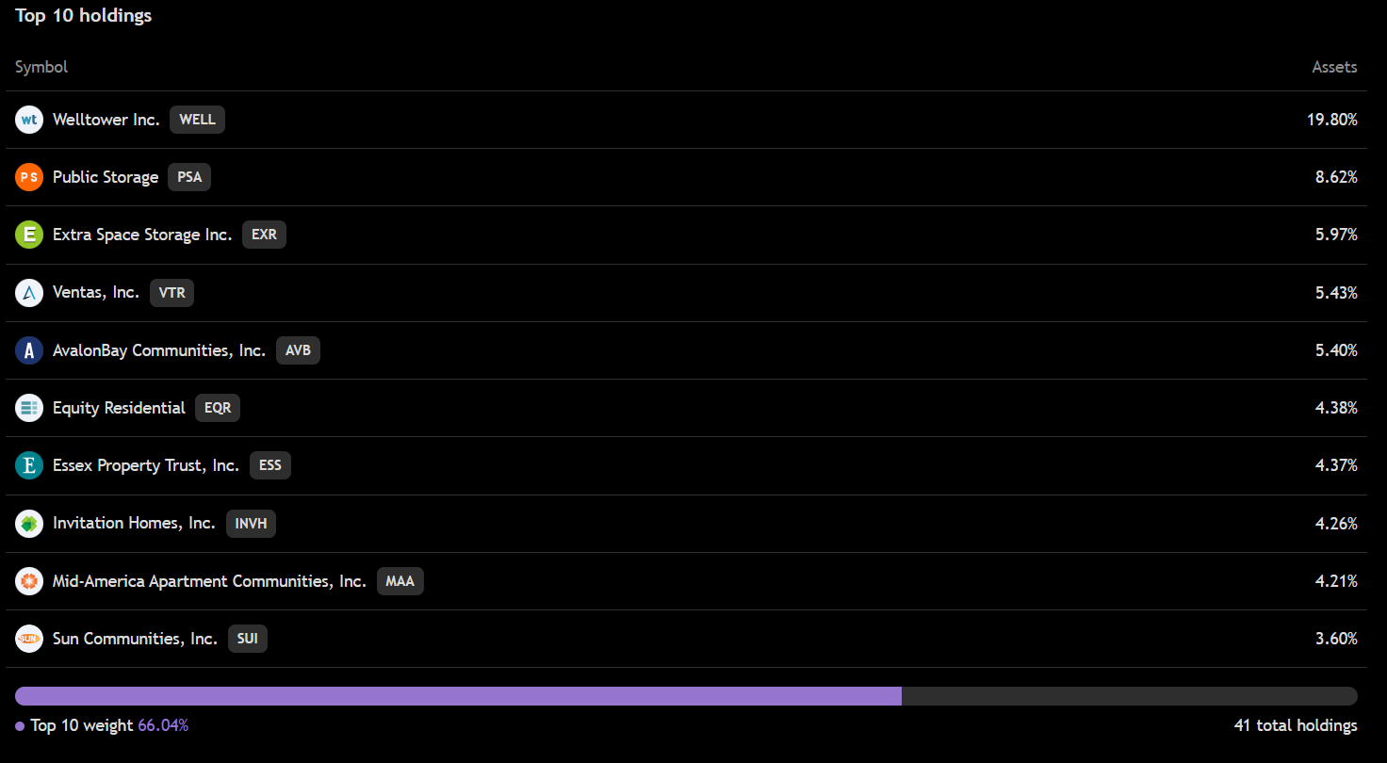
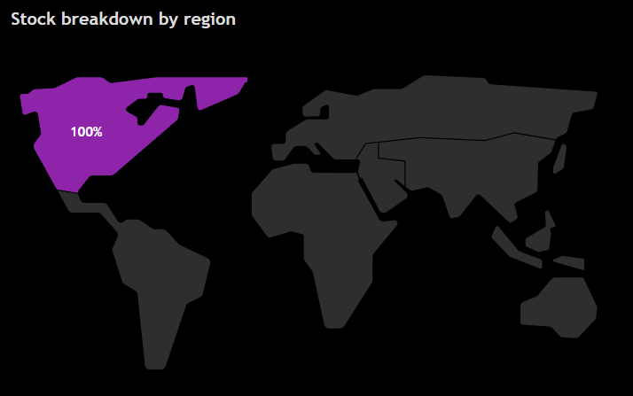
iShares Residential and Multisector Real Estate ETF (REZ)
ETF Overview
What is it: REZ is a multisector U.S. real estate ETF, investing in a broad range of REITs including apartments, manufactured homes, healthcare, self-storage, and single-family homes.

Slide 3

ETF Overview
Key Financial Ratios
Stock ticker: REZ
Name: iShares Residential and Multisector Real Estate
Industry: Real State
Current stock price: 83.98
Number of holdings: 40
P/CF ratio: 17.27
P/B ratio: 2.32
Discount/Premium to NAV: 0.010%
ETF Financials
Valuation Summary
Dividend yield: 2.39 %
Expense ratio: 0.48%
Net Asset Value (NAV): 81.05
Assets Under Management (AUM): 800.77M
Funds flows: 147.07M
REZ ETF appears slightly overvalued, trading at a premium to its NAV and showing a high P/B ratio of 2.32. Its elevated P/CF ratio of 17.27 further suggests investors are paying a premium relative to the fund’s underlying real estate assets

Slide 4

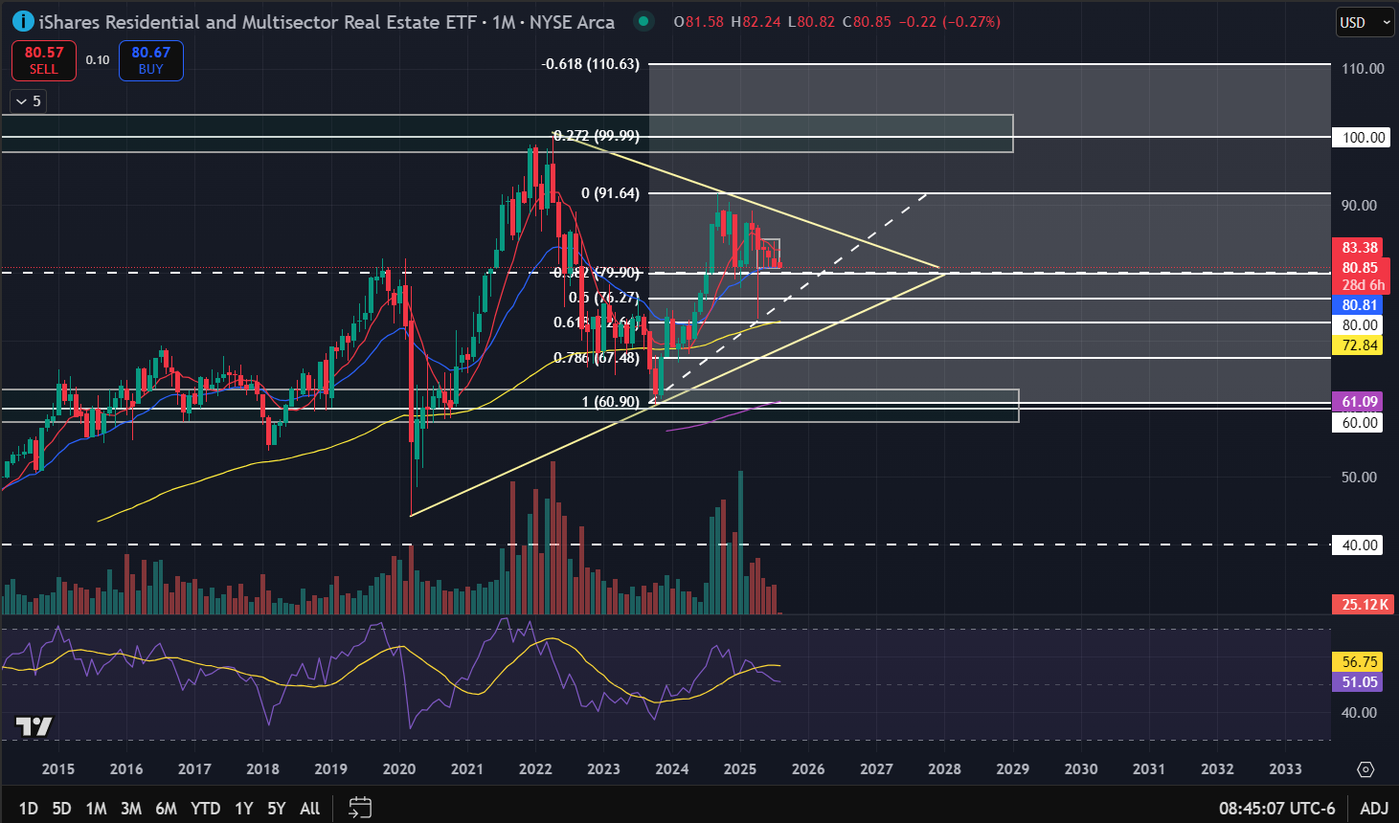
Bi
Monthly timeframe: REZ
Uptrend on the monthly, higher lows with lower lows
Neutral RSI
Big support at $80, with Fibonacci level 0.382 and 21 EMA further strengthen it
Note: Triangle pattern formation may indicate a reversal to the downside

Slide 5
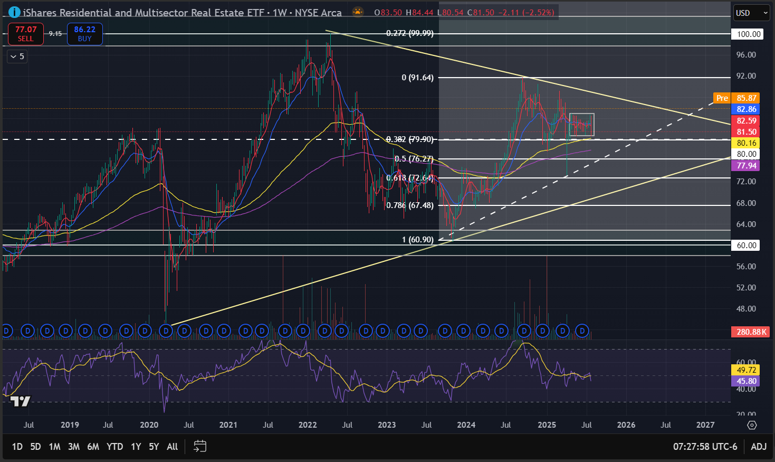
Weekly timeframe: REZ
Uptrend on the monthly, higher lows with lower lows
Currently laying above the weekly support level at $80, also where the 0.382 Fibonacci level is located

Slide 6
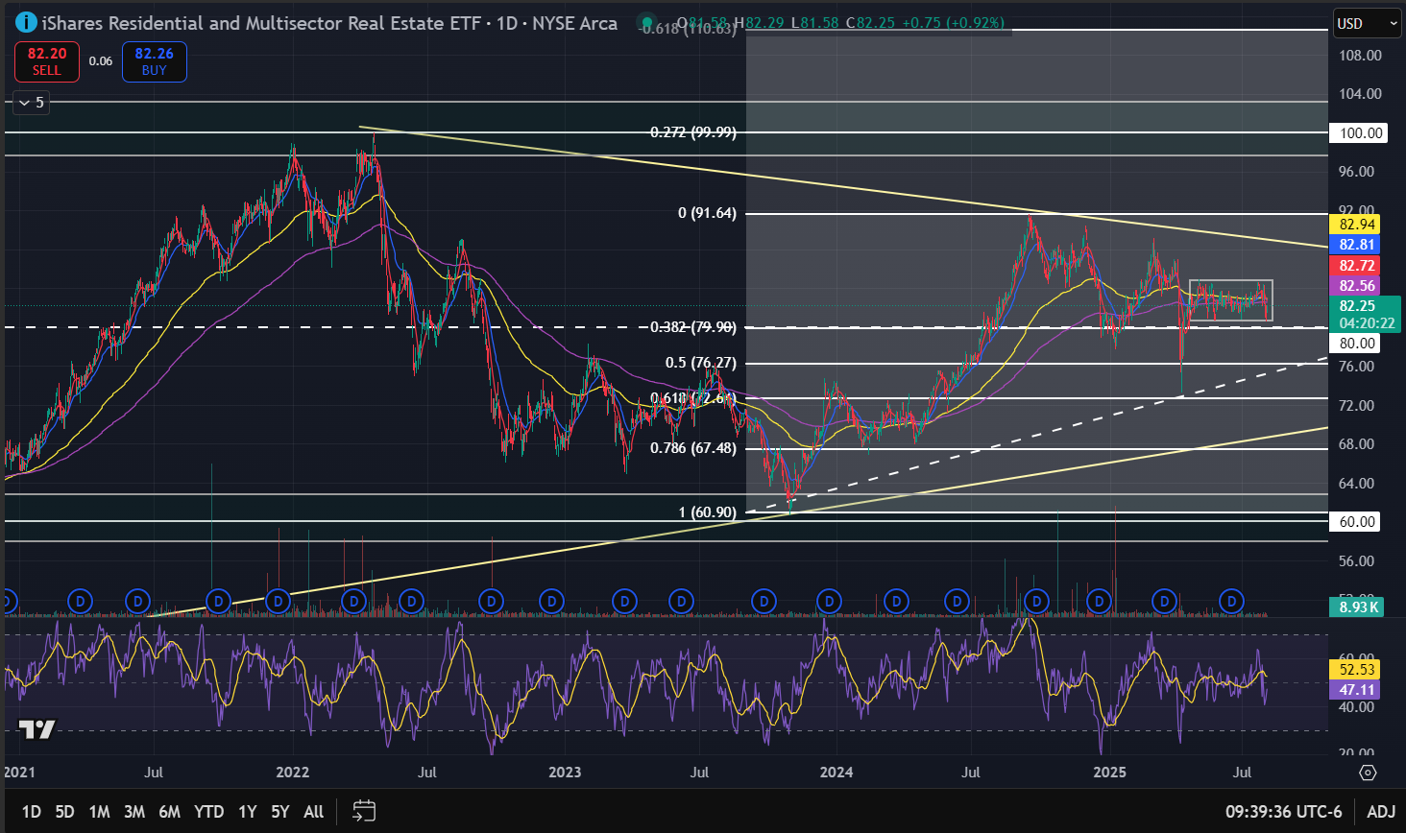
Daily timeframe: REZ
Consolidation above the $80 support level and 0.382 Fibonacci level
Neutral RSI

Slide 7

Qualitative Analysis: REZ
Recent News
Potential Catalyst
Industry Overview
After underperforming in 2024 due to high interest rates, REIT valuations have become more attractive. With inflation moderating and rate cuts expected, investor interest has returned
The potential for Fed rate cuts in mid-to-late 2025 and easing long-term yields may reduce borrowing costs for REITs and lift NAVs
Carlyle raised $9B for U.S. real estate bets, explicitly focusing on residential, self-storage, and industrial sectors—and avoiding structurally challenged office and retail segments where REZ doesn’t invest heavily
As of mid‑2025, the self-storage sector led equity REITs with a trailing 12‑month FFO multiple of ~28.3×, well above the broader REIT index at 19.2×
Healthcare REITs followed closely around 28.2×, while multifamily/apartments lagged (~18.5×)
According to J.P. Morgan, 2025 guidance for multifamily REIT FFO growth ranges between 1–2%, with single-family REITs slightly stronger

Slide 8

Final Recommendation
REZ offers a cautiously bullish setup, backed by strong fund inflows, sector alignment with institutional trends, and potential rate cuts in late 2025. Though slightly overvalued (P/B 2.32, P/CF 17.27), its focus on resilient REIT segments and solid technical support at $80 suggest medium-term upside. Hold to accumulate near support with a target range of $91–$99.

Slide 9
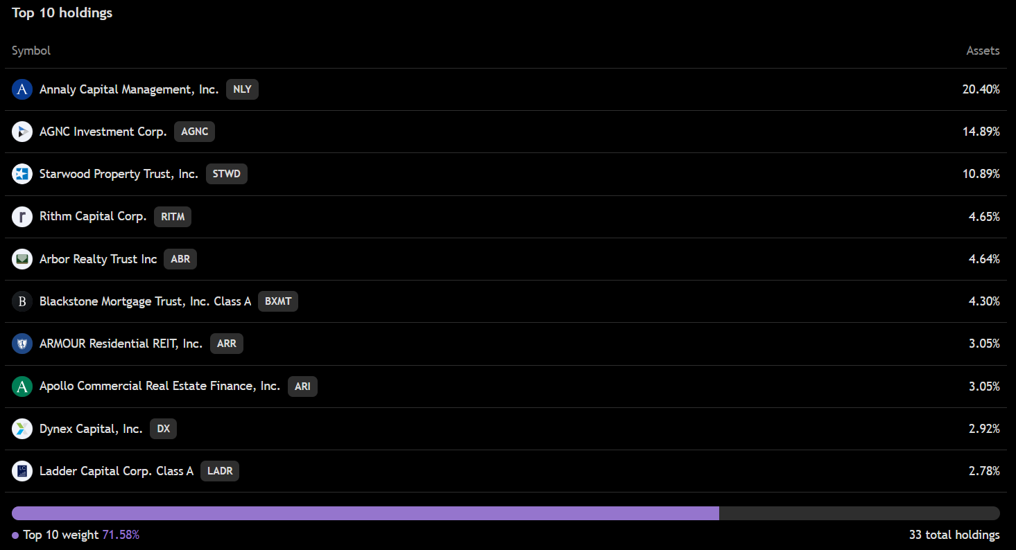
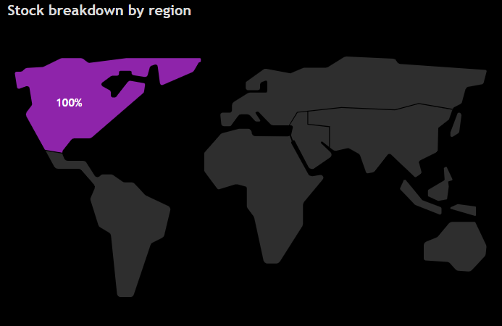
iShares Mortgage Real Estate ETF (REM)
ETF Overview
What is it: REM holds a concentrated portfolio of residential and commercial mortgage REITs, closely tracking a neutral benchmark for the sector. The index applies five eligibility screens: size, liquidity, invested assets, free float, and UBTI. A capping strategy limits individual weights to 22.5% (or 3% from the reserve list), with quarterly rebalancing. Mortgage finance and savings associations are included only when the number of main constituents drops below 20.

Slide 10
ETF Overview
Key Financial Ratios
Stock ticker: REM
Name: iShares Mortgage Real Estate ETF
Industry: Real State
Current stock price: 22.15
Number of holdings: 32
P/CF ratio: 5.09
P/B ratio: 0.86
Discount/Premium to NAV: -0.03
ETF Financials
Valuation Summary
Dividend yield: 9.34%
Expense ratio: 0.48%
Net Asset Value (NAV): 22.11
Assets Under Management (AUM): 574.88 M
Funds flows: 4.42 M
REM is undervalued, trading below NAV with a low P/B of 0.86 and P/CF of 5.09. Its 9.34% yield adds income appeal, though mortgage REITs remain rate-sensitive.

Slide 11
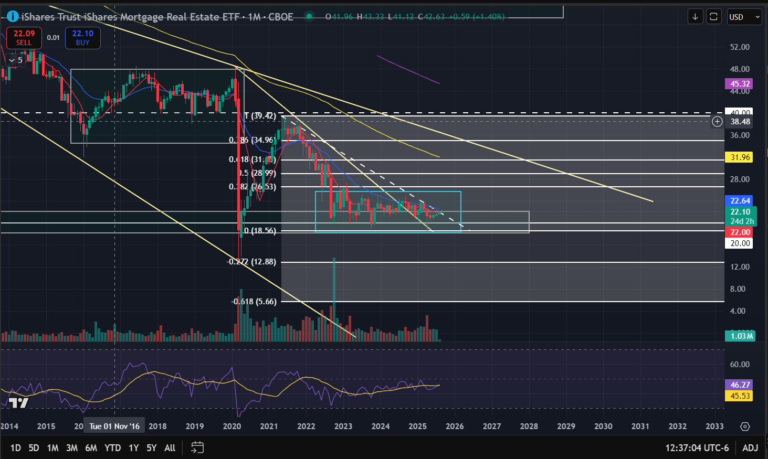
Monthly timeframe: REM
Downtrend on the monthly, lower highs with lower lows for a long time
Neutral RSI
Note: Downward channel, resistance at $40
Consolidating for the past 2 years above the $20 support level bouncing off around the $25 price level

Slide 12
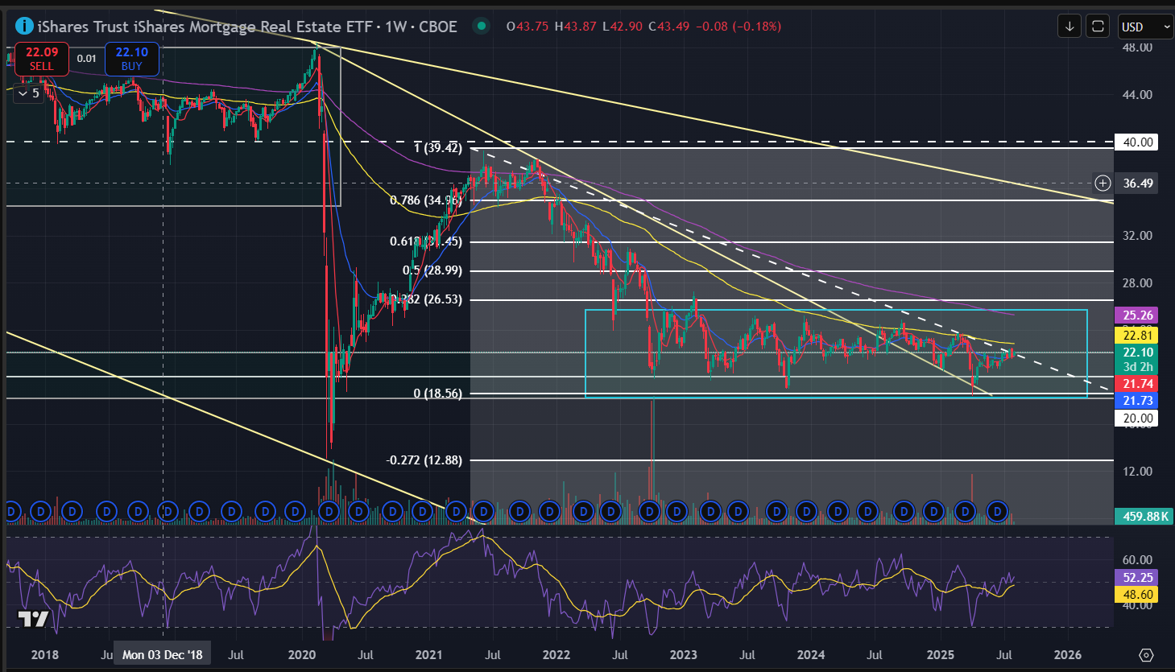
Weekly timeframe: REM
Consolidating for the past 2 years above the $20 support level bouncing off around the $25 price level
Major moving averages following the downtrend
Note: Big drop during 2020, recovered 2021 and found resistance at $40 (Mainly due to the extreme rate cuts)

Slide 13
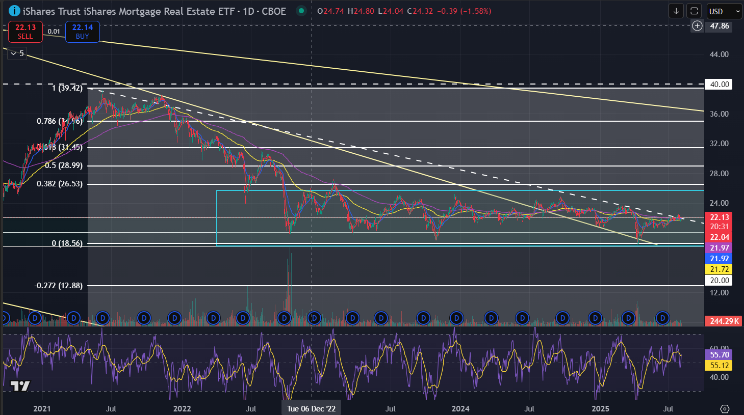
Daily timeframe: REM
Consolidating for the past 2 years above the $20 support level bouncing off around the $25 price level
Major moving averages following the downtrend
Neutral RSI

Slide 14
Qualitative Analysis: REM
Recent News
Potential Catalyst
Industry Overview
The average rate on a 30-year mortgage fell to a 10-month low of 6.57% on Monday, down from 6.74% on July 28, according to Mortgage News Daily.
concerns over tariffs and ongoing uncertainty about future costs have kept those rates within the same narrow range for months. Those higher rates, along with much higher home prices, have been a relentless obstacle for would-be buyers
REM price has risen by 0.91% over the last month, and its yearly performance shows a −0.18% decrease
NAV returns, showed a 7.42% increase in three-month performance and has increased by 5.15% in a year.

Slide 15
Final Recommendation
REM is a long candidate for income-focused investors, offering a 9.34% yield and undervalued metrics (P/B 0.86, P/CF 5.09). While technically in a downtrend, stable support near $22 and improving NAV performance suggest potential for recovery. Accumulate cautiously for medium-term upside and dividend income.

Slide 16
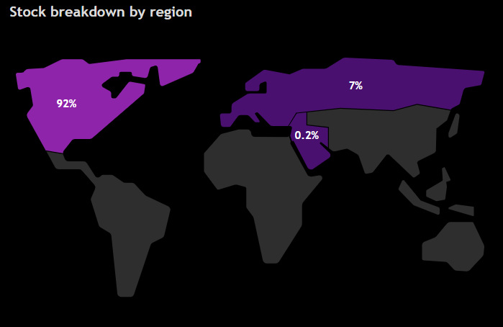
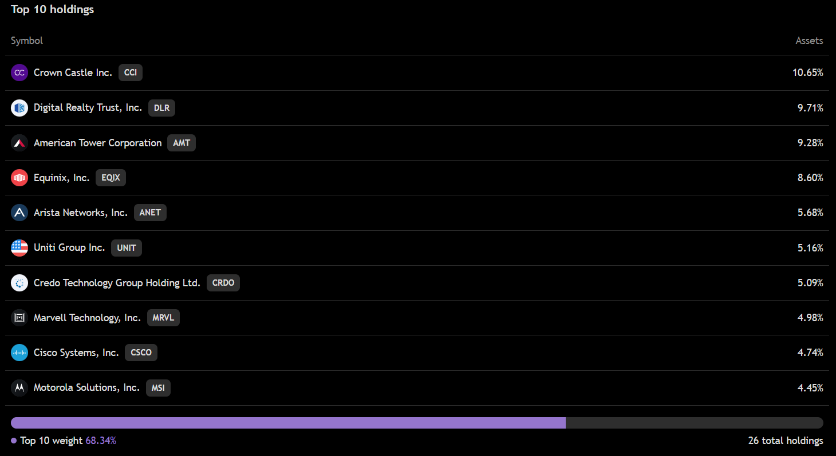
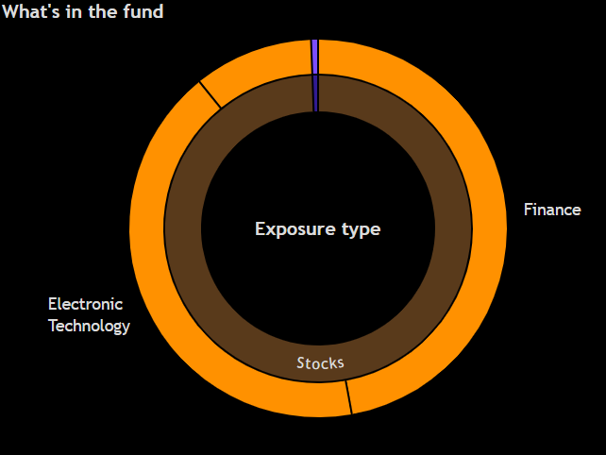
iShares U.S. Digital Infrastructure and Real Estate ETF (IDGT)
ETF Overview
What is it: IDGT tracks U.S.-listed stocks involved in digital infrastructure—such as data storage, transmission, and processing. It selects 50 stocks across 17 sub-industries using a tiered approach: Tier 1 includes telecom towers and data centers; Tier 2 covers equipment and semiconductor firms. Tier 1 companies are prioritized, with Tier 2 added if needed. The fund applies strict caps at the stock and group level, rebalances quarterly, and is reviewed annually. Formerly known as IGN, it rebranded in Dec. 2023.

Slide 17
ETF Overview
Key Financial Ratios
Stock ticker: IDGT
Name: iShares U.S. Digital Infrastructure and Real Estate ETF
Industry: Real Estate
Current stock price: 82.78
Number of holdings: 26
P/E ratio: 38.33
P/B ratio: 3.97
Discount/Premium to NAV: -0.04%
ETF Financials
Valuation Summary
Dividend yield: 1.40%
Expense ratio: 0.39%
Net Asset Value (NAV): 84.34
Assets Under Management (AUM): 115.89 M
Funds flows: 60.20 M
IDGT appears overvalued, trading at a steep P/E ratio of 38.33 and a high P/B ratio of 3.97, well above typical real estate ETF benchmarks. Despite a slight discount to NAV (−0.04%), these elevated valuation metrics suggest investors are paying a premium for its digital infrastructure exposure.

Slide 18
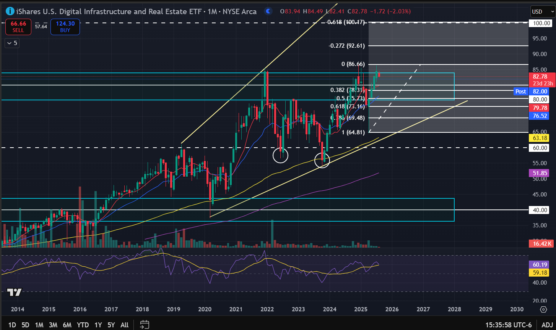
Monthly timeframe: IDGT
Uptrend on the monthly, higher lows with higher highs
RSI in the 60s, not yet overbought
Note: Double bottom pattern formation (Bullish formation)

Slide 19
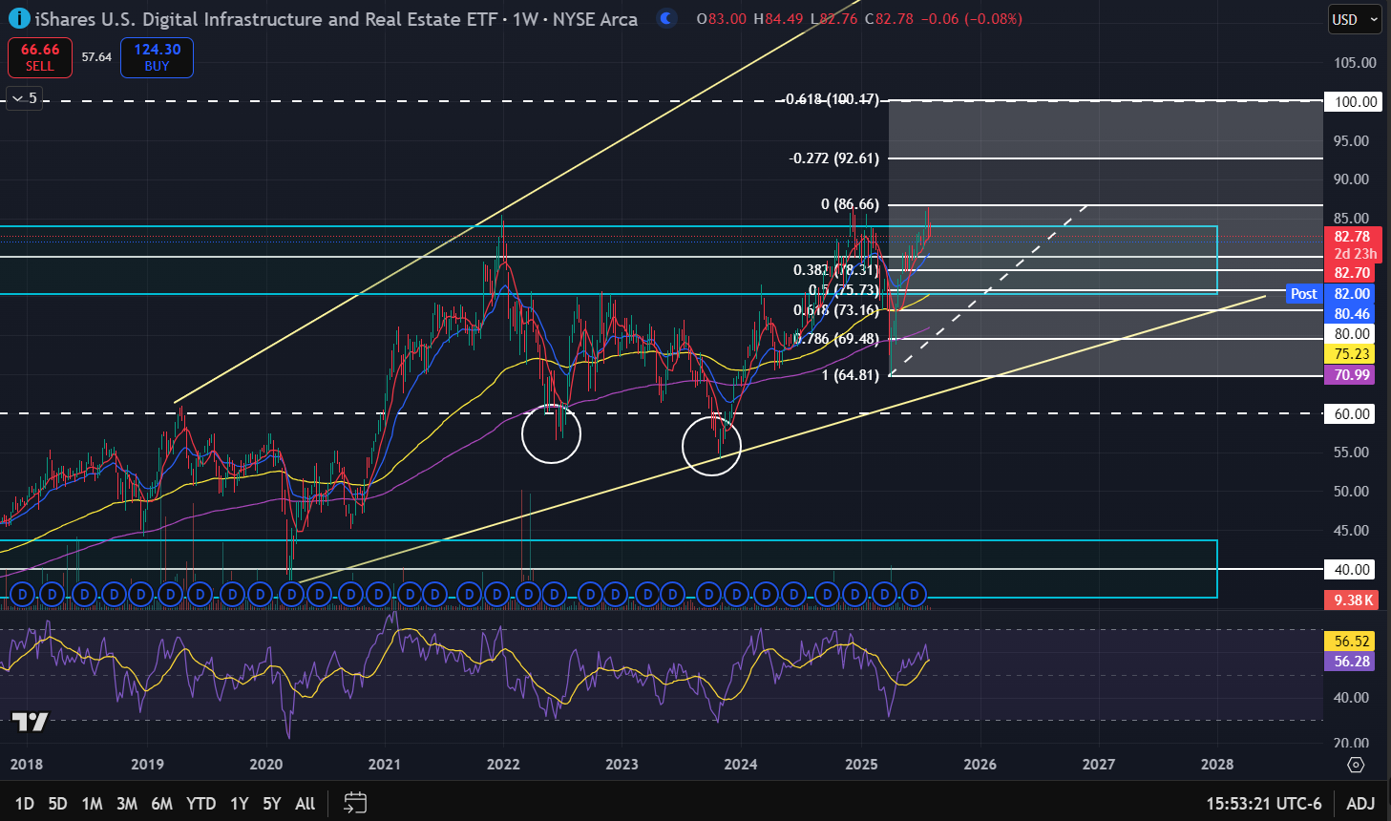
Weekly timeframe: IDGT
Bullish 8 SMA over the 21 EMA crossover
Note: broke the $80 resistance level twice, finding rejection at ~$85. Wait for confirmation that $80 can act as support and break to the upside

Slide 20
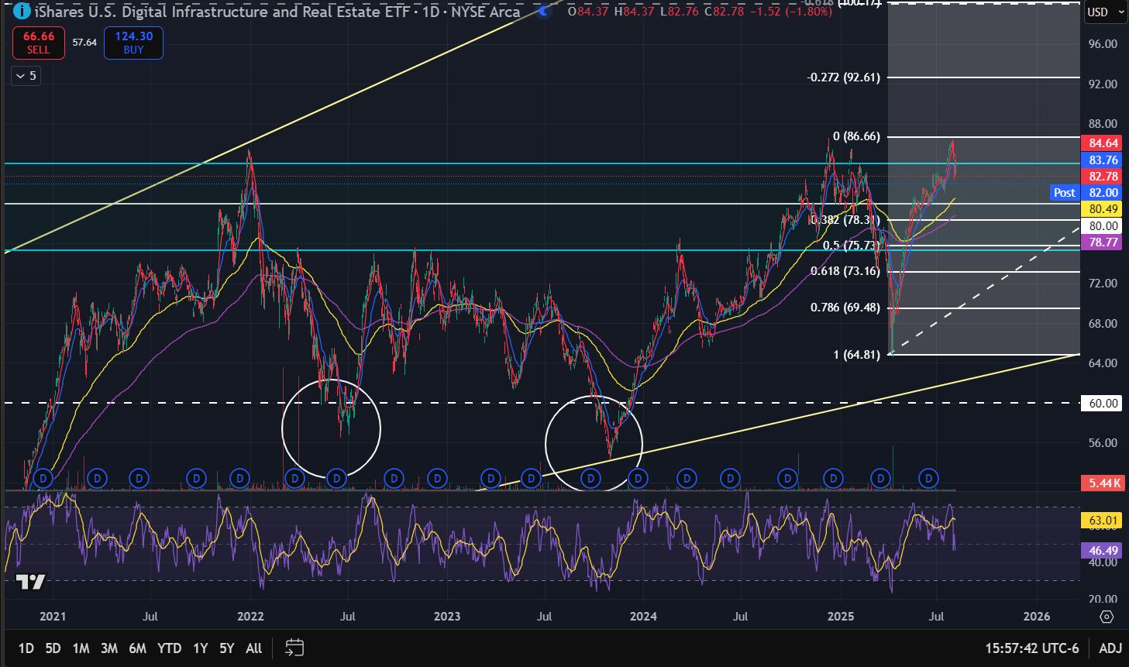
Weekly timeframe: IDGT
Bearish engulfing candlestick at the end of last session (as of 8/5/2025)
Note: May find support at the 0.382 Fibonacci level or $80 level, which is further confirmed by the 200 MA.

Slide 21
Qualitative Analysis: IDGT
Recent News
Potential Catalyst
Industry Overview
BlackRock expands infrastructure ETF offerings, highlighting long-term growth in digital and physical infrastructure—IDGT is part of this $10B ETF suite, positioned to benefit from rising global investment (projected to reach $68T by 2040) in data centers, energy, and logistics hubs.
Tech Spending Intent's Continued Rise Threatened By Tariffs, may lead to a decrease in the demand of this type of infrastructure
IDGT price has risen by 1.67% over the last month, and its yearly performance shows a 17.24% increase
NAV returns, another gauge of an ETF dynamics, have risen by 1.52% over the last month, showed a 9.53% increase in three-month performance and has increased by 16.64% in a year

Slide 22
Final Recommendation
IDGT is a hold with selective long potential for growth-oriented investors. While fundamentally overvalued (P/E 38.33, P/B 3.97), its strong technical setup—marked by an uptrend and bullish double bottom—and solid NAV performance (16.64% yearly gain) reflect momentum. Backed by BlackRock’s infrastructure push and global investment tailwinds, IDGT offers upside, but elevated valuations and tariff risks warrant caution. Hold existing positions and consider adding on pullbacks

