Slide 1


NASDAQ: DASH | Hold Rating | Implied Share Price - $176.3
Jake Layton, Bradin Haynie, Amanda Seck, and Mauricio Caruso Jannet
April 30, 2026
1

Slide 2




Meet the Team
DASH
Add Photo
Add Photo
Add Photo
Jake Layton
Bradin Haynie
Amanda Seck
Mauricio Jannet Caruso
Incoming Business Valuation Summer Analyst at Stout
Incoming Private Equity Summer Analyst at Chicago Pacific Founders
Sophomore Equity Analyst
Incoming Controllers Summer Analyst at Goldman Sachs
Neeley Equity Research Club | DoorDash, Inc. (NASDAQ: DASH) | April 30, 2026
2

Slide 3
Agenda
DASH
01
Company Overview
02
Industry & Market
Background, leadership, market position & key company stats
U.S. online food delivery landscape and DoorDash's projected growth vs. the market
03
Revenue
04
Key Operating Metrics
Disaggregated revenue by geography — U.S. vs. International (2023–2025)
Total orders, Marketplace GOV, revenue growth, and net revenue margin
05
Recent Performance
06
Valuation & Projections
Q4 2025 earnings review and full-year 2025 results
DCF model, income statement, balance sheet & cash flow projections
07
Investment Thesis
08
Final Recommendation
Competitive moat, macro environment, innovation, and target price
Hold rating rationale and conditions for a more constructive outlook
DoorDash, Inc. (NASDAQ: DASH) | April 30, 2026
2

Slide 4


Welcome to DoorDash
DASH
Headquarters:
San Francisco, CA
DoorDash, founded in 2013 in San Francisco, is the largest food & commerce delivery marketplace in the U.S. with 67% market share. It connects consumers, Merchants, and Dashers through on-demand delivery, DashPass subscriptions, DoorDash Drive (logistics), and Wolt in Europe.
Important Company Information
Exchange
NASDAQ
Industry
Internet & Direct Marketing
Operations:
U.S., Canada, Australia,
Japan, Europe (Wolt)
Last Close (04/29/26)
$169.33
Leadership:
Marketplace GOV by Geography (Est. 2024)
Market Cap
73.78B
CEO: Tony Xu
Total Debt
$3.29M
Co-founder and CEO since 2013. Stanford MBA, former McKinsey. Grew DoorDash to 67% U.S. market share and led international expansion via the Wolt acquisition.
Cash
$5.51M
Global Presence:
+30 countries
Enterprise Value
$71.57B
P/E (TTM)
77.5x
EV/EBITDA
47.87x
COO & President: Prabir Adarkar
Current Ratio
1.4x
Active Users:
+40M monthly users
CFO since 2018, elevated to COO & President in March 2023. NYU Stern MBA. Oversees operations, logistics, and international growth across 30+ countries.
ROA
5.5%
Profit Margin
6.82%
EBITDA
1.47B
Next Earnings Date
May 2026
Source: DoorDash IR, Yahoo Finance
2

Slide 5
Company Overview
DASH
Revenue Breakdown 2025 (Full Year, $M)
Management Team
• Market Dominance: DoorDash leads with 67% U.S. market share - nearly 3x Uber Eats (23%)
• Revenue Growth: 28% YoY revenue growth in 2025, outpacing Uber (25%) and Instacart (11%)
• First GAAP Profitability: $123M net income in 2024 — first full year of positive GAAP earnings
Segment
2025 Revenue ($M)
YoY Growth
U.S. Marketplace
$11,460
+22%
International (Wolt)
$2,257
+71%
Total Revenue
$13,717
+28%
Uber Eats
$17,248
+25%
• Strategic Shift: Transitioning from delivery app → infrastructure layer for local commerce
• Partnerships with major retailers: Foot Locker, Urban Outfitters, Old Navy, etc. position DoorDash as a “one-stop shop” for local delivery
• Wolt Acquisition (2022): ~$7B all-stock deal expanded DoorDash into 25+ international markets, accelerating global footprint
Source: DoorDash IR
3

Slide 6
Regulatory Landscape: Key Risks to DASH Economics
Bucket | Why it Matters | Investor Takeaway
Courier pay / worker classification | Higher mandated pay or reclassification risk can lift fulfillment costs and compress margins. | Biggest long-term regulatory swing factor.
Fee transparency / FTC scrutiny | May require earlier disclosure of full costs and reduce pricing flexibility. | Could pressure conversion and take-rate presentation
City-level delivery rules | Local ordinances can drive higher consumer fees and lower order volume in affected markets. | Risk is fragmented, but can be meaningful market-by-market.
Source: https://ir.doordash.com/news/news-details/2026/DoorDash-Releases-Fourth-Quarter-and-Full-Year-2025-Financial-Results/default.aspx

Slide 7
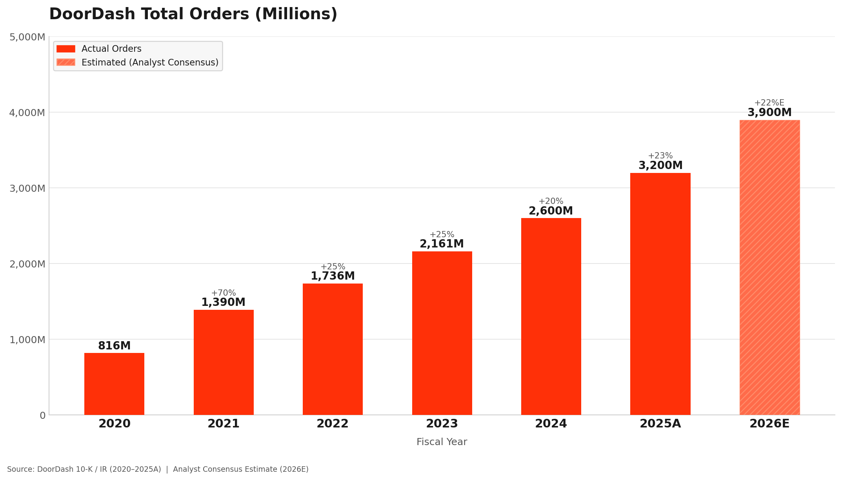
Total Orders Overview

Slide 8
Key Operating Metrics
DASH
2,161M
2,583M
3,172M
2023 Total Orders
2024 Total Orders
2025 Total Orders
▲ +20% Y/Y
▲ +23% Y/Y
(in millions, except percentages) | 2023 | 2024 | 2025
Total Orders | 2,161 | 2,583 | 3,172
Total Orders Y/Y growth | 24% | 20% | 23%
Marketplace GOV ($M) | $66,771 | $80,231 | $102,018
Marketplace GOV Y/Y growth | 25% | 20% | 27%
Revenue ($B) | $8,635 | $10,722 | $13,717
Revenue Y/Y growth | 31% | 24% | 28%
Net Revenue Margin | 12.9% | 13.4% | 13.4%
Source: DoorDash 10-K (2025) | GOV = Gross Order Value
4

Slide 9
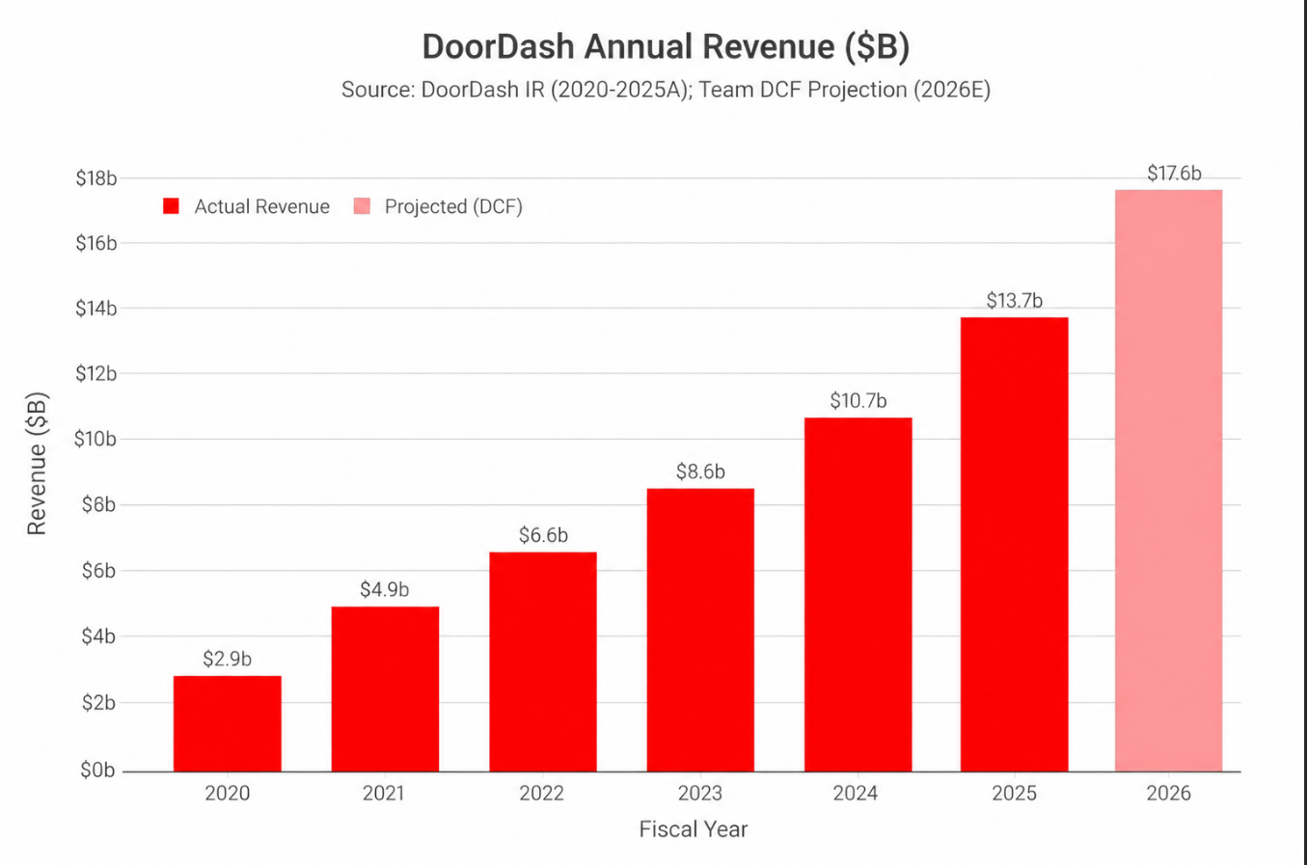
DASH Revenue Overview
DASH
US Online Food Delivery
DoorDash (DASH)
20.2% CAGR
We Project It To Grow
2025 – 2030
Source: Grand View Research, DoorDash IR
5
5

Slide 10
Revenue Breakdown
DASH
International Becoming the Growth Engine
U.S. Revenue (2025)
Revenue by Geography ($M)
$11.5B
+21.9% YoY
($ in millions) | 2023A | 2024A | 2025A
United States | $7,781 | $9,403 | $11,460
International | $854 | $1,319 | $2,257
Total Revenue | $8,635 | $10,722 | $13,717
Total YoY Growth | — | +24.2% | +27.9%
International % of Total | 9.9% | 12.3% | 16.5%
Mature segment scaling steadily; durable cash engine
International Revenue (2025)
$2.2B
+71.1% YoY
Wolt + Deliveroo flywheel accelerating across 25+ markets
International Mix Shift
9.9% → 16.5%
2023 → 2025
KEY TAKEAWAY
Geographic exposure re-rating in just two fiscal years
International is growing 3x+ faster than the U.S. and now drives ~17% of revenue. The Wolt acquisition is paying off and underpins forward-period growth assumptions in our DCF.
Source: DoorDash 10-K (FY2025) | Note: No individual country outside the U.S. represented 10%+ of consolidated revenue.
9

Slide 11
Recent Stock Performance
DASH
From Peak Euphoria to Re-Rating
Price Action Snapshot
Key Drivers
Last Close (4/29/26)
52-Week High (10/16/25)
52-Week Low (3/27/26)
1
Q4 2025 Earnings Miss (Feb 2026)
$169.33
$285.50
$143.30
Top- and bottom-line miss vs. consensus and soft 2026 guidance triggered the initial selloff despite robust GOV growth.
YTD 2026 Return
1-Year Return
From Recent Low
2
Regulatory Headwinds
−35%
~0.7%
+18%
Australian landmark minimum-pay deal for delivery workers reignited courier reclassification fears; NYC operations dispute added uncertainty.
3
Valuation Reset
CONSOLIDATION VIEW
Stock had run from ~$140 to $285 in 2025 (+100%); P/E expanded to ~130x at peak. Multiple compression on rising rates and growth deceleration.
Stock has consolidated near $165–$175 after a 50% drawdown from the October 2025 peak. With Q1 2026 earnings on May 11, near-term direction depends on the credibility of management's guidance reset — a setup that supports our Hold thesis.
4
Recovery Catalysts (April 2026)
Foot Locker partnership, Also/Rivian autonomous delivery JV, $5B buyback execution, and exit from four unprofitable markets signal capital discipline.
Source: Yahoo Finance, MacroTrends, DoorDash IR | Prices as of last close 04/29/26.
10

Slide 12
Investment Thesis
DASH
WHY WE LIKE IT
WHY WE WAIT
Market dominance: 67% U.S. share vs. 23% Uber Eats — widening, not narrowing
Profitability inflection: First GAAP profit 2024 ($123M) → $935M in 2025 (+660% YoY)
Cash generation: $2.4B operating cash flow (2025); net cash positive
International flywheel: Wolt revenue +71% YoY; intl. mix climbed from 10% to 17%
Capital discipline: $5B buyback program + exited four unprofitable markets
Valuation balanced: ~78x TTM P/E and ~35x EV/EBITDA — premium leaves little margin
Growth deceleration: Even our model: 30.5% (2026E) → 19.3% (2027E) → 17.0% (2030E)
Regulatory overhang: Aus. minimum-pay precedent; reclassification risk; FTC fee scrutiny
Margin expansion unproven: EBITDA margin path 10.7% → 22.5% by 2030E assumes efficient scaling
Guidance credibility: Soft 2026 guide post-Q4 miss; market wants reset before re-rating
OUR VIEW
DoorDash is a best-in-class operator, but at $169 the stock trades roughly in line with our DCF intrinsic value of $176.30 (~4% upside). The bull case is largely priced in — we'd be more constructive on a pullback below $150 or evidence of accelerating EBITDA margin expansion.
HOLD
Target
Current
$177
$169
Source: DoorDash IR, NERC analysis | DCF intrinsic value $176.30 vs. last close $169.33.
11

Slide 13
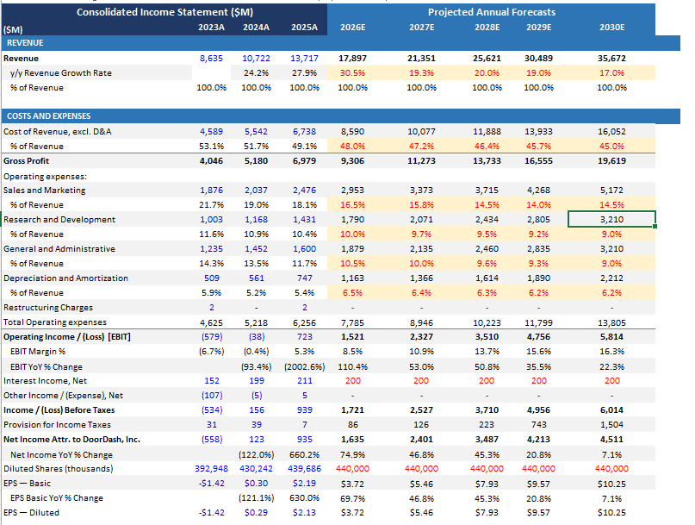
Income Statement Projections
DASH
Volume Driven Revenue Growth: Marketplace GOV increasing by 23.6% CAGR compared to Net Revenue Margin remaining flat (13.4%)
Revenue growth to remain elevated near term as DoorDash expands merchants, retailers, grocery/retail categories, DashPass/Wolt+/Deliveroo Plus membership, and international reach.

Slide 14
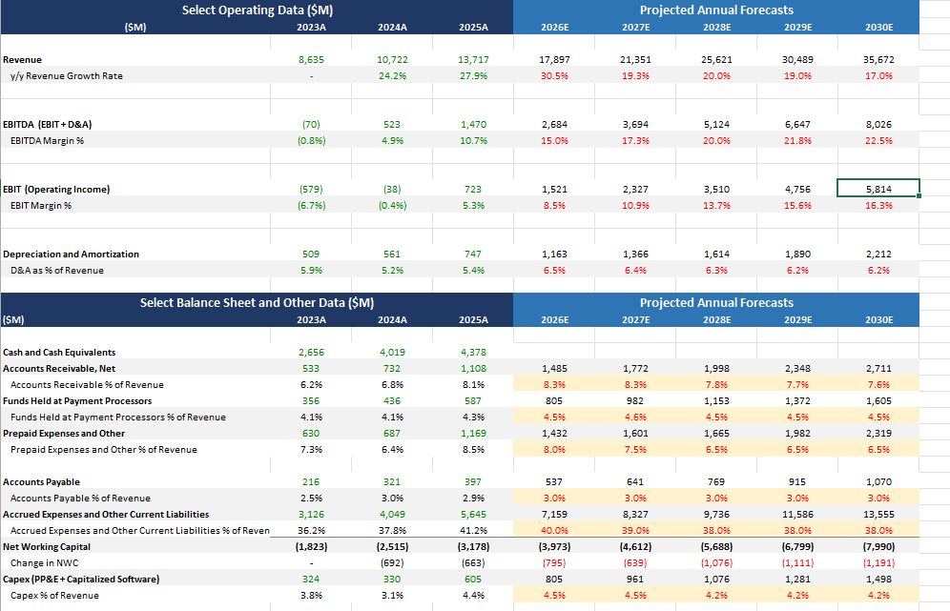
Select Operating and Balance Sheet Account Projections
DASH
10
10

Slide 15
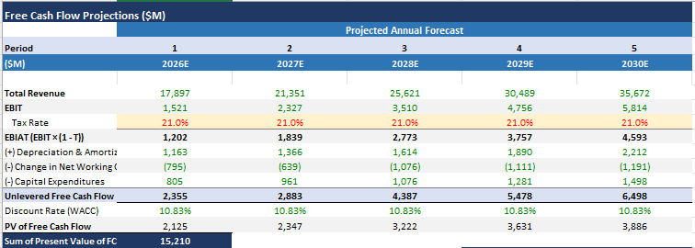
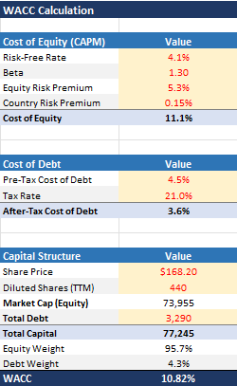
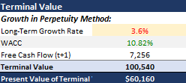

DCF Projections
DASH
11
11

Slide 16
Comparable Company Analysis & Valuation Cross-Check
DASH
PEER MULTIPLES | Source: Bloomberg RV 04/24/26 | Primary peers: Uber + Grab
Company
Mkt Cap
EV/EBITDA LTM
EV/EBITDA FY1
EV/EBITDA FY2
EV/Rev
Rev Growth
DASH Premium
DOORDASH (DASH)
$74B
40.3x
20.5x
15.5x
3.9x
28%
—
Uber Technologies
$152B
21.9x
14.7x
12.1x
2.6x
18%
+36%
Grab Holdings
$16B
27.4x
15.5x
10.7x
2.6x
20%
+32%
Lyft Inc.
$6B
21.4x
7.3x
5.9x
0.7x
9%
+181%
Primary Peer Avg (Uber+Grab)
—
24.7x
15.1x
11.4x
2.6x
~19%
—
DASH commands a 36% premium on earnings multiples and 50% on revenue vs Uber+Grab — partly justified by superior growth (28% vs ~19%); partly reflects earnings uncertainty.
HISTORICAL PREMIUM ANALYSIS (Bloomberg EQRV)
VALUATION FOOTBALL FIELD | Current Price: $169.33
Metric
Current Prem.
Hist. Avg Prem.
Diff.
Implied Price
Signal
EV/Revenue (hist. avg)
$146
EV/EBITDA
+15%
+46%
-31%
$221.70
Earnings upside not priced in
DCF — Base Case
$177
P/E (TTM)
-43%
+1%
-44%
$313.00
Deep discount vs history
Current Price
$169
EV/EBIT
+22%
+70%
-48%
$239.82
Earnings re-rating pending
EV/EBITDA (hist. avg)
$222
EV/Revenue
+126%
+86%
+40%
$146.34
Growth story fully priced in
Street Consensus (ANR)
$253
What the market is saying:
Revenue ($146 implied) < $169 — growth story fully priced in
Earnings ($222 implied) > $169 — profitability not yet credited
DCF ($174) approx. current price — fairly valued on base-case
ROIC 6.35% < WACC 10.82% — economic value creation not yet achieved
Source: Bloomberg EQRV, Bloomberg RV, Bloomberg ANR, DoorDash 10-K (FY2025) | Prices as of 04/29/26

Slide 17
DASH
Final Recommendation
BUY, SELL, HOLD
Best-in-class operator with strong market share and cash generation, but valuation appears more balanced at current levels.
Market Leadership
Financial Strength
Why Hold
67% U.S. market share and scale advantages continue to support DoorDash's long-term competitive trajectory.
Revenue growth, GAAP profitability, and free cash flow show the business model is maturing well.
The business is high quality, but near-term upside looks more balanced after strong execution and current valuation.
Conclusion: Maintain exposure, but wait for a more attractive entry point before turning more constructive.

Slide 18
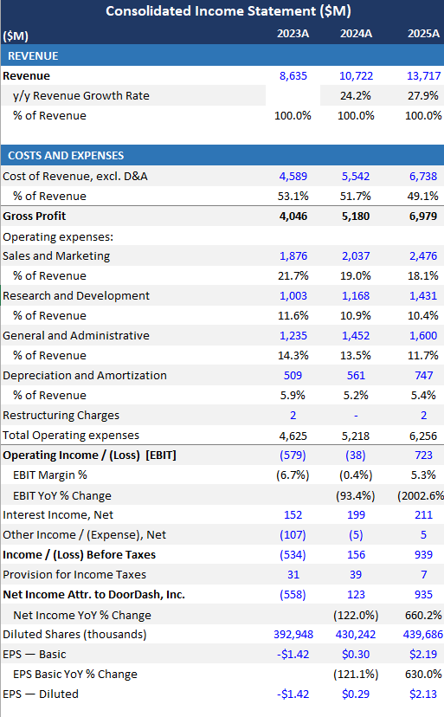
Income Statement

Slide 19
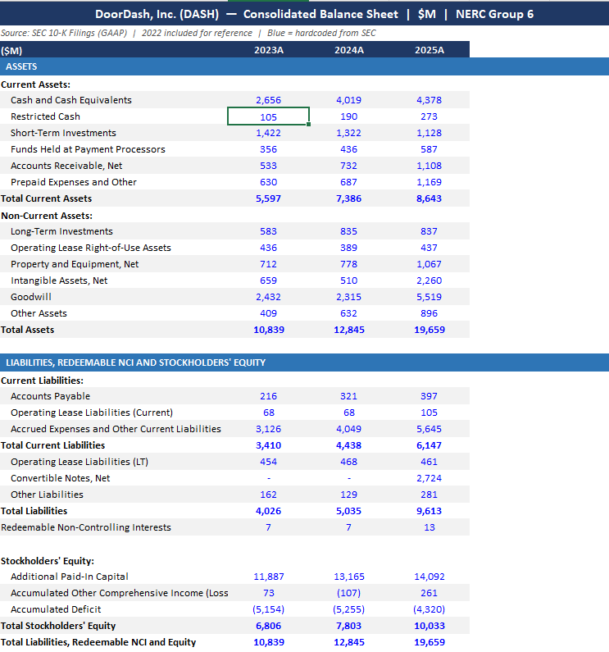
Balance Sheet
DASH

Slide 20
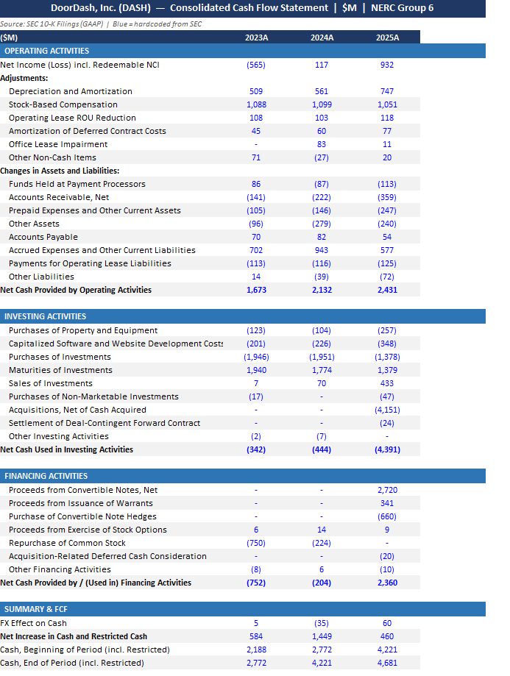
Cash Flow
DASH
13
13

