Slide 1

Quantum computing
Stock presentation
Carlos Corado

Slide 2
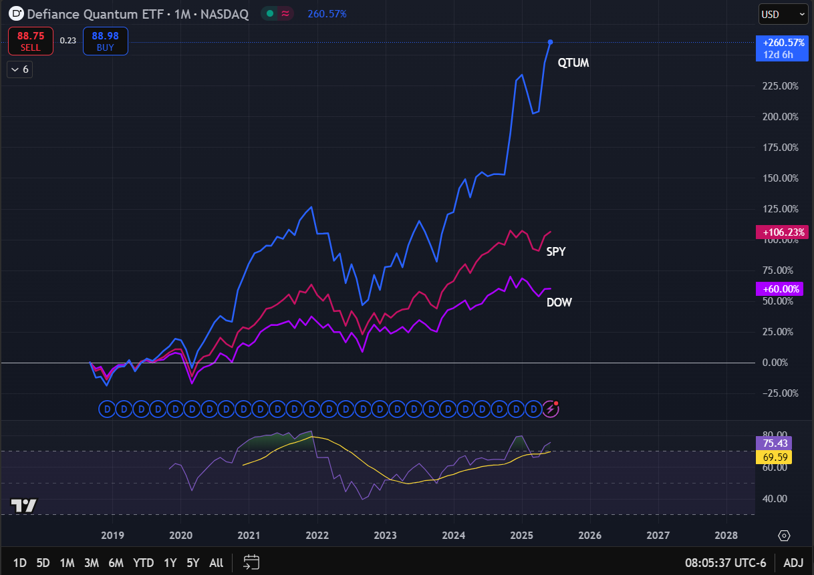
What is Quantum Computing?
“Quantum computing is an emergent field of computer science and engineering that harnesses the unique qualities of quantum mechanics to solve problems beyond the ability of even the most powerful classical computers.” (IBM)
Market Growth
Global market are expected to grow from $928M (2023) to $6.5B+ by 2030 (CAGR: ~37%).
Quantum-as-a-Service (QaaS) is emerging as a scalable SaaS. model it delivers cloud-based access to quantum processors and simulators — no need to own quantum hardware
Enables startups, researchers, and enterprises to run quantum algorithms remotely, affordably, and at scale.
Why It’s a Smart Investment?
Backed by Big Tech (IBM, Google, Microsoft)
Governments and Fortune 500s are investing early for competitive advantage.
Quantum advantage could break traditional encryption, requiring massive system upgrades = huge opportunity.
QTUM = Quantum computing ETF, outperforming the SPY and DOW starting 2018

Slide 3
Recent Developments & The Future Outlook
Recent News (2024–2025)
IonQ announced a #1 commercial quantum computer with 35 algorithmic qubits.
IBM's Condor chip hit 1,121 qubits — a major leap toward scalability.
U.S. government approved $1.2B in quantum funding through the CHIPS and Science Act.
Amazon & Microsoft launched Quantum Cloud platforms, making access global.
The Future of Quantum Computing
2025–2030: From “lab curiosity” to commercial value.
Key themes: Error correction breakthroughs, hybrid quantum-AI models, and QaaS monetization.
By 2035, quantum could add $450B–$850B in global value (BCG).
Bonus Insight: Quantum x Finance
Portfolio optimization, risk modeling, and fraud detection could be transformed.
Early investors in quantum infrastructure could capture venture-like returns as adoption scales.

Slide 4
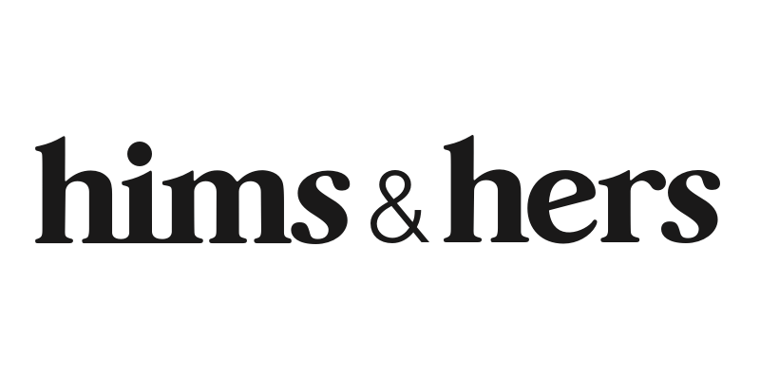
Fundamental Analysis
Stock overview
Stock Ticker | HIMS
Company name | Hims & Hers Health, Inc
Industry | Household & Personal Products
Current stock price | 58.82
Market Cap | 13.17 B
Company Growth
Revenue Growth Rate (YoY) | 69.32%
Earnings Growth Rate (YoY) | 581.82%
Overvalued
Financials | In thousands
Revenue (Last year) | 1,476.51
Net Income (Last year) | 126.04
EPS | 0.69
Dividend Yield | -
Key Financial Ratios
P/E | 85.65
P/B | 23.95
D/E | 0.12
ROE | 36.79%

Slide 5
key financial ratios
Financial Ratios
EPS Growth Next 5 Years – Over 10% | 34.58%
Return on Equity – Over +15% | 36.79%
Debt/Equity – Under 1 | 0.12
Sales Growth Past 5 Years – Over 10% | -
Return On Investment – Over +15% | 27.00%
Current Ratio – Over 1 | 1.59
EPS Growth Past 5 Years – Over 10% | 17.22%
Price target = 76.31

Slide 6
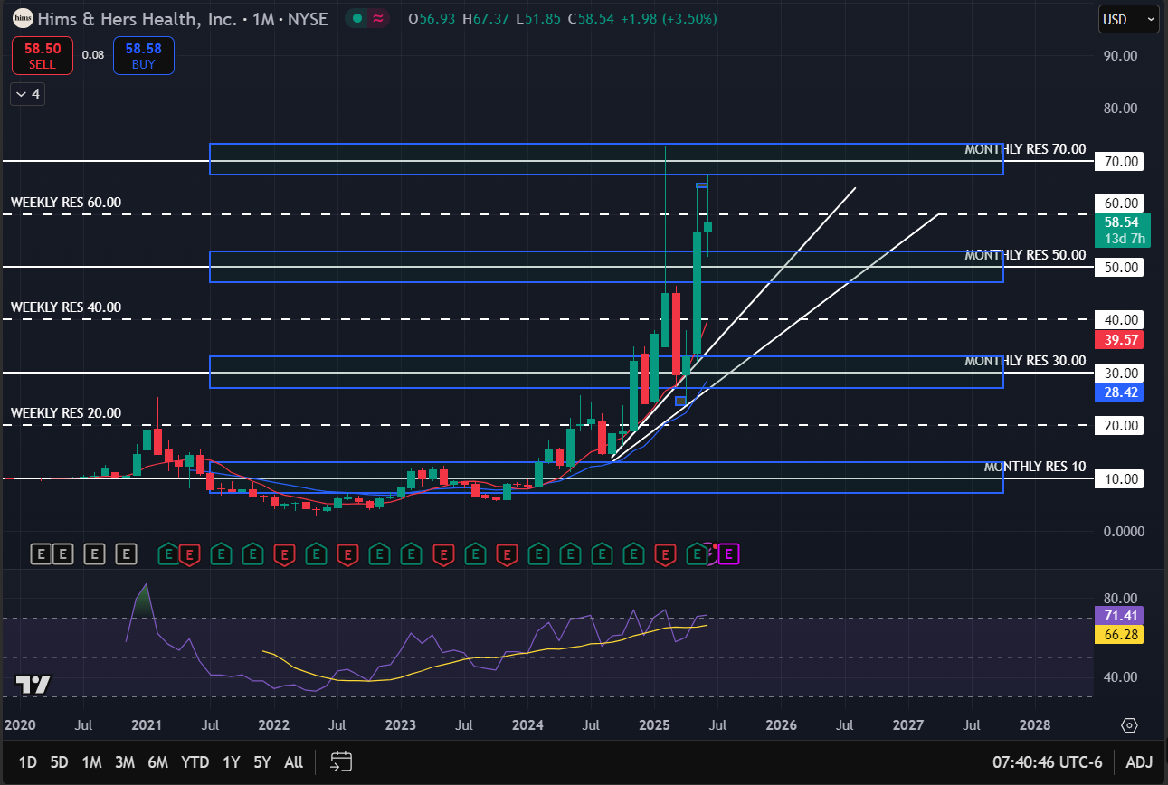
Monthly Chart

Slide 7
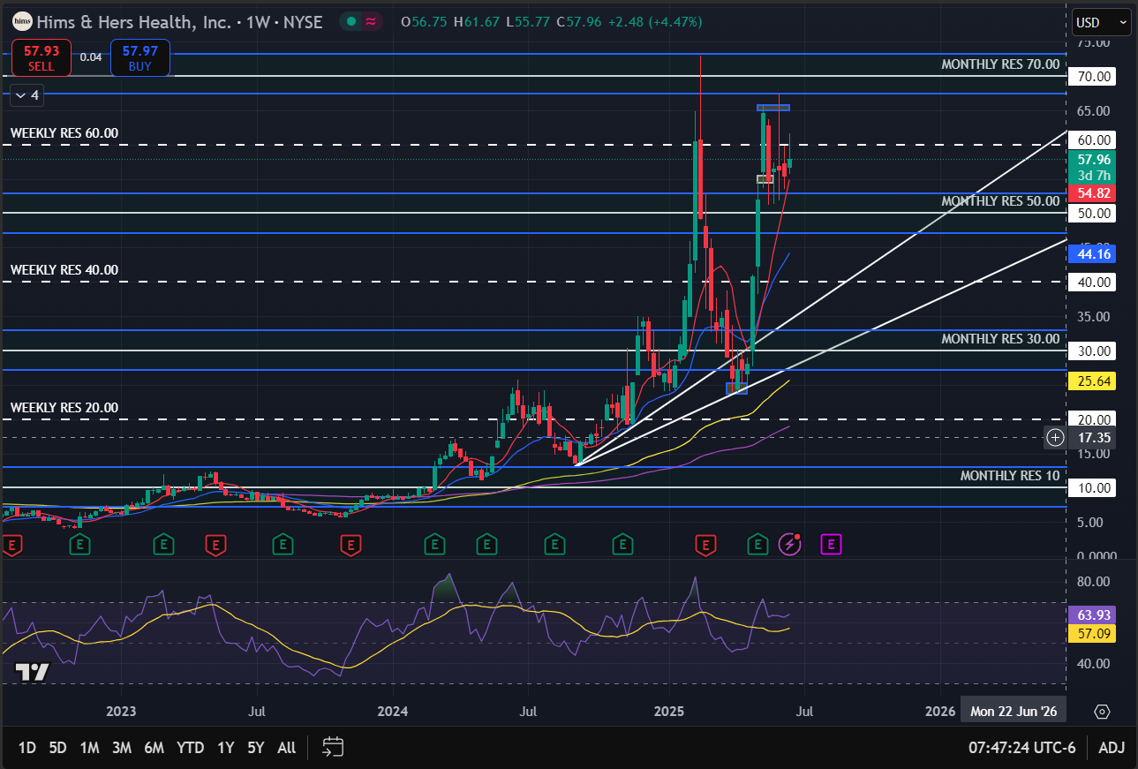
Weekly Chart

Slide 8
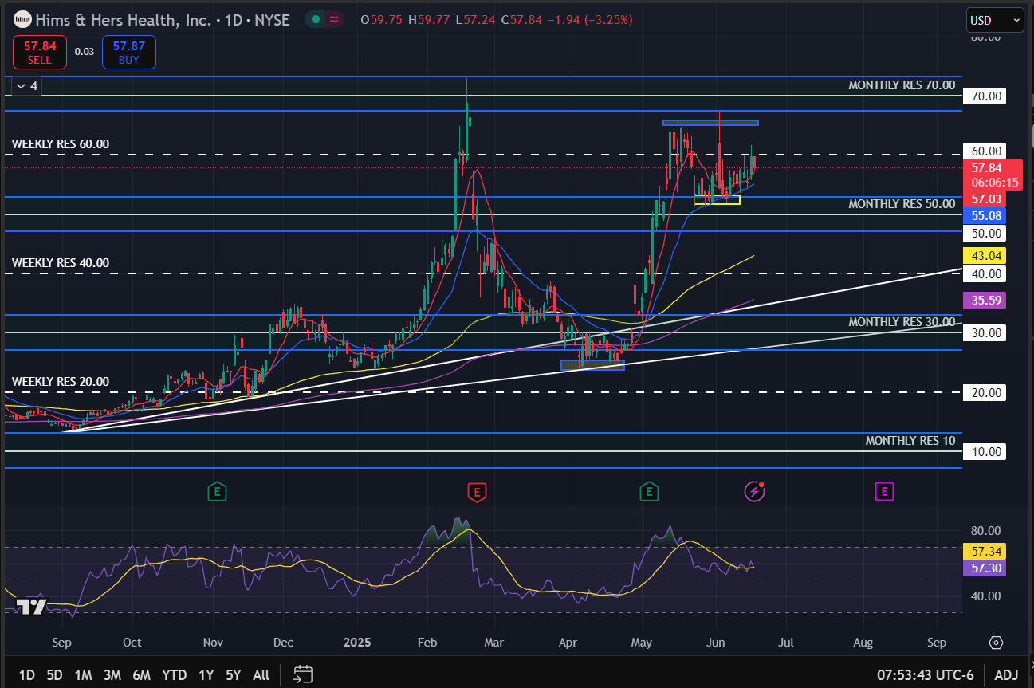
Daily Chart
Higher highs and higher lows in the monthly chart, the stock is following an uptrend for the long run
Key observations:
Cup and handle formation in the daily chart, handle already formed, ready to rally up
RSI in all time frames indicates it’s not yet oversold, but near high levels
Candlestick closely following 8 SMA in weekly and daily charts, indicating momentum
Below the weekly resistance level, bounced back from the support level at the 50 mark and 21 EMA, which acts as resistance on the daily frame

Slide 9
Qualitative Analysis
Hims and Hers, one of the fastest-growing names in telemedicine and the broader market:
Increased subscribers to 2.4M, +38% YoY
Adjusted EPS & operating cash flow quadrupled
Hims plans to acquire ZAVA, accelerating major European growth across the UK, Germany, France, and Ireland
Hims & Hers Health Insider Sold Shares Worth $13,813,792, According to a Recent SEC Filing
Fear of rising inflation due to an increase in oil prices and political tension
Fed holds rates steady, stays on track for 2 cuts in 2025

Slide 10
Investment Recommendation
Fundamentals:
High P/E ratio indicates overvaluation
Outstanding revenue and earnings growth
High return in equity
Technicals:
The stock follows a long-term uptrend
Currently too much momentum
The RSI near overvaluation
Cup and handle formation
Macro & Industry:
Fastest growing name in telemedicine
Increasing subscribers
Currently global tensions are impacting all markets
HOLD
In the short run the stock has plenty of momentum and may follow the upside completing the formation of the cup and handle, moving towards the $70 price mark. However, for the long run the stock may reach an even higher overvaluation which may lead to a correction, where the $50 mark and upward trend may serve a support and keep the upside

Slide 11
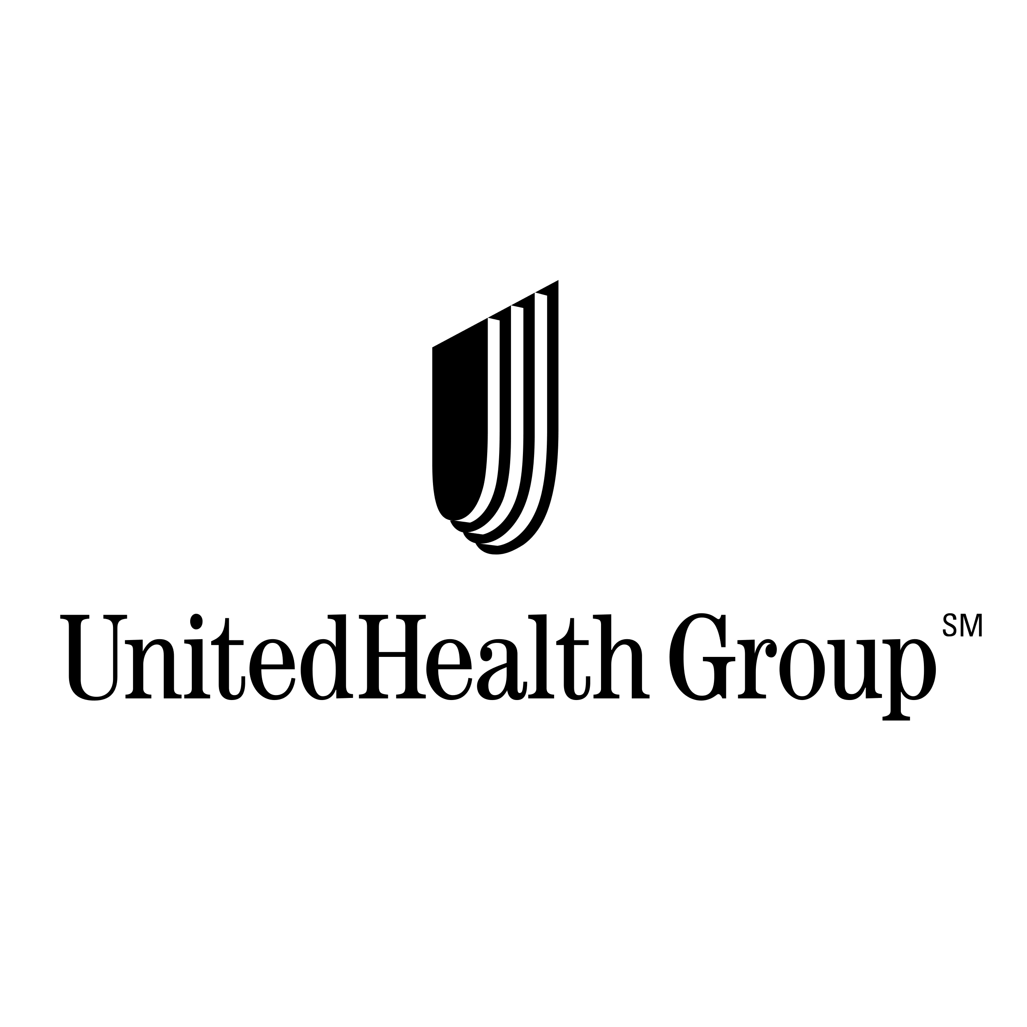
Fundamental Analysis
Stock overview
Stock Ticker | UNH
Company name | Unitedhealth Group Inc
Industry | Healthcare plans
Current stock price | 307.08
Market Cap | 278.56 B
Company Growth
Revenue Growth Rate (YoY) | 8.83%
Earnings Growth Rate (YoY) | 10.11%
Undervalued
Financials | In thousands
Revenue (Last year) | 400,278.00
Net Income (Last year) | 14,405.00
EPS | 27.66
Dividend Yield | 2.82%
Key Financial Ratios
P/E | 12.84
P/B | 2.94
D/E | 0.86
ROE | 24.33%

Slide 12
key financial ratios
Financial Ratios
EPS Growth Next 5 Years – Over 10% | 2.41%
Return on Equity – Over +15% | 24.33%
Debt/Equity – Under 1 | 0.83
Sales Growth Past 5 Years – Over 10% | 10.57%
Return On Investment – Over +15% | 13.29%
Current Ratio – Over 1 | 0.85
EPS Growth Past 5 Years – Over 10% | 1.60%
Price target = 371.73

Slide 13
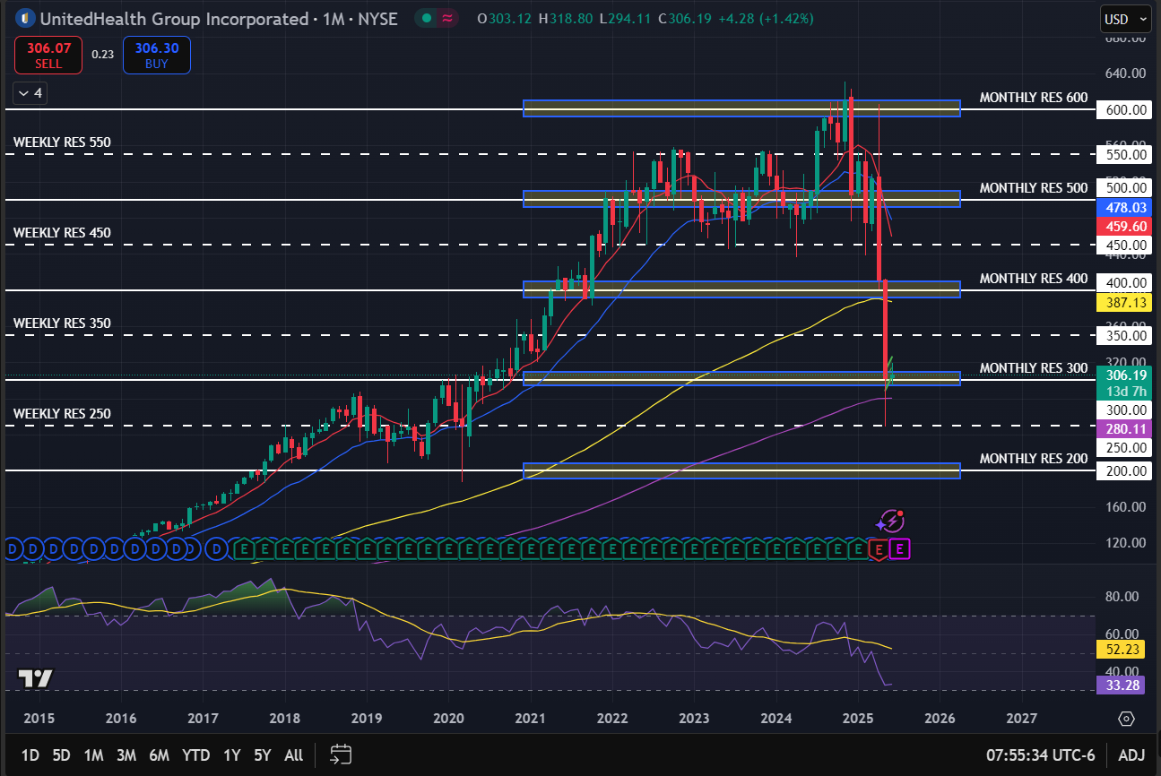
Monthly Chart

Slide 14
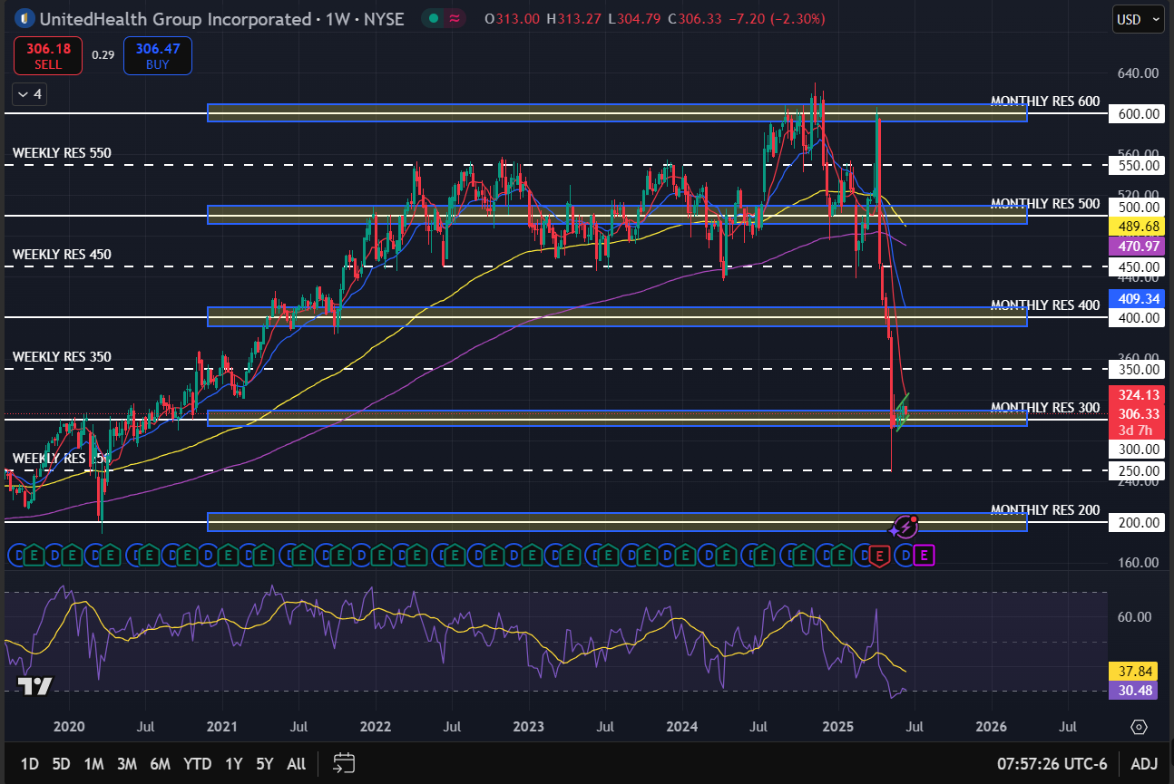
Weekly Chart

Slide 15
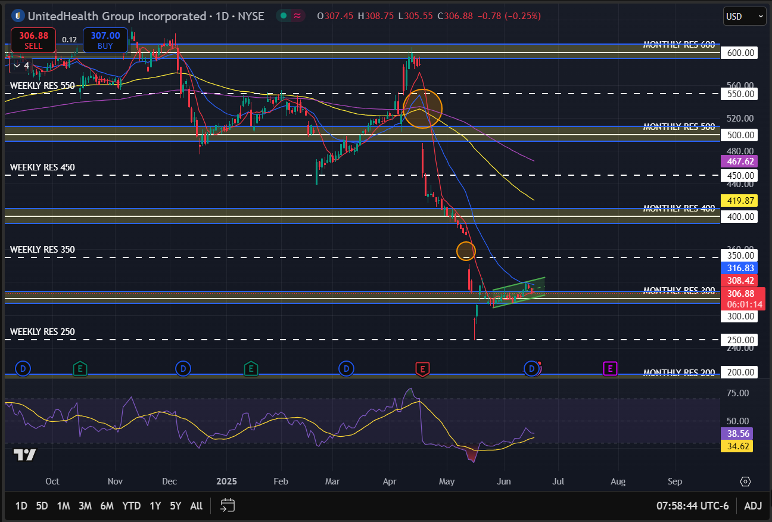
Daily Chart
UNH sank and is currently lying above the $300 support level
Key observations:
Upward channel
RSI in the high 30s, plenty of space for further upside
Candlestick closely following 8 SMA in daily charts, indicating momentum
2 gaps indicate that eventually they will get filled with an upside price move

Slide 16
Qualitative Analysis
UnitedHealth Group Explores Divestment of Latin American Operations Amidst Financial Pressures
UnitedHealth Group (NYSE:UNH) Reaches US$69 Million Record ERISA Settlement
UNITEDHEALTH ALERT: Bragar Eagel & Squire, P.C. Announces that a Class Action Lawsuit Has Been Filed Against UnitedHealth Group Incorporated and Encourages Investors to Contact the Firm
UnitedHealth Cuts Commissions On Some Medicare Advantage Plans - Bloomberg News
Fear of rising inflation due to an increase in oil prices and political tension
Fed holds rates steady, stays on track for 2 cuts in 2025

Slide 17
Investment Recommendation
Fundamentals:
Low P/E ratio, indicates the stock is undervalued
High return on equity
Small growth on revenue and earnings
Technicals:
Currently lying above $300 support level
Upward trending channel on the daily frame
RSI in the lower area in all time frames, enough space for upward movement
Closely following above the 8 SMA, looking to crossover the 21 EMA, a bullish signal
Gaps that will eventually get filled, further support an upside
Macro & Industry:
UnitedHealth Is Cutting Medicare Advantage Commissions
UNH looks to exit Latin America
Lawsuit against UNH
Currently global tensions are impacting all markets
BUY
High risk

Slide 18

Fundamental Analysis
Stock overview
Stock Ticker | CRM
Company name | Salesforce Inc
Industry | Software - Application
Current stock price | 263.50
Market Cap | 251.91 B
Company Growth
Revenue Growth Rate (YoY) | 8.72%
Earnings Growth Rate (YoY) | 24.09%
overvalued
Financials | In thousands
Revenue (Last year) | 37,895.00
Net Income (Last year) | 6,197.00
EPS | 6.95
Dividend Yield | 0.64%
Key Financial Ratios
P/E | 41.22
P/B | 4.16
D/E | 0.20
ROE | 10.31%

Slide 19
key financial ratios
Financial Ratios
EPS Growth Next 5 Years – Over 10% | 12.57%
Return on Equity – Over +15% | 10.31%
Debt/Equity – Under 1 | 0.20
Sales Growth Past 5 Years – Over 10% | 17.25%
Return On Investment – Over +15% | 8.64%
Current Ratio – Over 1 | 0.99
EPS Growth Past 5 Years – Over 10% | 112.11%
Price target = 606.05

Slide 20
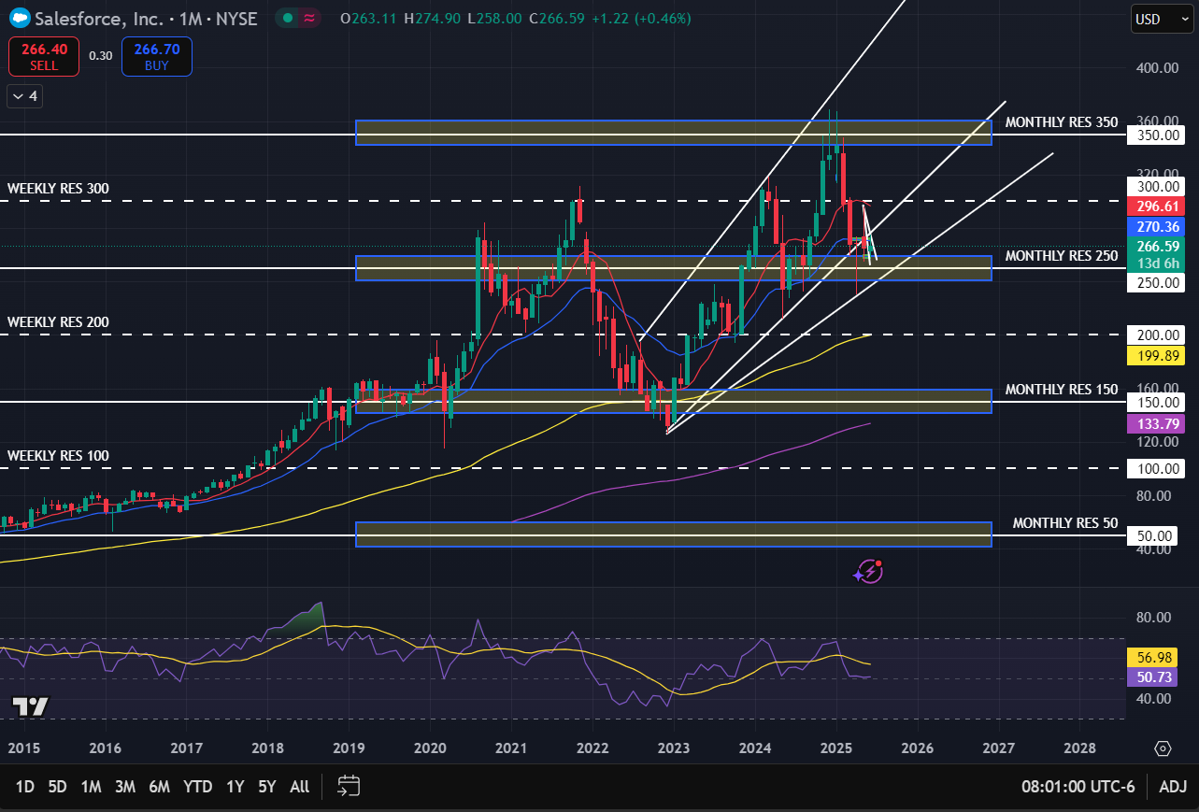
Monthly Chart

Slide 21
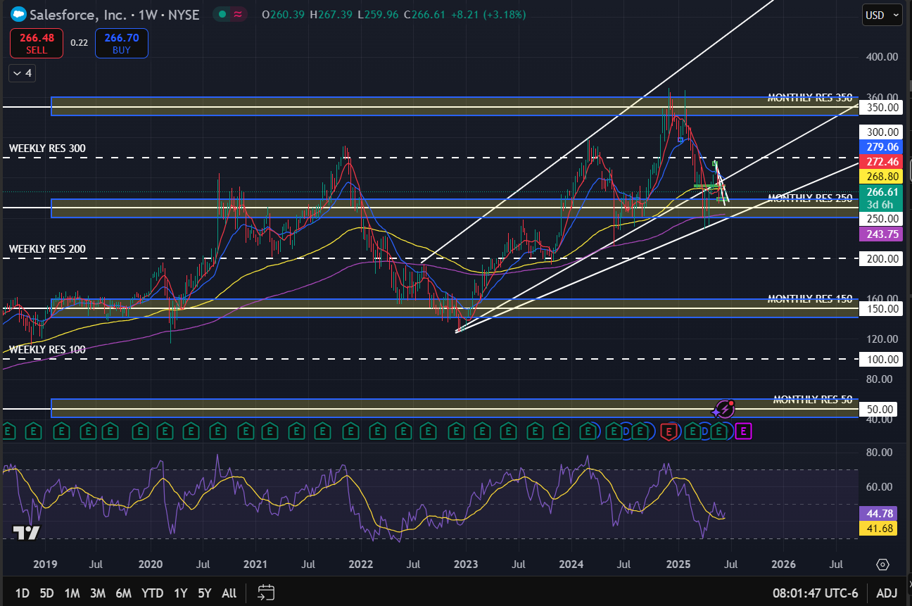
Weekly Chart

Slide 22
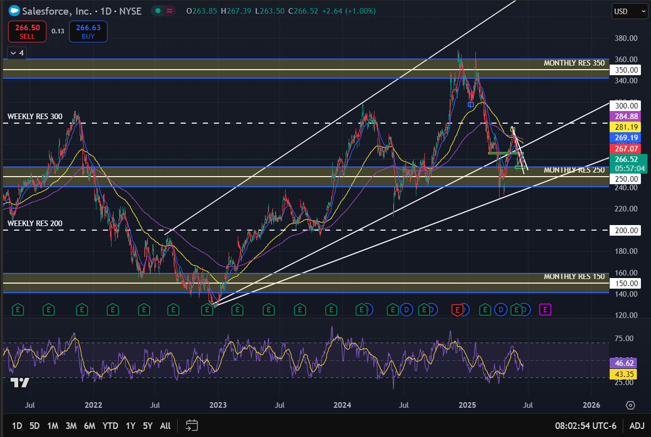
Daily Chart
The stock shows higher highs with higher lows following an uptrend in the long-term run
Key observations:
Earlier 2025 the stock reach all time highs and bounced back from the monthly resistance at the $350 mark
April 2025 the stock broke the outer trend line and found support at the monthly $250 resistance level and the long-term uptrend
RSI is in the middle, giving enough space for either the upside or further downside

Slide 23
Qualitative Analysis
Salesforce Raises Prices Amid AI Push
Salesforce's Agentforce 2.0 Platform Usage Expands With Execution Still in Early Stages, RBC Capital Says
Salesforce Declares Quarterly Cash Dividend Of $0.416 Per Share
Fear of rising inflation due to an increase in oil prices and political tension
Fed holds rates steady, stays on track for 2 cuts in 2025

Slide 24
Investment Recommendation
Fundamentals:
High P/E ratio, indicates overvaluation
Reasonable P/B ratio for long-term growth
Low leverage
Outstanding EPS growth
Technicals:
The stock is currently on an upward trend for the long run
Broke the outer trend line in April, may find support at the long-term trend line right by the $250 support level
The RSI has enough space for the further downside
21 EMA crossing over 8 SMA early June on the daily chart, indicating bearish price action. Following closely the 8 SMA and the 21 EMA acting as resistance
Macro & Industry:
Currently global tensions are impacting all market (fears of inflation and interest rates)
list prices for its Enterprise and Unlimited Editions will go up by an average of 6%
HOLD
Good buying opportunity at $250

Slide 25

Fundamental Analysis
Stock overview
Stock Ticker | HUBS
Company name | HubSpot Inc
Industry | Software - Application
Current stock price | 549.57
Market Cap | 28.98 B
Company Growth
Revenue Growth Rate (YoY) | 21.07%
Earnings Growth Rate (YoY) | 37.86%
overvalued
Financials | In thousands
Revenue (Last year) | 2,627.54
Net Income (Last year) | 4.63
EPS | -0.26
Dividend Yield | -
Key Financial Ratios
P/E | -
P/B | 14.33
D/E | 0.33
ROE | -1.34%

Slide 26
key financial ratios
Financial Ratios
EPS Growth Next 5 Years – Over 10% | 20.48%
Return on Equity – Over +15% | -1.34%
Debt/Equity – Under 1 | 0.33
Sales Growth Past 5 Years – Over 10% | 31.24%
Return On Investment – Over +15% | -1.02%
Current Ratio – Over 1 | 1.55
EPS Growth Past 5 Years – Over 10% | -
Price target = -

Slide 27
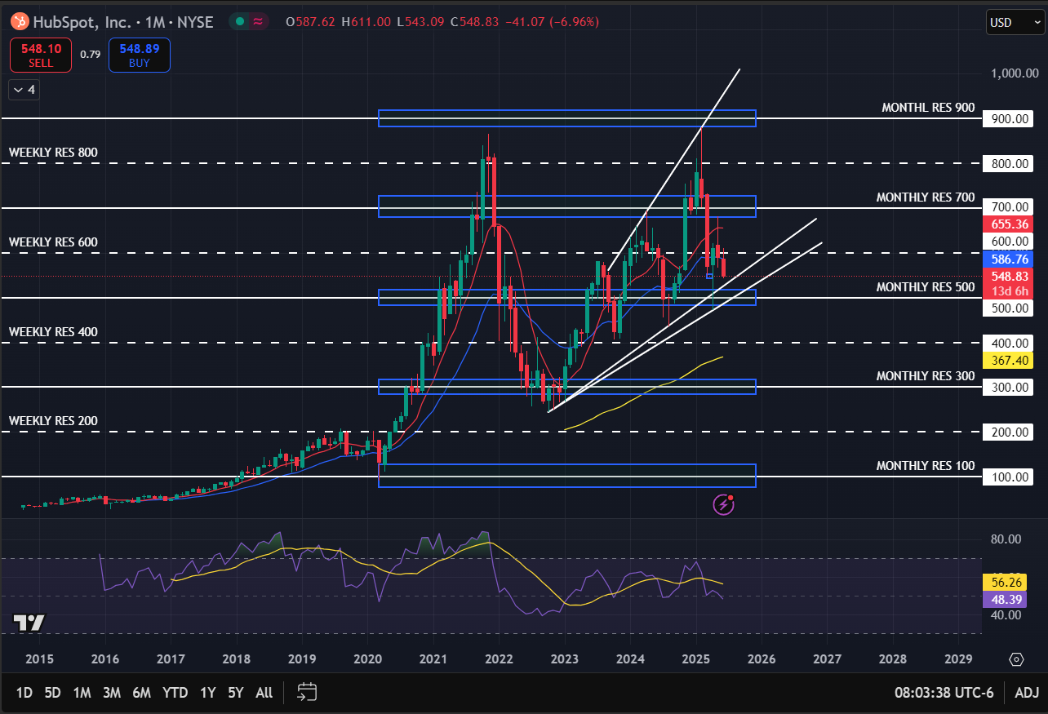
Monthly Chart

Slide 28
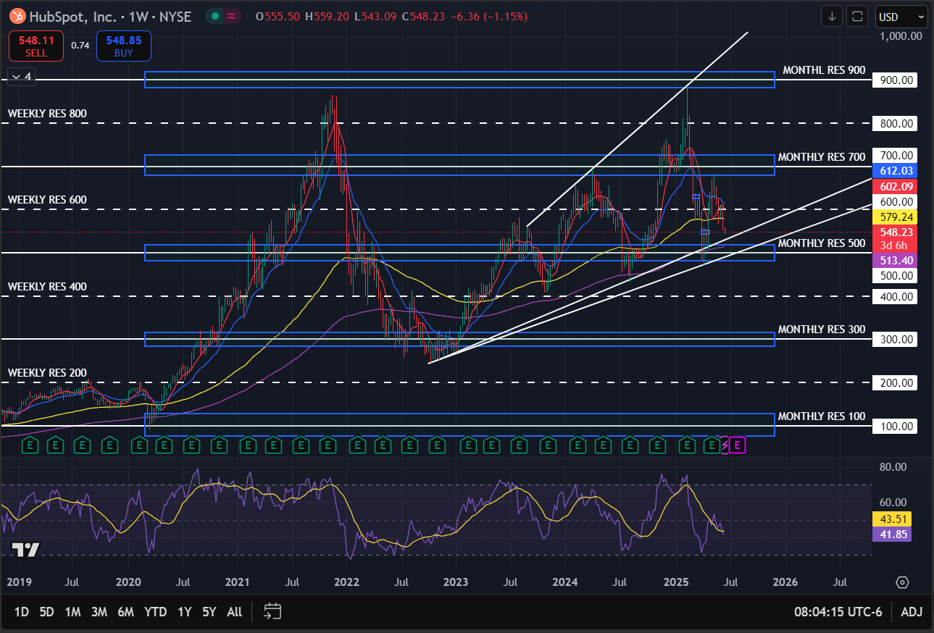
Weekly Chart

Slide 29
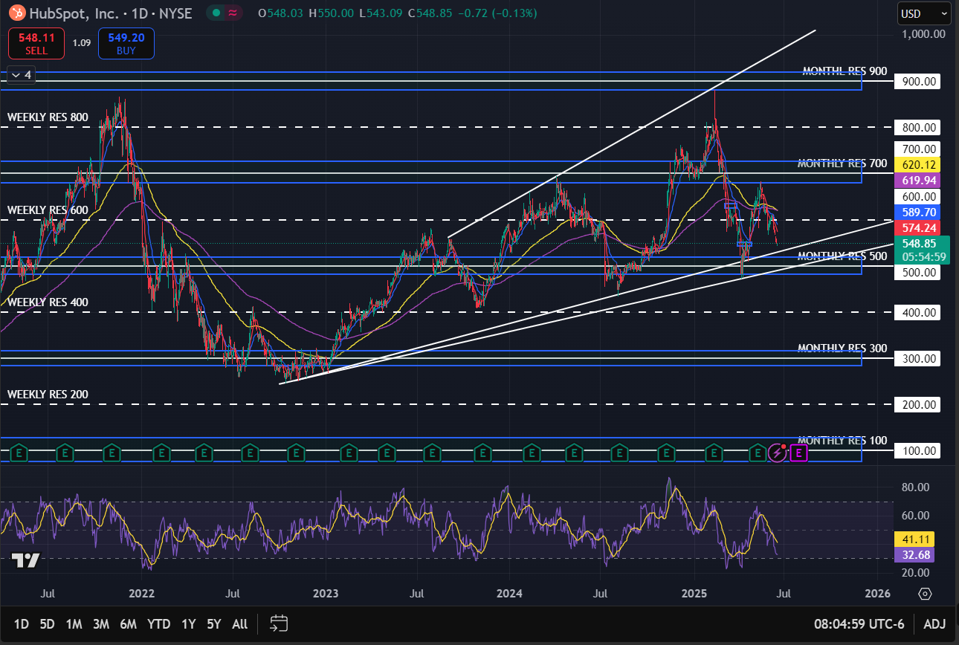
Daily Chart
UNH sank and is currently lying above the $300 support level
Key observations:
Upward channel
RSI in the high 30s, plenty of space for further upside
Candlestick closely following 8 SMA in daily charts, indicating momentum
2 gaps indicate that eventually they will get filled with an upside price move

Slide 30
Qualitative Analysis
Hubspot Insider Sold Shares Worth $364,690, According to a Recent SEC Filing
HubSpot Is Maintained at Overweight by Wells Fargo
Fear of rising inflation due to an increase in oil prices and political tension
Fed holds rates steady, stays on track for 2 cuts in 2025

Slide 31
Investment Recommendation
Fundamentals:
High P/B ratio, which shows overvaluation
Negative earnings per share are mainly due to its aggressive investment for future growth
Good cash flow
High earnings growth rate
Technicals:
The stock broke the $600 support level and is heading towards the $500 monthly support level
It may find support on the outer trend line, major support at $500 where the long-term trend line also intersects
RSI is down, may come down a little bit further before the stock gets oversold
Macro & Industry:
Currently global tensions are impacting all market (fears of inflation and interest rates)
HOLD
Good buying opportunity at $500

