Slide 1
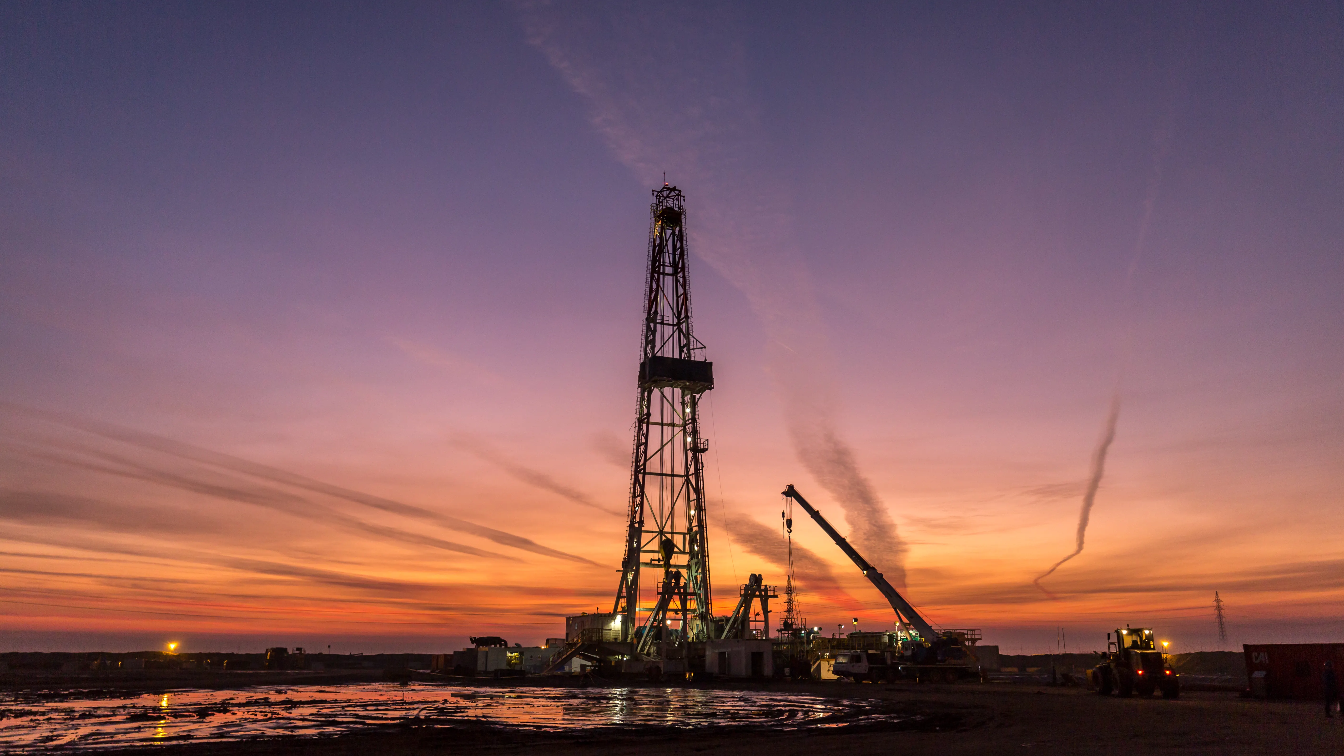

Diamondback Energy (NASDAQ:FANG)
Current Stock Price: $160.86 (March 31, 2025)
Long: $265.61(65.1%)
Q4 2030
Darin Stuart
TCU Finance Club
March 31,2025

Slide 2
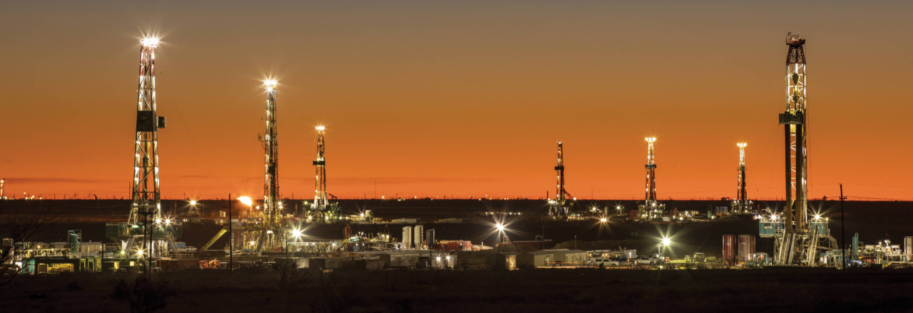
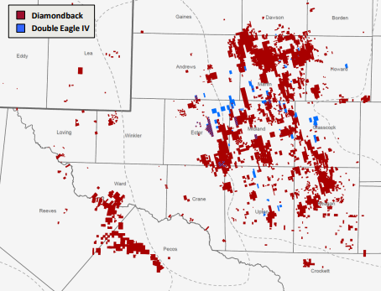
Executive Summary
Diamondback & Double Eagle IV Acreage
Company Overview
Diamondback Energy is a leading independent oil and gas producer focused on unconventional resources in the Permian Basin. Its core activities include the exploration, development, production, and sale of petroleum, natural gas, and natural gas liquids.
Recent major acquisitions: $26 billion Endeavor merger; $4.1 billion Double Eagle IV deal
Diamondback Market Snapshot
NASDAQ Symbol | FANG
Market Cap | $46.56billion
Net Debt | $12.99 billion
Enterprise Value | $60.313 billion
Share Count | 289 million
Annual Base Dividend | $4.00 (2.6% current yield)
Revenue | 10.56 billion
Current PE | 10.37
Current EPS | 15.53
Current EV/EBITDA | 8.28
Current EV/FCF | 16.56
Beta | 1.393
Pro forma scale of approximately 885,000 net acres with ~500 Mbo/d (~900 Mboe/d) of run-rate production beginning in Q2 2025
Best in class inventory depth and quality with ~8,400 gross Midland Basin locations economic at $50 / Bbl

Slide 3




Executive Summary contd.
Diamondback Differentiation
Management Team
High-Quality Asset Base: Diamondback controls approximately 885,000 net acres in the Permian Basin and maintains an oil-weighted reserve mix—with 50% of its proved reserves being oil—that supports robust production averaging 598,000 BOE/d in 2024. ​
Low-Cost Production Efficiency: With operating costs averaging about $10.30 per BOE, the company can break even at WTI prices below $40 per barrel, even in half-cycle market conditions.
​Disciplined Capital Allocation: Diamondback returned roughly 51% of Q4 Adjusted Free Cash Flow to shareholders through an increased base dividend (now $4.00 per share) and share repurchases, contributing to an investment-grade balance sheet with consolidated net debt of approximately $13 billion and liquidity of about $2.6 billion. ​
Strategic M&A for Scale and Synergy: Its $26 billion Endeavor merger and $4.1 billion Double Eagle IV acquisition have expanded its asset base and production capabilities, setting it apart from peers with smaller scales.
​Superior Capital Efficiency: Generating $3.6 billion of free cash flow in 2024 (or $18.76 per share Adjusted FCF), Diamondback outperforms competitors in capital efficiency, ensuring sustainable growth and enhanced shareholder returns. ​
Travis Stice
Chairman of the Board and Chief Executive Officer
Mr. Stice has been CEO since January 2012 and Chairman since February 2022. He will step down as CEO at the 2025 Annual Meeting and serve as Executive Chairman through 2026.
Kaes Van't Hof
President
Mr. Van't Hof has served as President since February 2022. He will become CEO and join the Board after the 2025 Annual Meeting.
Jere Thompson
Executive Vice President and Chief Financial Officer
Mr. Thompson was appointed EVP and CFO in February 2025, previously serving as EVP of Strategy and Corporate Development.
Danny Wesson
Executive Vice President and Chief Operating Officer
Mr. Wesson has been EVP and COO since February 2022, having joined Diamondback in February 2012 and held various operational leadership roles.

Slide 4
Industry Overview
Permian Basin Market Dynamics
Basin | Existing Wells Breakeven ($/bbl) | New Wells Breakeven ($/bbl) | Notes
Permian (Delaware) | $38 | $59 | Lowest breakeven price among major basins
Permian (Midland) | $38 | $66 | Higher costs offset by strong production
Eagle Ford | $45 | $66 | Lower production despite lower costs
Other Basins | $31-45 | $59-70 | Varies by specific region
Dominant Production Hub: Contributes 46% of US crude oil production, 20% of US natural gas production, and 51% of rig count activity
Growth Trajectory: Production increasing at ~485,000 barrels per day annually (equivalent to Colombia's consumption)
Record Activity: Nearly 40% of total US upstream M&A deal value in 2024 occurred in the Permian
Infrastructure Expansion: New midstream projects addressing takeaway constraints, including the 2.5 Bcf/d Matterhorn Express Pipeline (operational Oct 2024)
Capital Discipline: Industry-wide focus on shareholder returns and operational efficiency rather than production growth at any cost
Period | Brent Crude ($/barrel) | WTI Crude ($/barrel)
2025 | $70-75 | $65-70
2026 | $65-75 | $60-70
2027 | $60-85 | $55-80
2028 | $73-109 | $68-105
2030 | $70-81 | $65-77
2040 | $81 | $76
2050 | $87 | $82

Slide 5
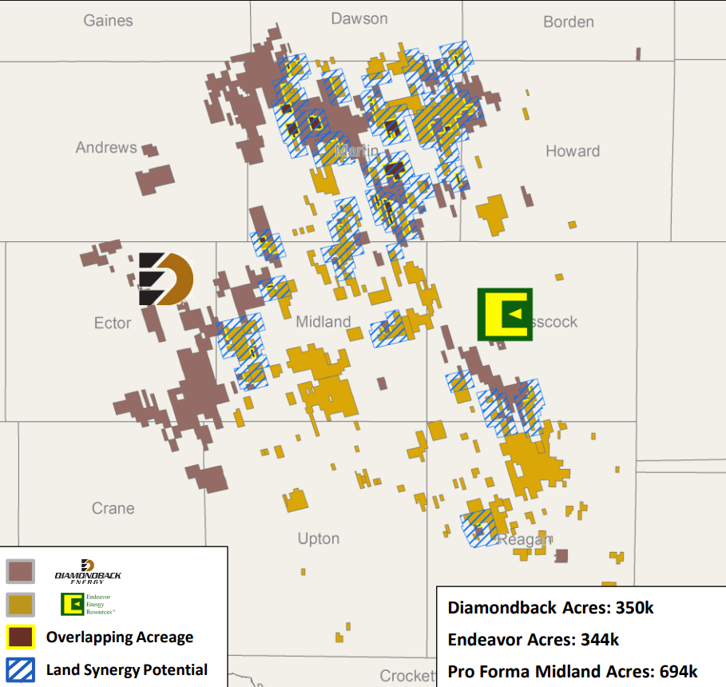
Recent M&A - Endeavor
High-Quality Inventory Depth: The combined company gained approximately 6,100 pro forma drilling locations with break-evens below $40 WTI, providing years of high-return development opportunities and supporting Diamondback's focus on capital efficiency over production growth.
Significant Cost Synergies: The merger is delivering annual synergies of $550 million (representing over $3 billion in NPV10 over the next decade), including $325 million in capital and operating cost synergies, $150 million in capital allocation and land synergies, and $75 million in financial and corporate cost synergies.
Enhanced Financial Performance: The acquisition has improved Diamondback's free cash flow generation, with the company's post-dividend breakeven oil price reduced to $37 per barrel (down from $40), enabling stronger shareholder returns even in lower commodity price environments.
Operational Efficiencies: The integration has progressed ahead of schedule, with Diamondback applying its operational expertise to the combined asset base, reducing well costs to $600 per lateral foot in core Midland Basin areas and improving capital efficiency across the portfolio.

Slide 6
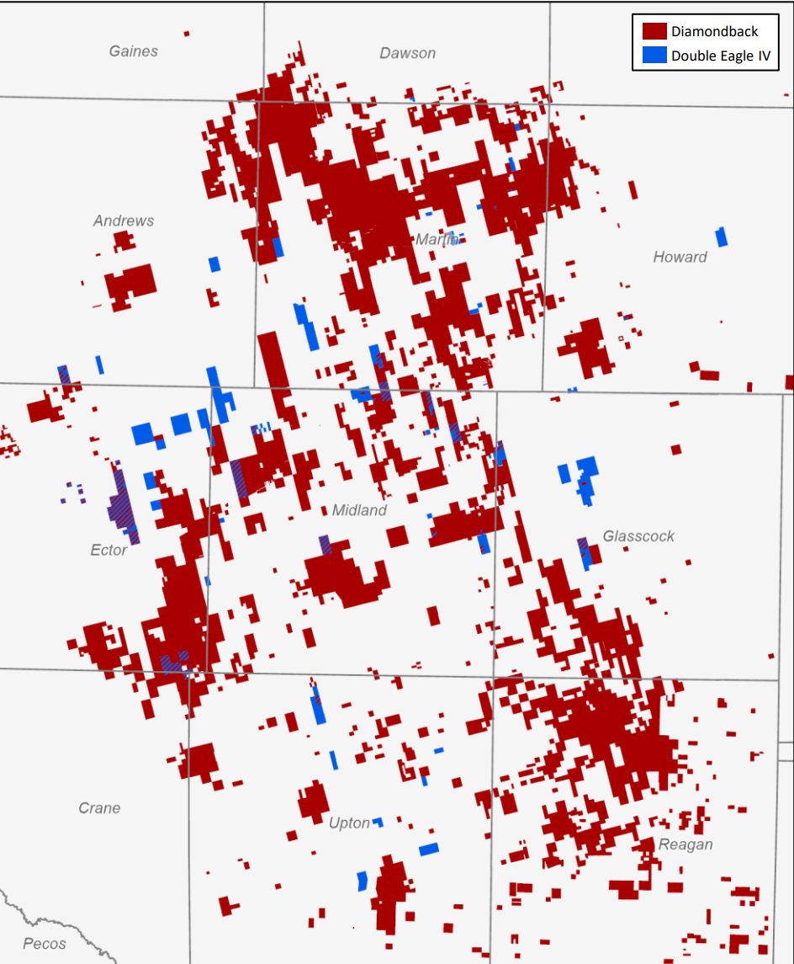
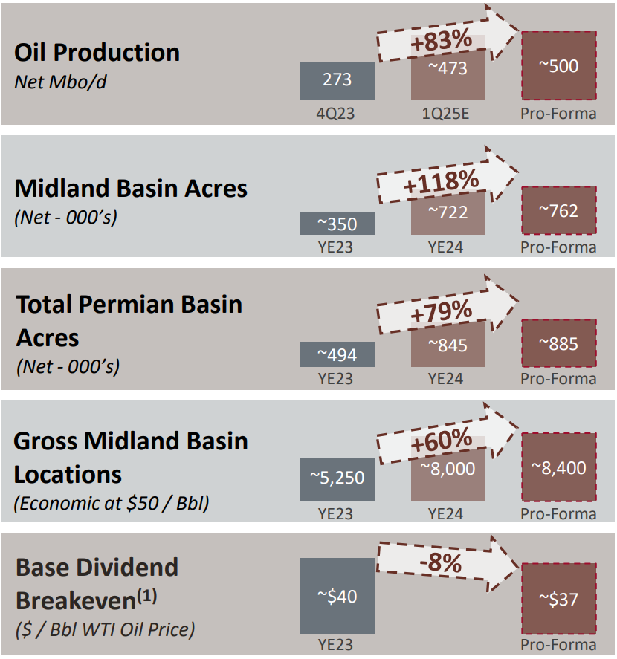
Recent M&A – Double Eagle IV
Diamondback & Double Eagle IV Acreage
Pro Forma Asset Overview

Slide 7
Exceptional Historical Growth
Year | EPS ($) | Revenue ($ millions) | FCF/Share ($) | Current Ratio
2024 | 15.53 | 11,066 | 18.79 | 0.44
2023 | 17.34 | 8,412 | 25.70 | 0.77
2022 | 24.61 | 9,643 | 26.70 | 0.81
2021 | 12.24 | 6,797 | 18.55 | 1.01
2020 | -28.61 | 2,813 | 11.67 | 0.49
2019 | 1.47 | 3,964 | 17.06 | 0.69
2018 | 8.06 | 2,176 | 0.24 | 0.91
2017 | 4.94 | 1,205 | 0.22 | 0.62
2016 | -2.20 | 527 | 0.39 | 8.56
2015 | -8.74 | 447 | 0.09 | 0.77

Slide 8
Competition
Ticker | Company Name |  | Market Cap (USD mil) | Trailing P/E | Forward P/E
FANG | Diamondback Energy Inc |  | 46,562 | 13.9x | 12.2x
APA | APA Corp (US) |  | 7,693 | 9.6x | 7.5x
CLR | Continental Resources Inc |  | 26,561 | 7.5x | 19x
COG | Cabot Oil & Gas Corp |  | 8,893 | 32.6x | 24.5x
DVN | Devon Energy Corp |  | 24,383 | 8.4x | 7.5x
MRO | Marathon Oil Corp |  | 15,971 | 12x | 9x
MUR | Murphy Oil Corp |  | 4,193 | 10.3x | 9.4x
PDCE | PDC Energy Inc |  | 6,425 | 3.5x | 3.5x
RRC | Range Resources Corp |  | 9,706 | 27.1x | 30.6x
TOU.TO | Tourmaline Oil Corp |  | 18,112 | 20.5x | 14x
Ticker | Company Name |  | Market Cap (USD mil) | Trailing EV/EBITDA | Forward EV/EBITDA
FANG | Diamondback Energy Inc |  | 46,562 | 7.8x | 5.6x
APA | APA Corp (US) |  | 7,693 | 2.5x | 3.3x
CLR | Continental Resources Inc |  | 26,561 | 3.7x | 6x
COG | Cabot Oil & Gas Corp |  | 8,893 | 12.8x | 7.1x
EQT | EQT Corp |  | 32,190 | 18.7x | 16.9x
MRO | Marathon Oil Corp |  | 15,971 | 4.8x | 5.4x
OAS | Oasis Petroleum Inc |  | 2,145 | 1.5x | 1.4x
PXT.TO | Parex Resources Inc |  | 921 | 1.3x | 1.3x
TOU.TO | Tourmaline Oil Corp |  | 18,112 | 9.2x | 5.9x
XEC | Cimarex Energy Co |  | 8,966 | 7.2x | 7.2x

Slide 9
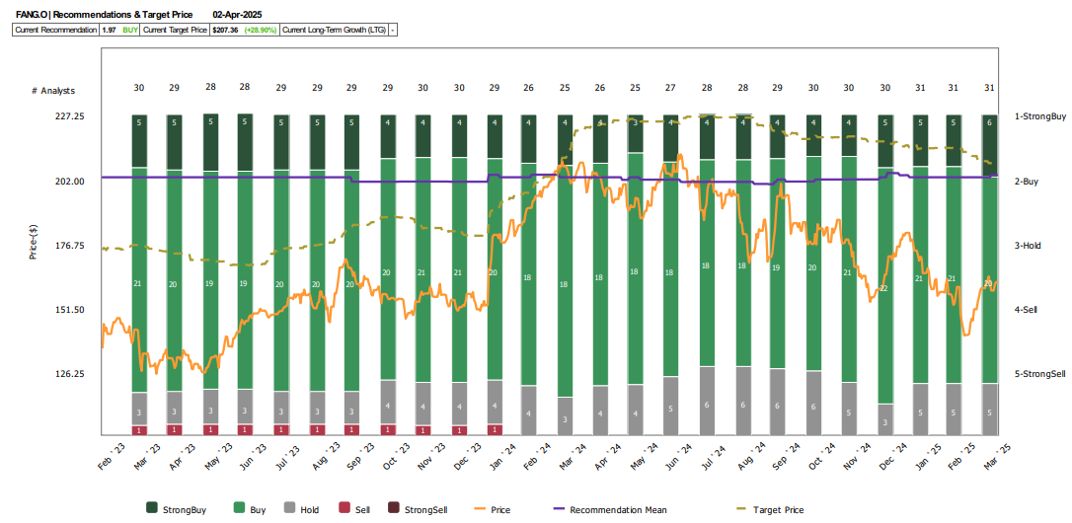

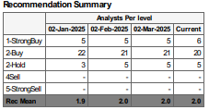
Analyst Views

Slide 10
DCF Valuation
(USD in millions) |  |  | Projections
 |  |  | FY25 | FY26 | FY27 | FY28 | FY29 | Terminal
Profit before tax |  |  | 4,787 | 5,619 | 6,742 | 7,974 | 9,509 | 8,075
(-) Net interest income/expense |  |  | 27 | 32 | 37 | 44 | 51 | 44
(+) Depreciation & Armortization |  |  | 5,878 | 7,060 | 8,303 | 9,629 | 9,945 | 9,292
EBITDA |  |  | 10,638 | 12,647 | 15,007 | 17,559 | 19,402 | 17,323
(-) Tax |  |  | 980 | 1,150 | 1,380 | 1,632 | 1,946 | -
(-): Capex |  |  | 7,087 | 8,206 | 9,718 | 11,347 | 13,366 | -
(-): Change in NWC |  |  | (427) | 276 | 385 | 129 | 391 | -
Free Cash Flow (FCF) |  |  | 2,997 | 3,015 | 3,524 | 4,451 | 3,699
Terminal value |  |  |  |  |  |  |  | 103,937
WACC / Discount rate |  | 6.81%
Long-term growth rate |  | 2.00%
Timing of FCF (mid year) |  |  | 0.50 | 1.50 | 2.50 | 3.50 | 4.50 | 5.00
Present value of FCF |  |  | 2,900 | 2,732 | 2,989 | 3,535 | 2,751 | 74,785
Enterprise value | 89,692
Projection period | 14,907 | 16.6%
Terminal value | 74,785 | 83.4%
(-) Current net debt | 12,814
Equity value | 76,878
(/) Outstanding shares | 289
Fair price | 265.61
 |  |  | Projections
 |  |  | FY25 | FY26 | FY27 | FY28 | FY29 | Terminal
Low | WACC | 7.59%
 | Long-term growth rate | 1.0%
 | Terminal value |  |  |  |  |  |  | 75,528
 | Present value of FCF |  | 2,890 | 2,702 | 2,935 | 3,446 | 2,662 | 52,393
 | Enterprise value | 67,027
 | Equity value | 54,213
 | Fair price | 187.30
 | Fair price (USD) | 187.30
High | WACC | 6.02%
 | Long-term growth rate | 3.0%
 | Terminal value |  |  |  |  |  |  | 128,882
 | Present value of FCF |  | 2,911 | 2,762 | 3,045 | 3,628 | 2,843 | 96,211
 | Enterprise value | 111,400
 | Equity value | 98,586
 | Fair price | 340.61
 | Fair price (USD) | 340.61

Slide 11
DCF Drivers
Revenue and Expense Drivers
Change in Working Capital Forecast
(USD in millions except days) |  |  |  | Projections
 | Historical Avg | Dec-2024 |  | Dec-2025 | Dec-2026 | Dec-2027 | Dec-2028 | Dec-2029
Days receivables | 39 |  |  | 39 | 43 | 45 | 42 | 43
Trade receivables |  | 1,585 |  | 1,233 | 1,568 | 1,942 | 2,136 | 2,580
Days payables | 37 |  |  | 37 | 40 | 35 | 38 | 38
Trade payables |  | (253) |  | (338) | (407) | (420) | (510) | (589)
Days inventory | 14 |  |  | 14 | 13 | 14 | 14 | 14
Inventory |  | 116 |  | 127 | 137 | 161 | 185 | 212
Net working capital |  | 1,448 |  | 1,021 | 1,297 | 1,683 | 1,812 | 2,203
Change in NWC |  |  |  | (427) | 276 | 385 | 129 | 391
(USD in millions) |  |  | Projections
 | Dec-2024 |  | Dec-2025 | Dec-2026 | Dec-2027 | Dec-2028 | Dec-2029
Revenue | 11,066 |  | 11,604 | 13,436 | 15,911 | 18,578 | 21,883
% Growth | 32% |  | 5% | 16% | 18% | 17% | 18%
Cost of goods sold | (3,201) |  | (3,289) | (3,733) | (4,332) | (4,957) | (5,722)
% of Revenue | 29% |  | 28% | 28% | 27% | 27% | 26%
Selling, G&A expenses | (213) |  | (223) | (259) | (306) | (358) | (421)
% of Revenue | 2% |  | 2% | 2% | 2% | 2% | 2%
Research & Development | - |  | - | - | - | - | -
% of Revenue | 0% |  | 0% | 0% | 0% | 0% | 0%
Net interest incomes/expenses | 26 |  | 27 | 32 | 37 | 44 | 51
% of Revenue | 0.2% |  | 0.2% | 0.2% | 0.2% | 0.2% | 0.2%
Other incomes/expenses | (3,177) |  | (3,331) | (3,857) | (4,568) | (5,334) | (6,283)
% of Revenue | -28.7% |  | -28.7% | -28.7% | -28.7% | -28.7% | -28.7%
Tax expense | (800) |  | (980) | (1,150) | (1,380) | (1,632) | (1,946)
Tax rate | 18% |  | 20% | 20% | 20% | 20% | 20%
Net profit | 3,701 |  | 3,807 | 4,469 | 5,362 | 6,342 | 7,563
% Margin | 33% |  | 33% | 33% | 34% | 34% | 35%
Capital Expenditure Plan
(USD in millions) |  |  |  | Projections
 |  |  |  | Dec-2025 | Dec-2026 | Dec-2027 | Dec-2028 | Dec-2029
Capex |  |  |  | 7,087 | 8,206 | 9,718 | 11,347 | 13,366
% of Revenue |  |  |  | 61.1% | 61.1% | 61.1% | 61.1% | 61.1%
 |  |  |  | Historical
 |  | 5y Avg |  | Dec-2020 | Dec-2021 | Dec-2022 | Dec-2023 | Dec-2024
Capex |  | 4,870 |  | 2,044 | 2,299 | 3,505 | 4,714 | 11,787
% of Revenue |  | 61.1% |  | 72.7% | 33.8% | 36.3% | 56.0% | 106.5%

Slide 12
Thank You
Appendix

Slide 13
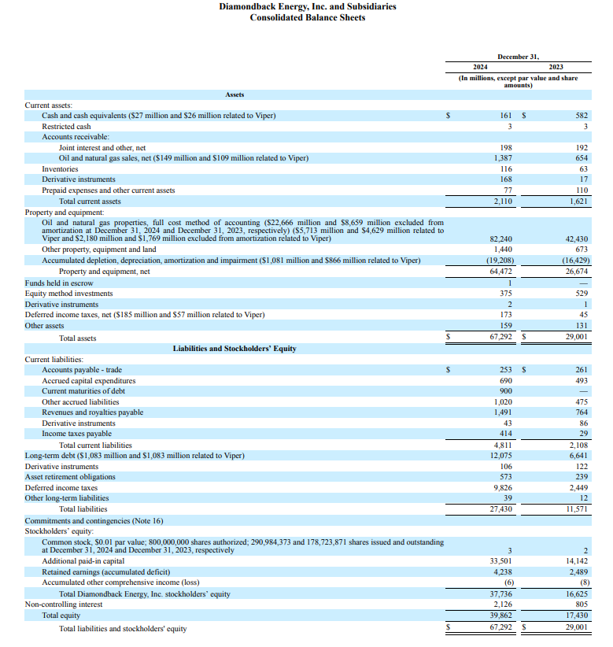
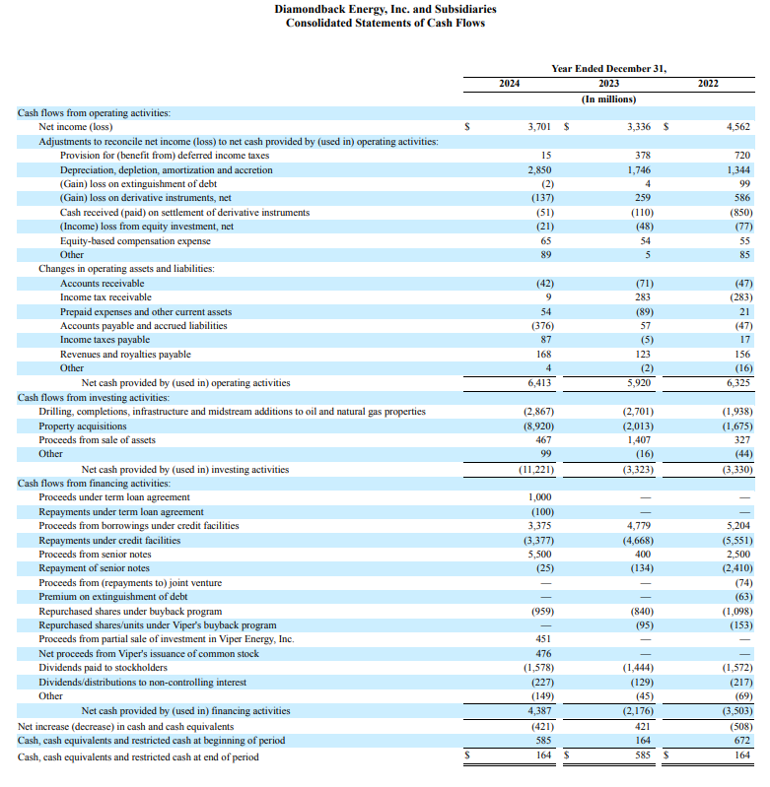
Balance Sheet and Statement of Cash Flows

Slide 14
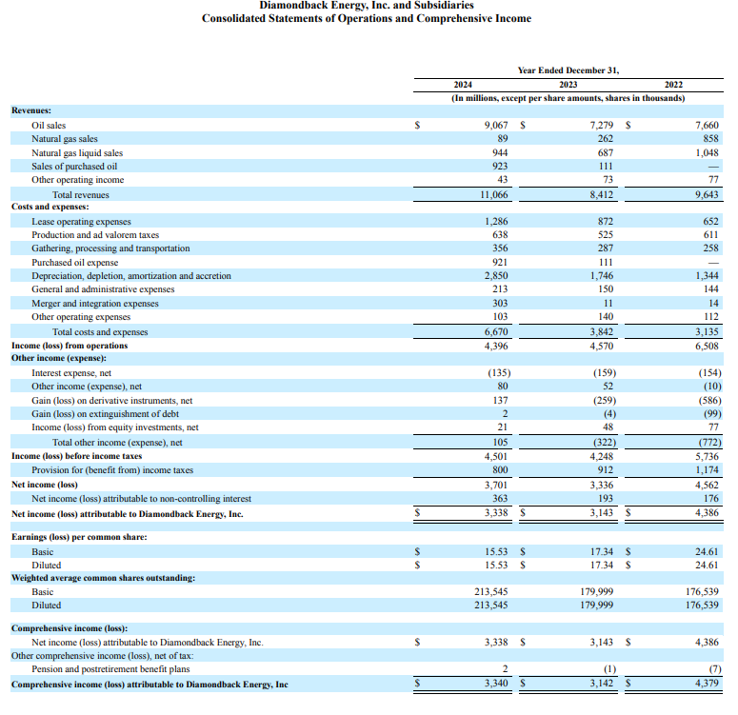
Income Statement

