Slide 1
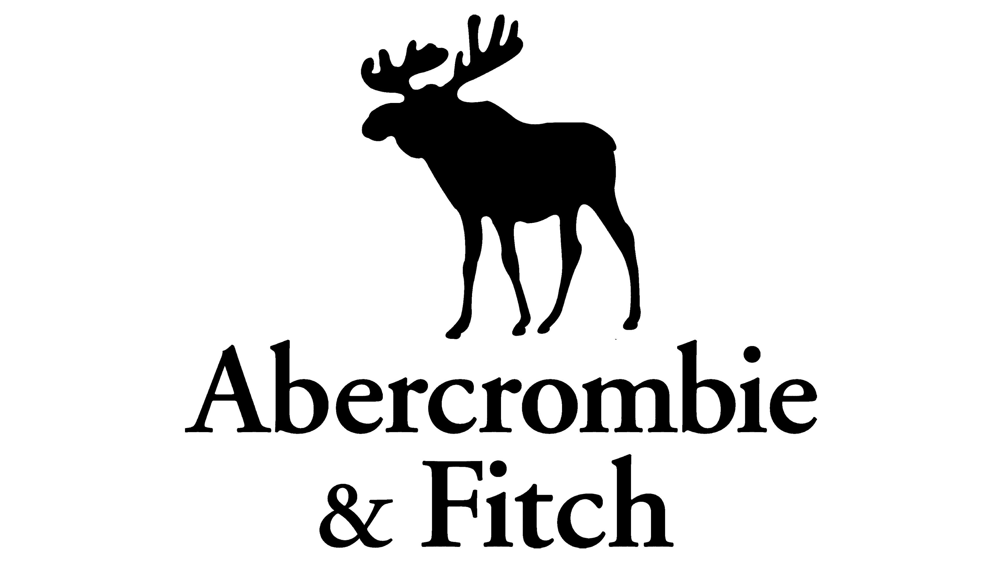
ABERCROMBIE
& FITCH CO.
NYSE: ANF
LONG | $125.00
Ricardo Guzman | Vice President
Landen Brown | Analyst
Tiffany Geere | Analyst
Ben Le | Analyst
Annie Nguyen | Analyst
~46% Upside • Q4 2027 Target
Neeley Equity Research Club
April 30, 2026
True North Advisors
Sources: StockTitan, Investing.com, Robinhood, SEC Filings

Slide 2
COMPANY OVERVIEW
Abercrombie & Fitch Co.
The ANF Story
Relevant Company Information
Ticker | ANF
Exchange | NYSE
Industry | Specialty Retail / Apparel
Last Close | $92.5
Market Cap | ~$4.03B
TTM Revenue | $5.27B
TTM Net Income | $507M
EPS (TTM) | $10.46
P/E Ratio | 8.58x
Gross Margin | 61.5%
Operating Margin | 13.3%
ROE | 36.4%
Beta (5Y) | 1.17
52-Week Range | $65.45 – $133.11
Avg. Analyst Target | $120.83 (+28%)
Founded in 1892, Abercrombie & Fitch spent decades as a prestige outdoor brand before pivoting to cologne-drenched teen fashion in the '90s. By 2016, the brand was in freefall: exclusionary marketing, declining traffic, and an identity crisis.
Then came the turnaround. CEO Fran Horowitz took the wheel in 2017 and engineered one of retail's most compelling reinventions; shedding the logo-heavy aesthetic, embracing inclusivity, investing in digital-first strategy, and repositioning ANF for millennial young adults while Hollister dominated Gen Z.
Fiscal 2025:
$5.27B in revenue (+6.4% YoY)
$507M net income
13.3% operating margin
12 consecutive quarters of growth
750+ stores across 4 continents.
Sources: Yahoo Finance, SEC Filings — As of April 21, 2026

Slide 3



COMPANY OVERVIEW (CONT.)
Brands, Revenue & Management
Abercrombie
& Fitch
Hollister
Co.
Gilly Hicks
Active
Abercrombie
Kids
Target: Young Adults
25–34
Target: Teens
15–24
Target: All Ages
Target: Ages 5–14
$2.56B
52%
$1.86B
37%
~$0.4B
8%
~$0.15B
3%
Premium casual. Reset underway.
+19–22% growth engine.
Athleisure. Fast growing.
Niche loyalty driver.
How does Abercrombie make money?
Leadership
Abercrombie & Fitch generates revenue primarily through the sale of its apparel, accessories, and personal care products across its portfolio of brands. The company earns income through direct-to-consumer channels, including its e-commerce platforms and physical retail stores located in key markets worldwide.
CEO:
Fran Horowitz — Since 2017. Architect of the turnaround.
CFO:
Robert J. Ball — Joined 2025 from Gap. Operationally sharp.
COO:
Scott Lipesky — Supply chain & digital excellence.
Sources: ANF Investor Relations, SEC Filings, StockAnalysis.com

Slide 4
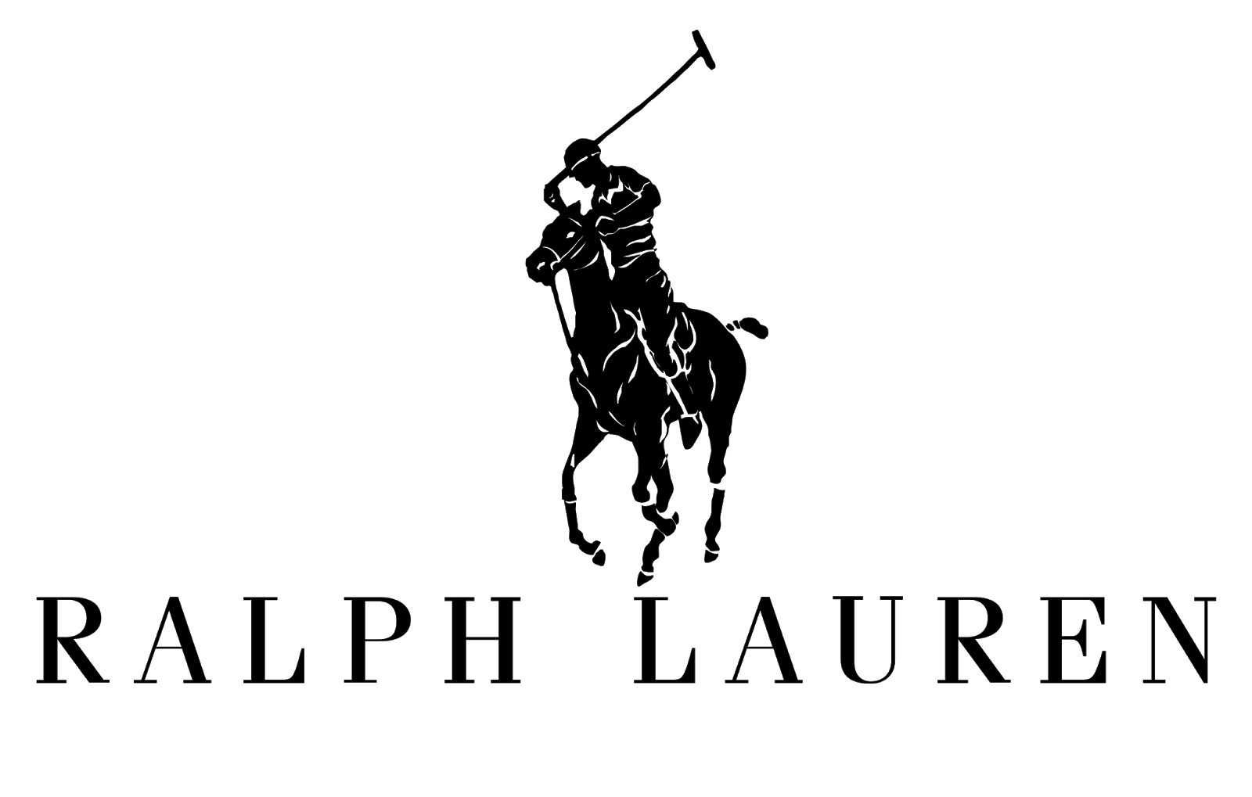
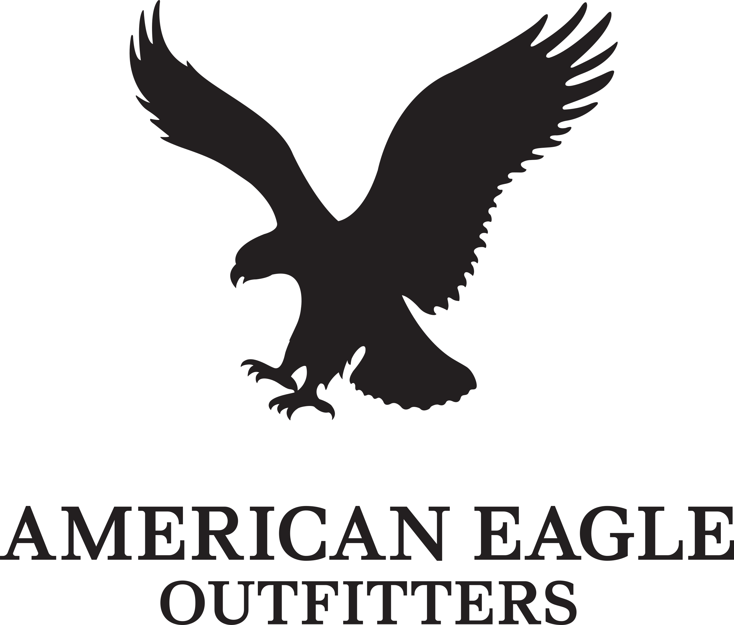
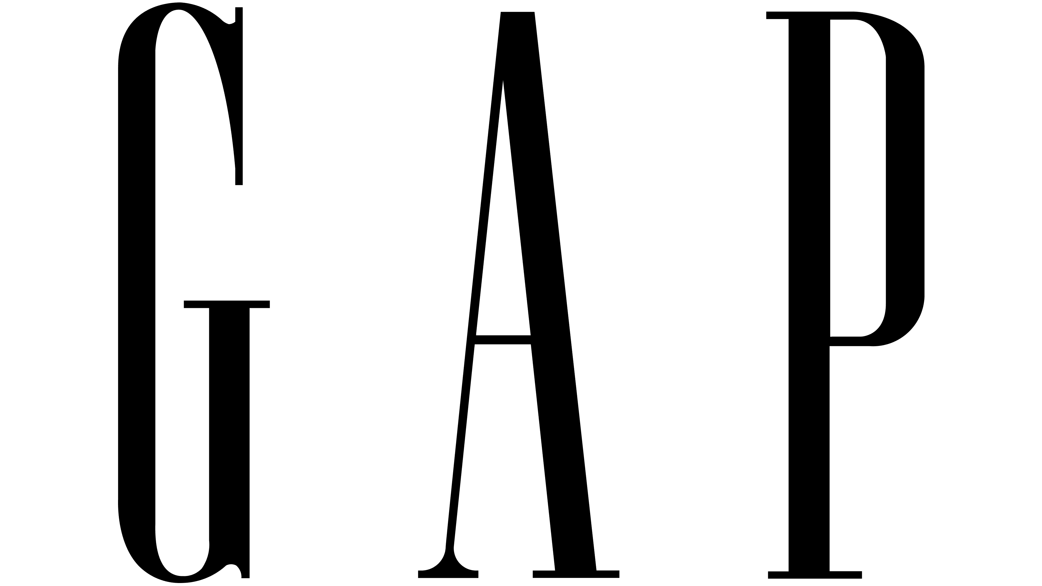
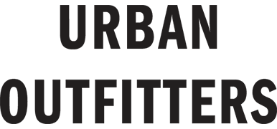
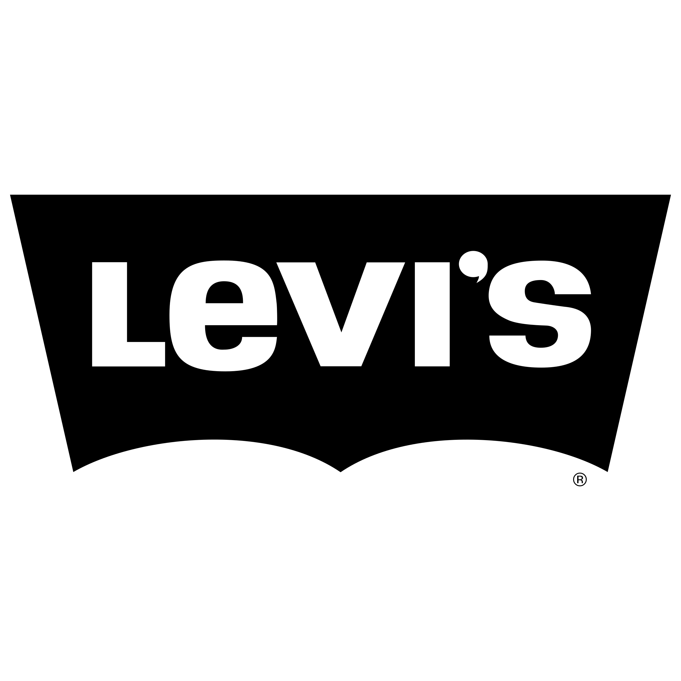
US SPECIALTY APPAREL INDUSTRY
Industry Overview
US Specialty Apparel Industry
Regulatory Environment
Moderate complexity. FTC oversight on advertising, labor practices, and sustainability disclosures. Tariff policy under Trump 2.0 is the live variable — Section 301 tariffs on Chinese goods directly impact sourcing costs across apparel.
Market Size: ~$200B+ US specialty apparel
E-commerce penetration: 35%+ of total sales
Millennials & Gen Z: 60% of apparel spend
Post-pandemic revenge spending still elevated
Athleisure crossover disrupting traditional categories
TikTok-driven micro-trends accelerating product cycles
Tariff headwinds on China-sourced goods (~$90M hit to ANF)
Off-price competition intensifying (TJX, Burlington)
Consolidation accelerating — weaker brands fading
Competitor | Mkt Cap | P/E | EV/EBITDA | Rev Growth
Ralph Lauren Corp. (RL) | $22.9B | 20.9x | ~13.4 | +6.8%
American Eagle (AEO) | $3.1B | 10.5x | ~4.5x | +4.1%
Gap Inc. (GAP) | $9.5B | 10.9x | ~4.6x | +1.8%
Urban Outfitters (URBN) | $6.4B | 12.4x | ~6.4x | +11%
Levi Strauss & Co. (LEVI) | $8.8B | 14.6x | ~8.6 | 4.1%
Sources: Bloomberg, Yahoo Finance, Statista, Macrotrends, SEC Filings

Slide 5
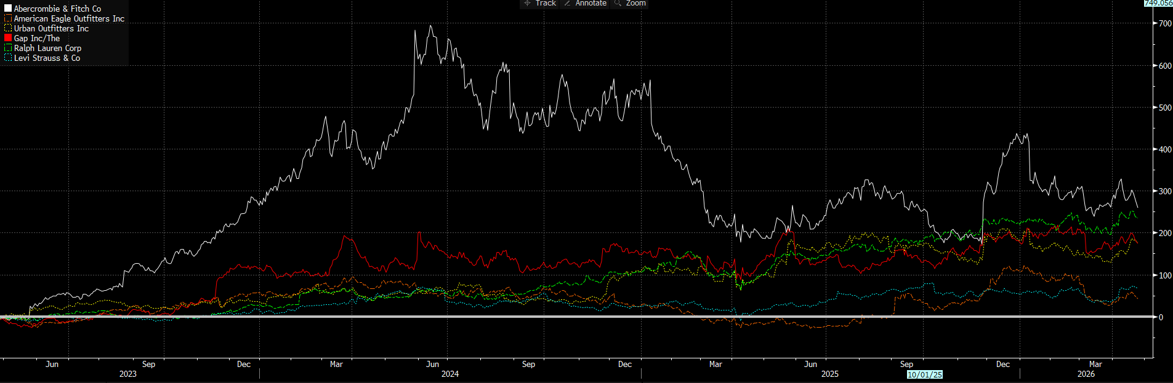
MACRO & MARKET OVERVIEW
Consumer Landscape — April 2026
US Consumer Confidence
Tariff Environment
Fed Rates
Resilient
Headwind
Stable
Spending patterns holding in premium casual; ANF's sweet spot.
$90M annual impact from China tariffs. Manageable via pricing + sourcing diversification.
Rate stability reduces discount rate pressure on consumer discretionary multiples.
Key Market Themes
Gen Z brand loyalty shifting toward authenticity over logos
Digital-native shopping accelerating: ANF at 44% e-comm
International expansion into APAC offers multi-year runway
Tariff-driven margin compression is sector-wide, not ANF-specific
Share buybacks ($450M planned FY26) acting as a floor
Sources: Federal Reserve, Bloomberg, Yahoo Finance, Statista, ANF Earnings Transcripts

Slide 6
INVESTMENT THESIS
The Contrarian Bull Case
ANF trades at 9x earnings — a 35% discount to specialty retail peers — despite best-in-class margins, 12 consecutive quarters of growth, and a dual-brand engine that peers cannot replicate.
I
Hollister Is a Structural Growth Engine
II
Abercrombie Brand Reset Is Misread as Decline
Hollister delivered 19–22% YoY growth in Q1–Q3 2025, driven by Gen Z cultural resonance, and Gilly Hicks Active expansion. With 40 of 60 planned new stores under Hollister, this brand is one of ANF's growth drivers — and the market isn't pricing it correctly.
The market is penalizing ANF for Abercrombie brand's -5% Q2 2025 decline. But this compares against a +26% prior-year record. Sequential improvement in women's, denim, and fleece signals reset, not a structural decline.
III
Capital Allocation at Its Finest
IV
Tariff Risk Is Overstated & Manageable
$450M in planned FY2026 share repurchases (~13% of current market cap). $1.3B total repurchase authorization. No dividend overhang. ROE at 36%. Supports EPS Growth.
$90M tariff headwind is real but contained: sourcing diversification into Vietnam, Bangladesh, and Sri Lanka is underway. The stock has priced in a worst case, yet we see this as a temporary margin compressor, not a structural threat to avoid the stock.
Sources: ANF Q3 2025 Earnings, Panabee, BeyondSPX, DCFMODELING.com, AInvest

Slide 7
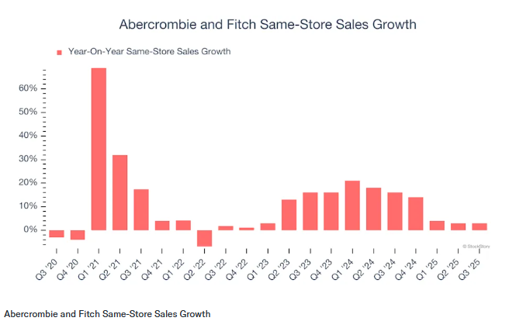
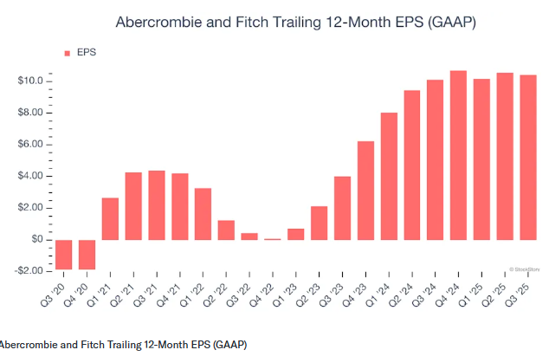
PERFORMANCE
Brand & Stock Trajectory
12 Consec. Growth Quarters
Digital % of Sales
Retu
Share Buyback (FY26)
12
44%
36.4%
$450M
Sources: ANF Q3 2025 Slides, Investing.com, StockAnalysis.com, Panabee

Slide 8
ADDITIONAL FINANCIAL INFORMATION
Analyst Ratings & Catalysts
Analyst Recommendations
Key Price Motivation
Strong Buy / Buy
10
Q4 2025 Abercrombie brand stabilization → removes market's bear case
Spring 2026 price increases absorbing tariff costs → margin recovery
New Hollister store openings in APAC (China, Japan momentum)
Potential New York flagship — premium positioning signal
Share buyback execution ($450M) driving EPS accretion
Holiday 2026 season performance validation
Hold
2
Sell
0
Average Price Target: $120.83
(+28% from current ~$95)
Key Risks
⚑ Tariff Escalation:
Further China tariff increases could push annual impact beyond $90M, compressing margins beyond current guidance.
⚑ Abercrombie Brand Stall:
If the flagship brand fails to stabilize, revenue mix deteriorates and premium brand equity erodes permanently.
⚑ TikTok Trend Risk:
Ultra-fast micro-trends can make product lines obsolete in a single quarter; inventory surged 21% YoY in Q1 2025.
⚑ Consumer Slowdown:
ANF targets discretionary spend; a recession or consumer confidence collapse directly hits traffic and AUR.
Sources: Investing.com, Bloomberg, Panabee, BeyondSPX, Markets Daily

Slide 9
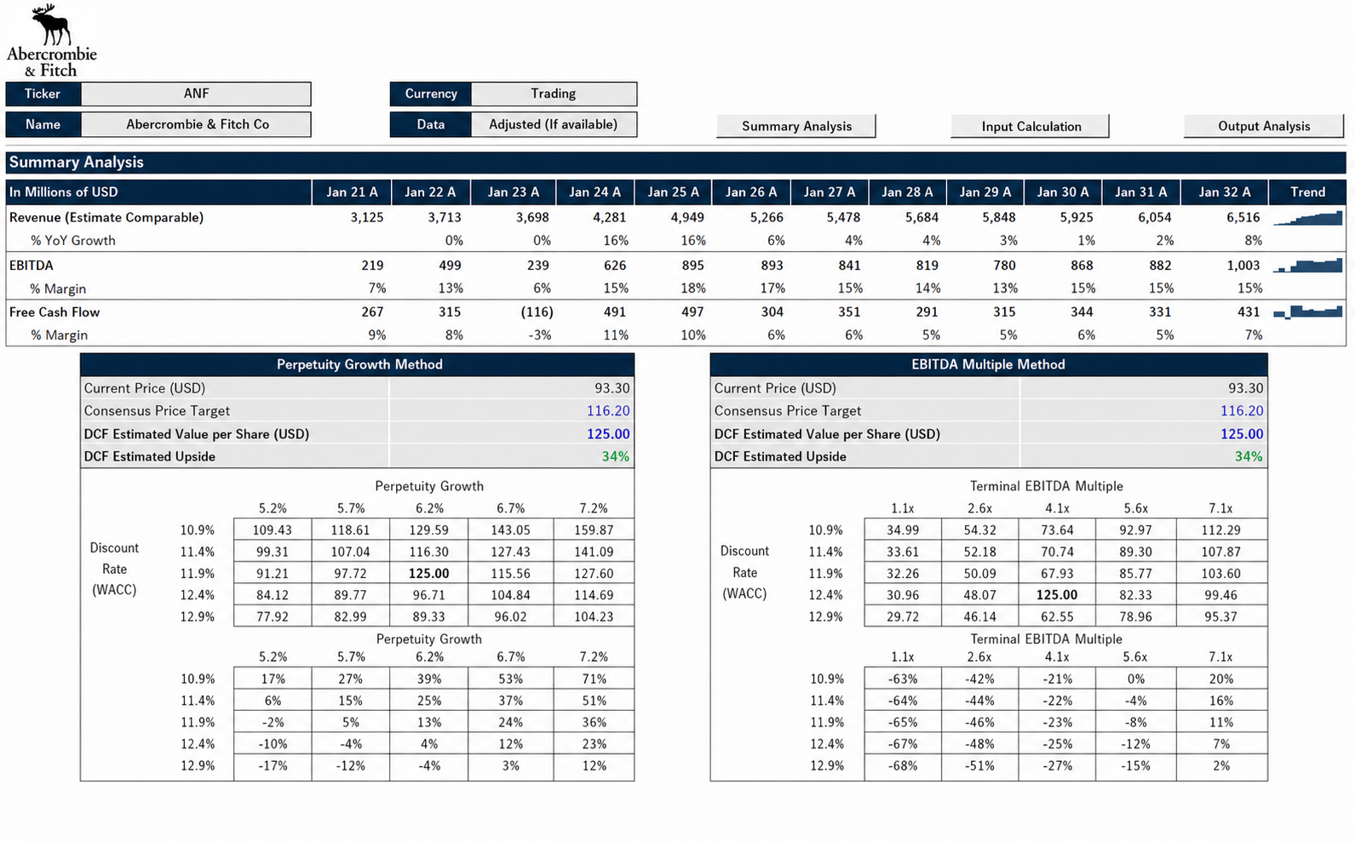
DCF VALUATION
Price Target Derivation — $125
Sources: Bloomberg, Yahoo Finance, Analyst Estimates

Slide 10
THANK YOU
ABERCROMBIE & FITCH CO. | NYSE: ANF
These are just a few reasons Abercrombie and Fitch is a high-quality business worth owning. With its shares trailing the market in recent months, the stock trades at 9.7× forward P/E. Now is the time to initiate a position.
Appendix
Neeley Equity Research Club | April 21, 2026

Slide 11
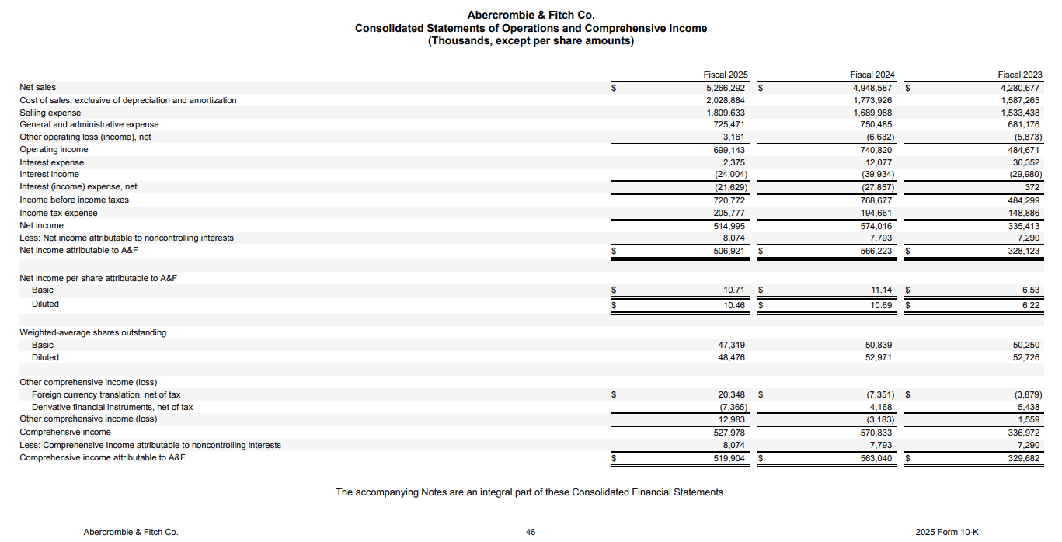
APPENDIX — INCOME STATEMENT SUMMARY
Sources: SEC 10-K Filings

