Slide 1
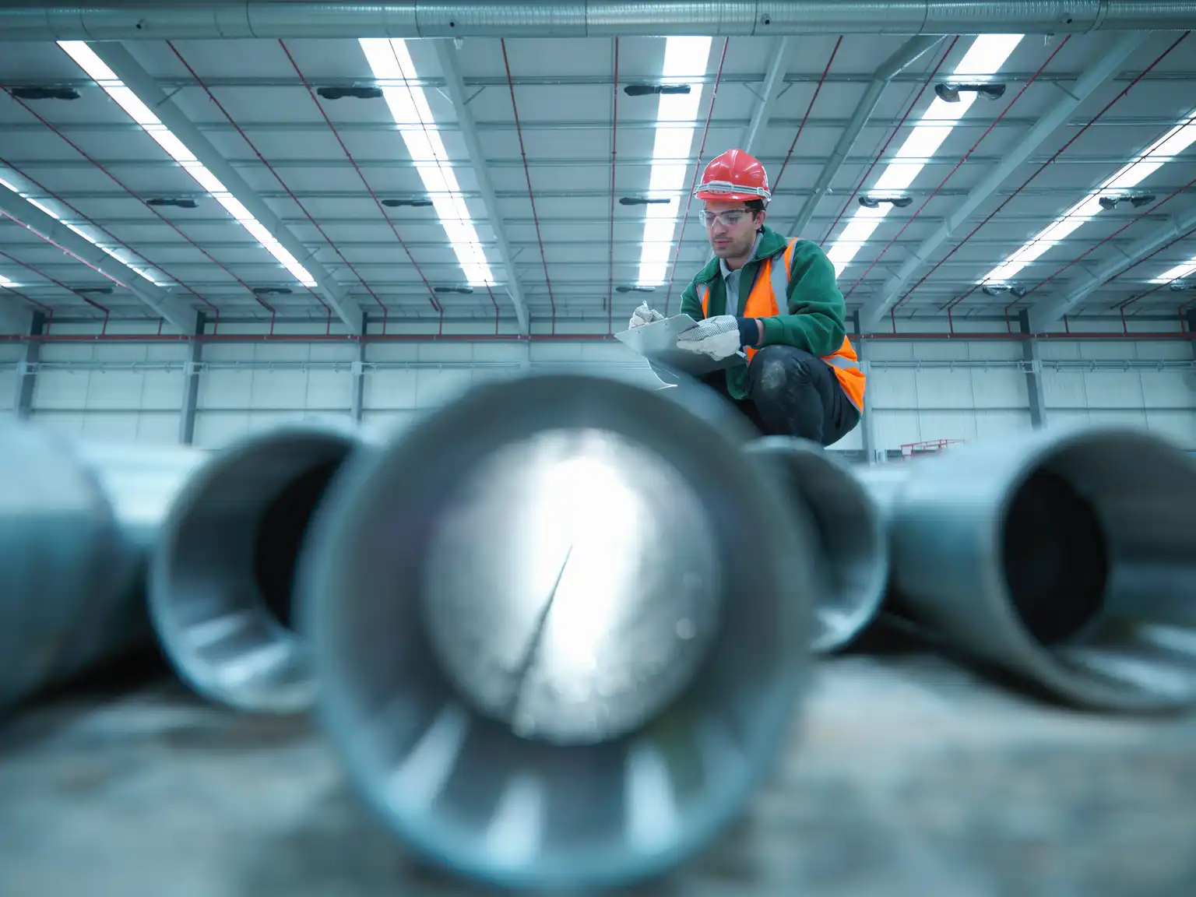
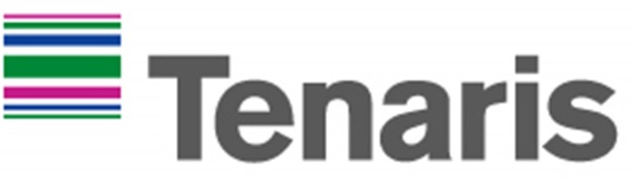

Tenaris S.A. (NYE: TS)
Hold: Target price of $27 to buy
Josue Beltran & Carlos Corado
March 6, 2025

Slide 2

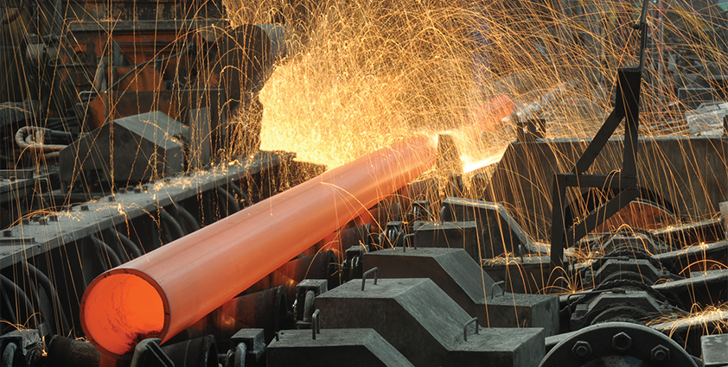
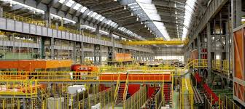
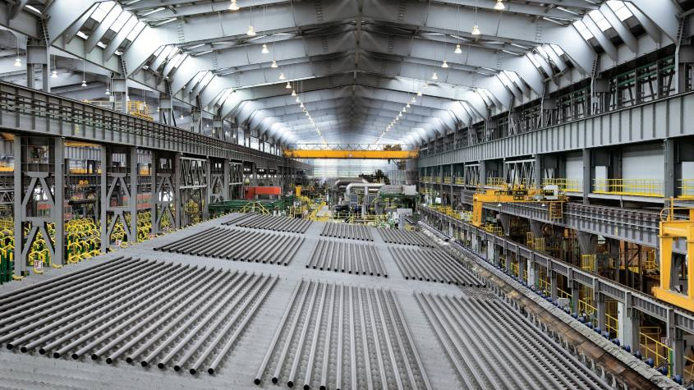
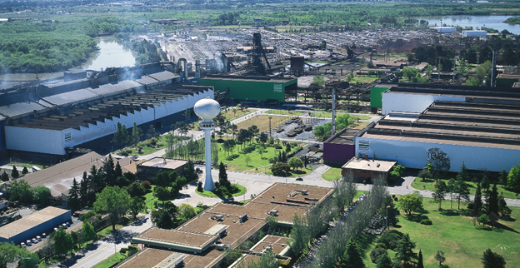
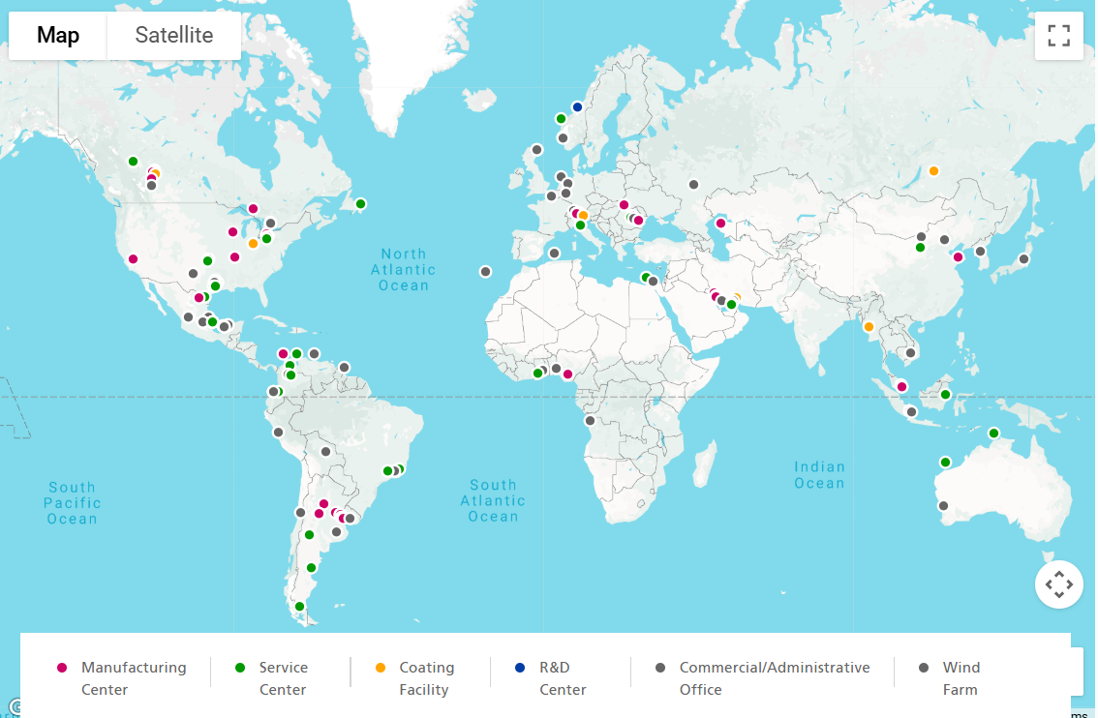
Welcome to Tenaris
Headquarters:
Luxembourg
Tenaris, founded in 2001 in Italy, with headquarters in Luxembourg, manufactures seamless and welded steel pipes for the oil & gas, energy and industrial sectors across North America, South America, Europe, the Middle East and Africa.
Important Company Information
Ticker | TS
Exchange | NYSE
Industry | Oil & Gas Equipment & Services
Last Close (04/04/25) | $33.17
Market Cap | $20.374b
Total Debt | $652,138
Cash | 3,513,835
Enterprise Value | $19.99b
P/E | 10.04
Current Ratio | 3.65x
Total Debt/EBITDA | 0.20x
ROA | 7.60%
ROIC | 14.67%
Credit Rating | A-
Next Fyend | 12/31/2025
Latest Report | 02/19/2025 (2024 Q4)
Next Earnings Date | 4/30/2025
Manufacturing facilities:
Latin America, Europe and Nort America
Geographic EBITDA
North America
EBITDA value
$1.13 Billion
South America
EBITDA value
$595 Million
Europe
EBITDA value
$341 Million
Global Presence:
+25 countries
Asia Pacific, Middle East & Africa
EBITDA value
$629 Million
Notes:
“To give you all a little bit of context, Tenaris was founded in 2001 in Italy with their headquarters in Luxembourg. They focus on the manufacturing of seamless and welded steel pipes for the oil and gas industry supplying and operating all around the globe”
“As we north America being their biggest market, with a 1.13B in EBITDA last year”
“This stock can be found on the NYSE, with some really good metrics in relation to its industry such as their P/E ratio of 10.04 or and EV of almost 20 B, which my friend here will talk further later in the presentation”

Slide 3
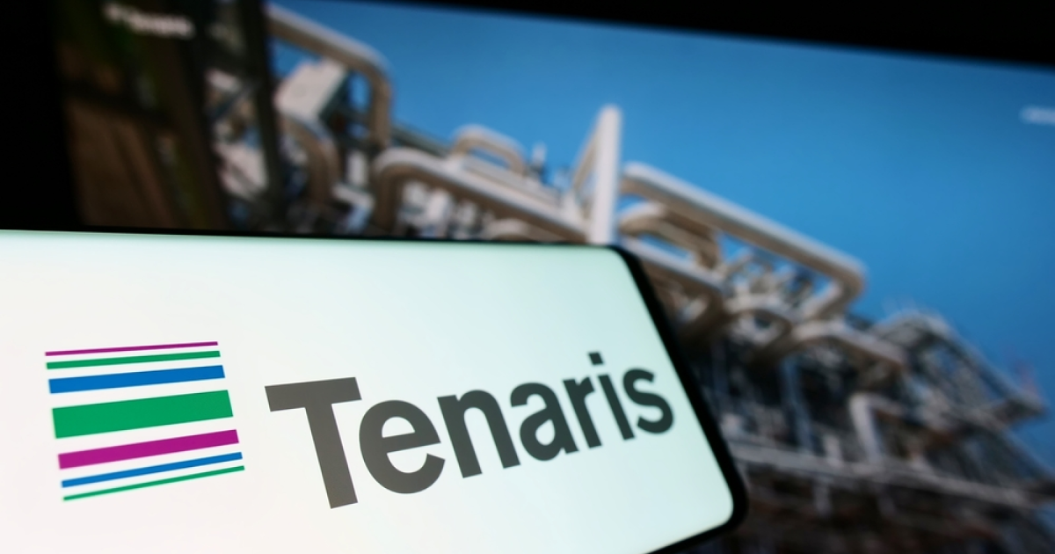
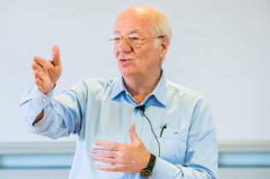

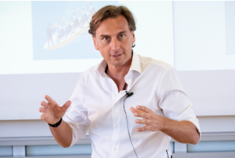
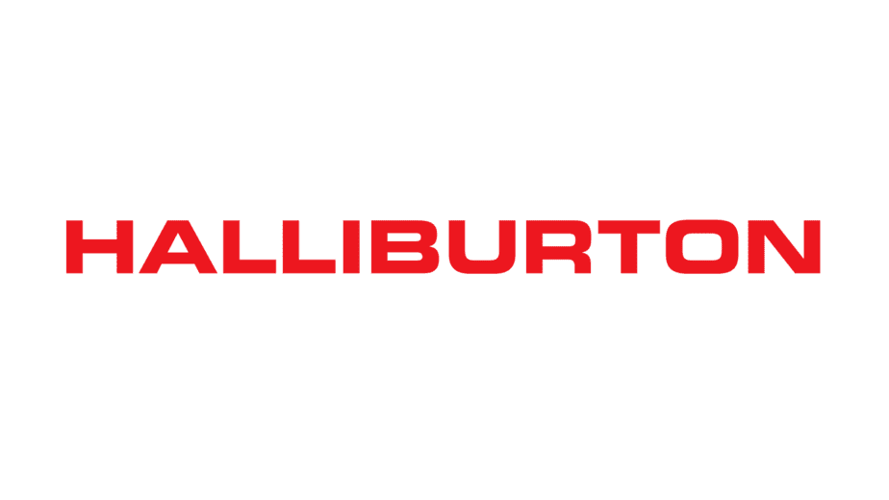
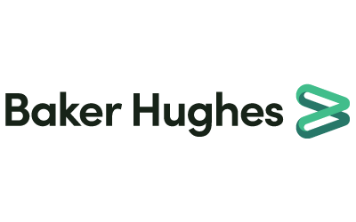
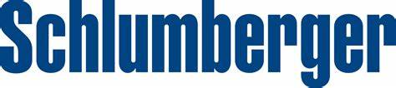
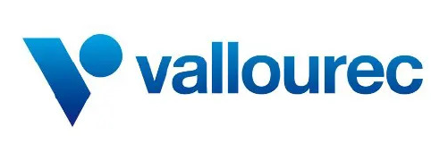
Company Overview
Sales Breakdown 2024
Management Team
Tubes Sales volume (thousand metric tons) 2024
CEO: Paolo Rocco
Mr. Rocca has been Tenaris's Chairman since 2002 and also serves as Chairman of Ternium, President of San Faustin, and a member of the World Steel Association's executive committee
CFO: Carlos Gomez Alzaga
Gómez Alzaga will become Tenaris's CFO on May 2, 2025, bringing 20+ years of finance experience, including Regional CFO roles and Economic and Financial Planning Director.
COO: Gabriel Podskubka
Gabriel Podskubka, Tenaris's COO since April 2023, oversees global sales, marketing, supply chain, and production. An industrial engineer from Argentina, he joined Tenaris in 1995 and has held key leadership roles across regions.
Seamless
Welded
Total
Volume
Volume
Volume
3,077
852
3,928
Competitors
Market
Cap
EV/EBITDA
21.76B
5.83x
55.89B
7.84x
42.42B
9.80X
4.07B
4.63x
Notes:
"Now, let’s look at Tenaris’s sales composition.
The company primarily sells two types of steel pipes: seamless and welded. Seamless pipes, which make up about 80% of total sales, are used in high-pressure environments like deepwater drilling. Welded pipes account for the remaining 20%.
In total, Tenaris sold over 3.9 million metric tons of pipes in 2024. This demonstrates its scale and ability to meet global demand."*

Slide 4
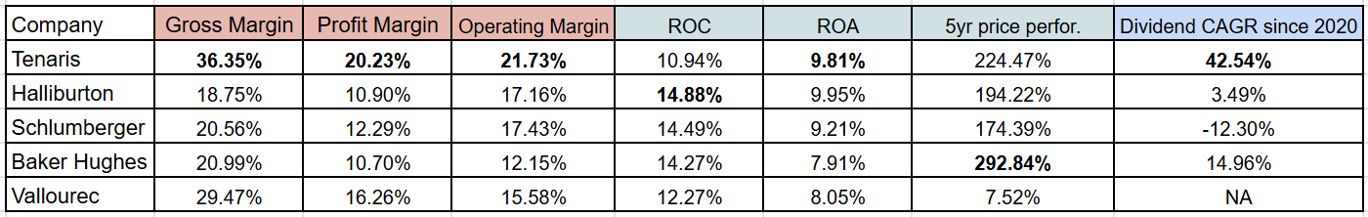
Competition
Best Profitability: Highest gross margin (36.35%) and profit margin (20.23%), ensuring strong earnings power.
Strong Financials: High Return on Assets (9.81%) and competitive
Return on Capital (10.94%), showing efficient capital use, only metric where it doesn't come first
Outstanding Dividend Growth: 42.54% CAGR since 2020, outpacing competitors.
Solid Stock Performance: 224.47% price growth in 5 years, making it one of the best-performing stocks in the sector.
Notes:
*"Tenaris operates in a highly competitive industry but maintains a leading position.
It commands over 20% of the global OCTG (Oil Country Tubular Goods) market, outperforming key competitors like Vallourec and ArcelorMittal.
What sets Tenaris apart is its profitability. It has the highest gross margin at 36.35% and the highest profit margin at 20.23% among peers.
Additionally, Tenaris has delivered a 42.54% compound annual dividend growth rate since 2020, making it an attractive stock for income investors."*

Slide 5
US industry overview
US Oil & Gas Equipment & Services
Oil and gas industry
Projected to grow
20.1% CAGR
Over the next 5 years
Market size: 214.229 B
YTD return: Industry*: 6.52%
S&P 500*: 1.80%
Regulatory Landscape
Complex
Environmental regulations, trade policies, energy transition policies, health and safety
Investment in sustainability efforts 30% reduction in carbon 2030
Notes:
“Now quickly looking into their industry we can see a decent market size of 214.229 and a year to day return, as of the third of February when is when we this data, as a higher return than the S&P 500”
“And as Goldman sachs analyst explain, we expect an outstanding 20.1% CAGR in that industry in the next 5 years”
“As we can see Tenaris has been perfoming decently with their revenue increasing each year, however yes we see a slight decrease in their revenue last year”
“furthermore its true that they operate in a complex regulatory environment, as there is a lot of regulations in terms of health and environment, however TS last year did an investment in sustainability efforts which they expect to reduce 30% of their carbon foot print”

Slide 6
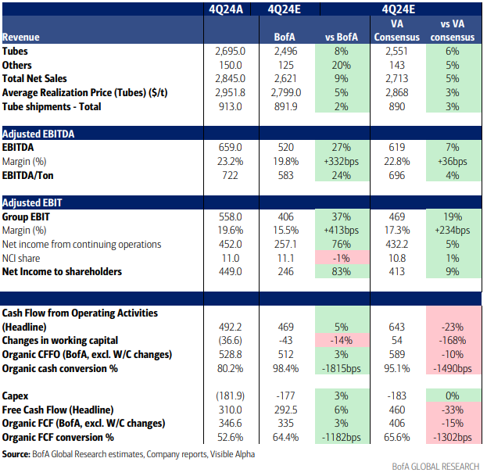
Recent Performance – 4Q24 Review
Earnings beat: +7% vs consensus
Key Metrics
  Revenue: 2.85b (+5% vs expected)
  EBITDA Margin: 23.25% (vs. Expected 22.8)
  Dividend Increased: $0.83 per share
Strong Balance Sheet: USD3.64bn of net cash
Notes:
*"Now, let’s break down Tenaris’s latest earnings.
In Q4 2024, the company exceeded expectations with a 7% earnings beat, reporting $2.85 billion in revenue, which was 5% higher than expected.
Its EBITDA margin stood at 23.25%, slightly above projections. Additionally, Tenaris increased its dividend to $0.83 per share, demonstrating confidence in its cash flow.
It also maintains a strong net cash position of $3.64 billion, giving it financial flexibility for future investments."*

Slide 7
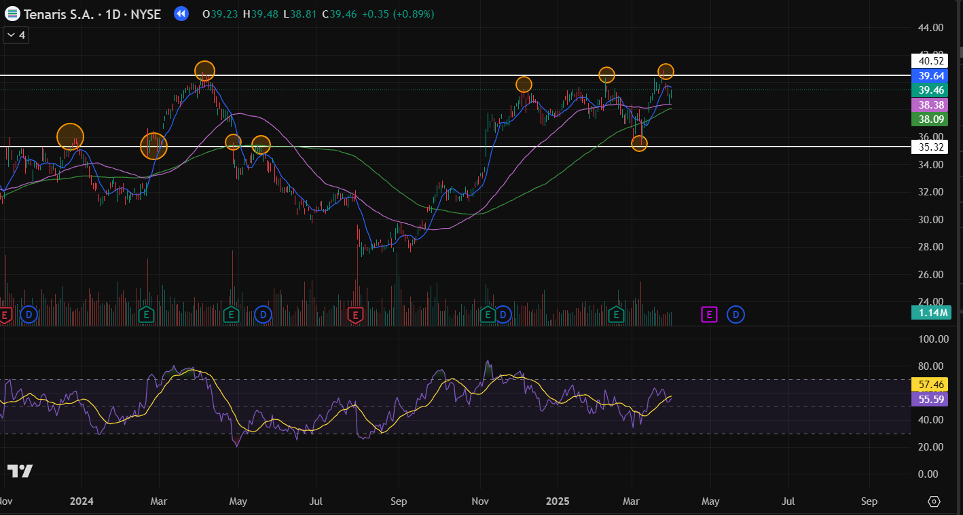
Technical Analysis
Major resistance level around 40$
“Death cross” indicating decline in price
High RSI indicating stock is overbought
Since the start of this year the stock has been in a consolidation zone
Notes:
“From a technical analysis view we do see TS starting this year has been in a consolidation zone between 40 and 35 with a major resistance level at 40$ however at the time of this analysis we see the death cross where the 50 day MVA is going to cross the 100 MVA indicating a decline in price most likely reaching to that weak support level of 35, this is also indicated by the Relative strength index that shows that currently the stock is being overbought and therefore overvalued at its current price or well the price at the moment and well this was proven actually Friday the stock reached that support level”

Slide 8
Investment Thesis
U.S. Economy
Innovation
Competitive Environment
25% tariff on steel products
More than 40% of US OCTG supplies are imports
OCTG will offset tariffs expenses
Uncertainty, broader market is selling off
Tariff leads higher oil prices
Rig Direct: Enhanced supply chain
WISer™: enhanced well construction operations
iRun Casing®: cloud-based tool
Torque turn monitoring system
Self-produced steel
Acquired IPSCO from TMK, which provided Tenaris ’with their first steel production mill in the United States
Tenaris has manufacturing facilities all over the globe
Fundamentals
Our view
Low debt compared to competitors
High levels of cashflow
Best current ratio, debt/assets, highest dividends
With high Tariffs, Tenaris can offset them with their US production sites and their own global steel manufacturers, and take advantage of higher prices and increase their revenue
Enhanced OCTG supply chain and digital solutions strengthen their demand forecasting and operations reducing expenses in the long term
Better margins than competitors
Solid company financially that is fairly priced
Target price to buy: $27 giving us a 25% margin of safety relative to our DCF valuation
Notes:
*"So, why consider investing in Tenaris?
Tariffs & Market Positioning: U.S. steel tariffs impact 40% of OCTG supply, giving Tenaris a competitive edge due to its U.S.-based manufacturing.
Strong Fundamentals: The company has low debt, high cash flow, and the best financial ratios among competitors.
Competitive Edge: By owning its steel production facilities, Tenaris reduces costs and enhances efficiency.
Innovation & Sustainability: Tenaris continues to develop new technologies like WISer™, iRun Casing®, and Rig Direct while also committing to a 30% CO2 intensity reduction by 2030.
Carlos: “Looking into the U.S. economy at the time of this analysis, were both conscious that tension and other decisions made by the administration where made last Friday that totally change our analysis but were gonna keep with what we previously did” “a 25% tariff imposed on steel products will directly impact the OCTG market as more than 40% supplies are imports, however as JP morgan explains the OCTG market will offset the tariff expenses with higher prices. Notwithstanding is important to mention the uncertainty in market right now which is leading the broader market to sell off and ultimately expecting oil prices to rise”
“In terms of innovation we see Tenaris implementing the latest in tehchnology in this case named Rig Direct which enhances their supply chain, they can manage the entirety of well operators ’ tubular supply chains, from steel procurement to well installation, besides that it increases efficiency and demand planning. Within Rig direct we see a new addition called WISer which basically just enhances well construction operations, and within it we find two technologies, one called iRun casing which is a cloud based tool real-time monitoring of casing installation to minimize the risk of lost lateral length and production and a Torque Monitoring system which analyzes real-time torque data to prevent errors”
“From our view with these high tariffs, Tenaris can offset them with their US production sites and their own global steel manufacturers that satisfy demands in each of the regions so wouldn’t have to worry if there is any retaliation from any other country because of the tariffs, this tariffs would also benefit Tenaris as higher prices would lead to an increase in revenue cause as we know oil is essential and inelastic so a changer in their price would lead to a proportionately smaller change in their quantity demanded”
“second with their digital solutions, which as stated by the company they plan on growing in terms of innovation, manufacturing and production facilities, will ultimately lead to a reduction in the costs of the good sold which would lead to a higher gross profit margin and a reduction in their operation costs which together lead to a higher net income in the long run”

Slide 9
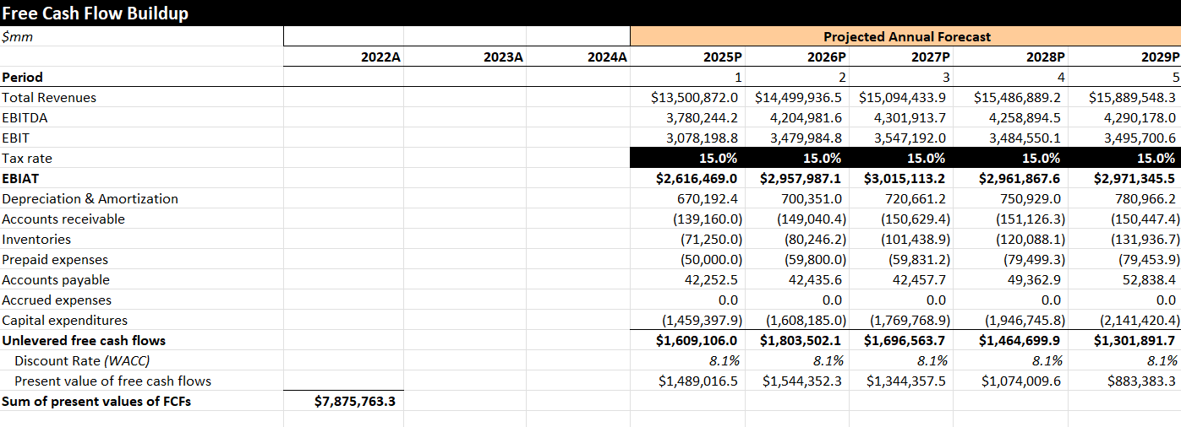
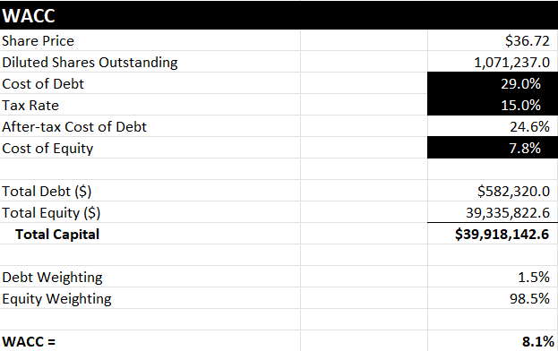
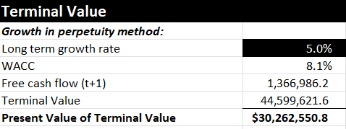
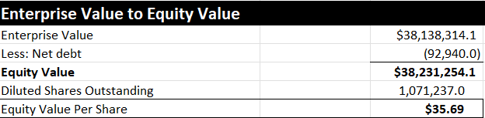
DCF Valuation
Notes:
“Our DCF suggests that Tenaris is currently trading near its intrinsic value, making it a hold. If market conditions shift or our assumptions change say a resolution with the whole tariffs imposed we may reconsider the investment stance”
“This dcf was made when the stock price was at 36.72, as seen our projections for its free cash flow increase each year until 2028 where we expect a decrease in their fcf for the last two years. Now moving the WACC we calculated a WACC of 8.1% given its cost of debt and equity, which ultimately leads us to the terminal value, we estimated a long term growth rate of 5.0% given its past performance and good outlook of the OCTG industry, it ultimately leads us to the present value of the terminal value of ….finally to get the equity value per share we just divided its equity value with its diluted shares outstanding which lead us to a price of 35.69”

Slide 10
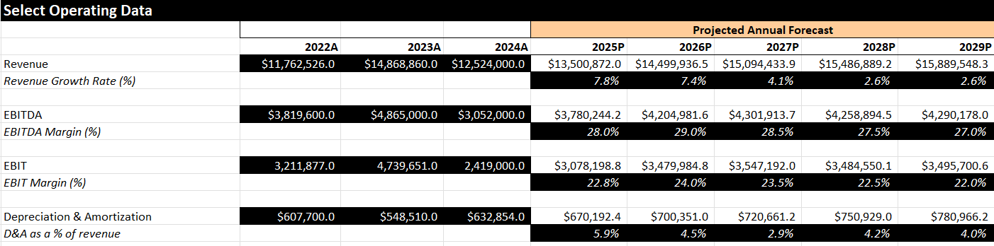
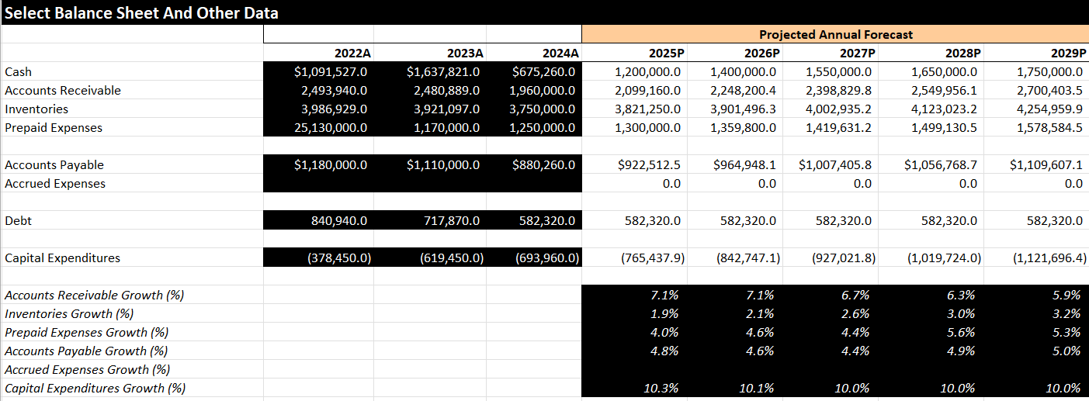
DCF Projections
Notes:
Here is the projections we did for our DCF, as we mentioned in our investment thesis we see revenue growing each year due to higher prices and optimized operations, leading to an increase in its EBITDA and cash flow, also important to mention its big increase in capital expenditures in the future like environmental and health efforts, new mill factories and power plants gloabally”

Slide 11
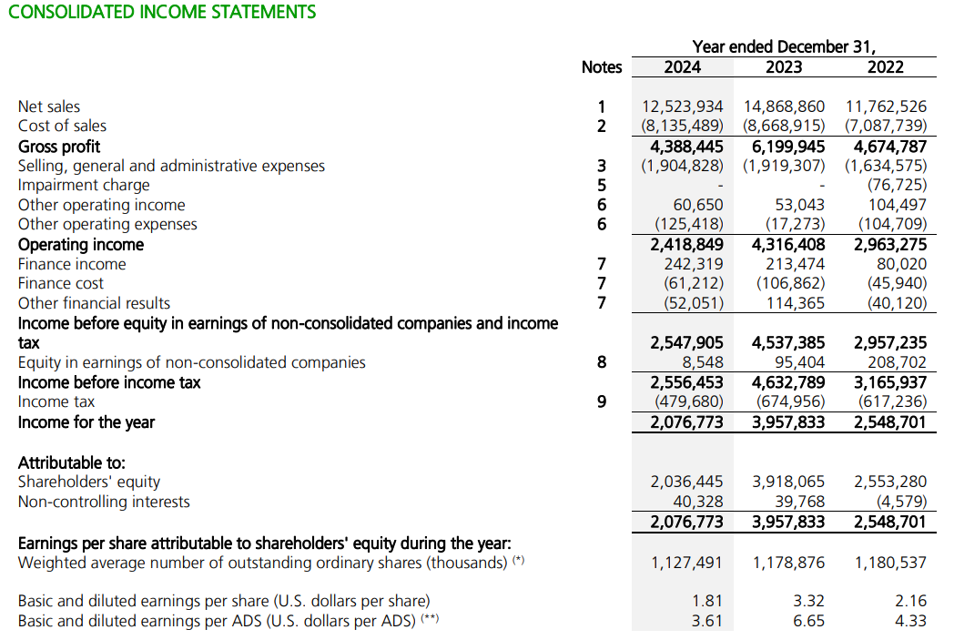
Income Statement
Notes:
Here is the projections we did for our DCF, as we mentioned in our investment thesis we see revenue growing each year due to higher prices and optimized operations, leading to an increase in its EBITDA and cash flow, also important to mention its big increase in capital expenditures in the future like environmental and health efforts, new mill factories and power plants gloabally”

Slide 12
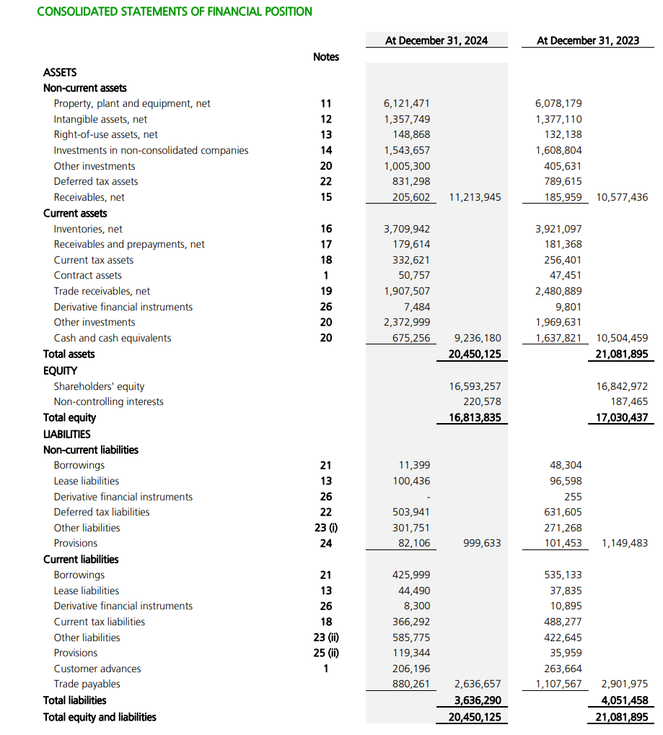
Balance Sheet
Notes:
Here is the projections we did for our DCF, as we mentioned in our investment thesis we see revenue growing each year due to higher prices and optimized operations, leading to an increase in its EBITDA and cash flow, also important to mention its big increase in capital expenditures in the future like environmental and health efforts, new mill factories and power plants gloabally”

Slide 13
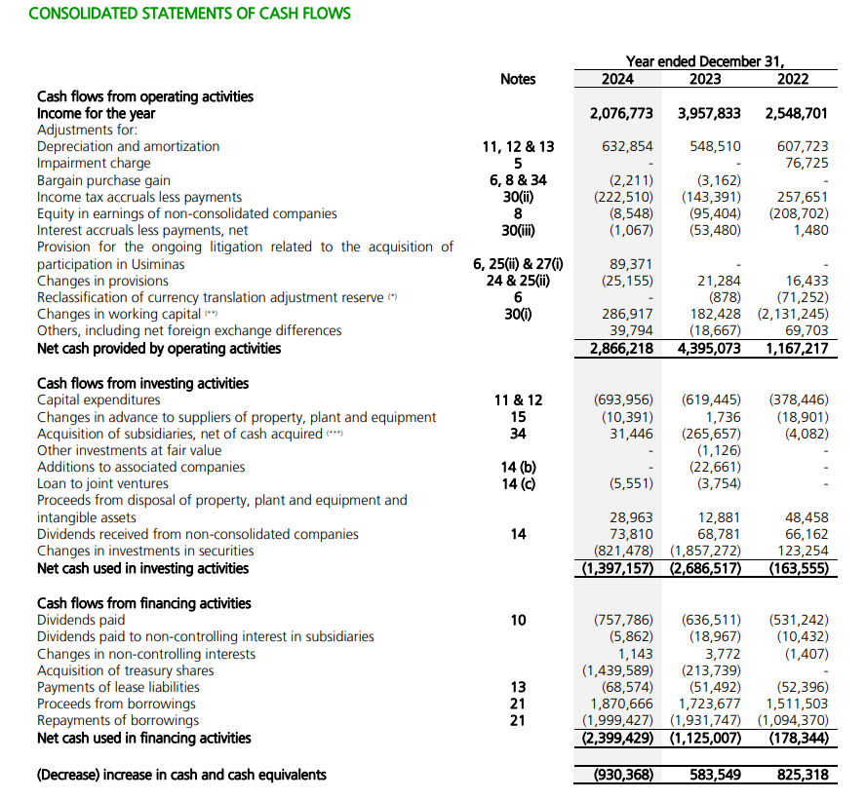
Cash Flow
Notes:
Here is the projections we did for our DCF, as we mentioned in our investment thesis we see revenue growing each year due to higher prices and optimized operations, leading to an increase in its EBITDA and cash flow, also important to mention its big increase in capital expenditures in the future like environmental and health efforts, new mill factories and power plants gloabally”

