Slide 1

Sector presentation
Real state
Carlos Corado
June 2025

Slide 2
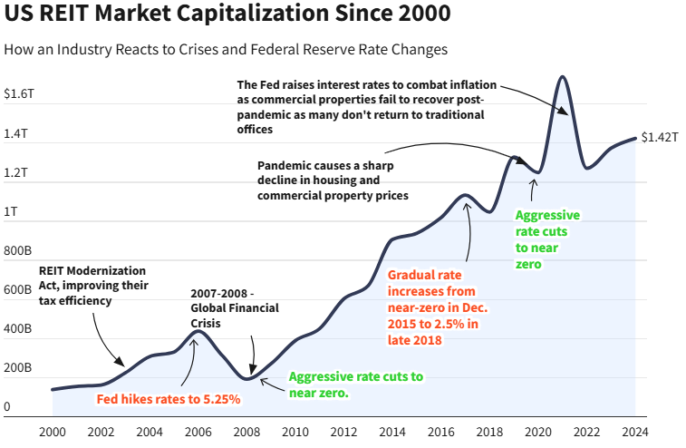
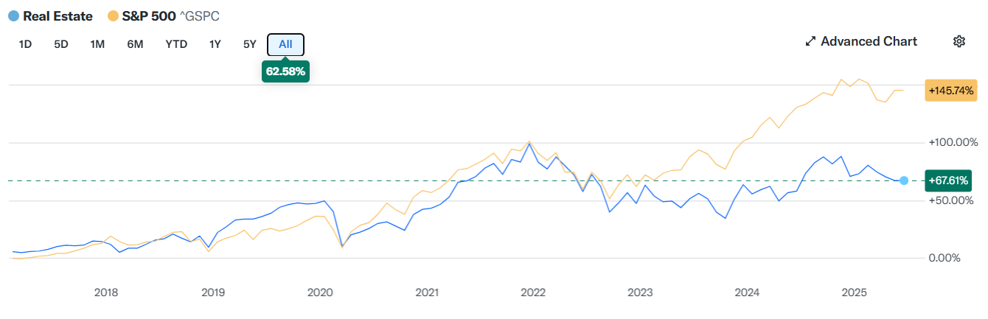

Slide 3


Fundamental Analysis
Stock overview
Stock Ticker | CTRE
Company name | Care Trust REIT Inc.
Industry | REIT – Health care facilities
Current stock price | 29.61
Market Cap | 5.68 B
Financials | In thousands
Revenue (Last year) | 296.31
Net Income (Last year) | 124.64
EPS | 0.92
Dividend Yield | 3.56%
Key ratios for real state sector
P/FFO | 16.6
AFFO payout ratio | 78%
Key Financial Ratios
P/E | 32.31
P/B | 1.90
D/E | 0.28
ROE | 7.02%
Company Growth
Revenue Growth Rate (YoY) | 36.07%
Earnings Growth Rate (YoY) | 56.90%
Valuation = slightly undervalued

Slide 4
Quantumvest Key Financial Ratios
Financial Ratios
EPS Growth Next 5 Years – Over 10% | 25.14%
Return on Equity – Over +15% | 7.02%
Debt/Equity – Under 1 | 0.28
Sales Growth Past 5 Years – Over 10% | 13.21%
Return On Investment – Over +15% | 4.31%
Current Ratio – Over 1 | 3.33
EPS Growth Past 5 Years – Over 10% | 10.17%
Price target = 60.48

Slide 5
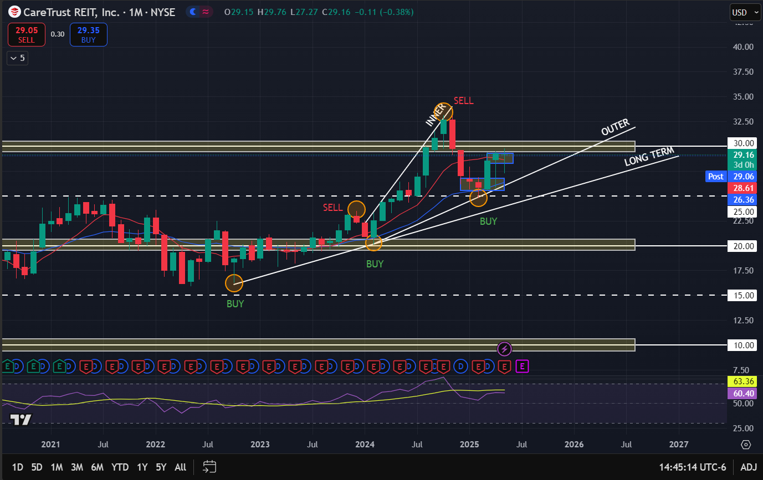
Monthly chart

Slide 6
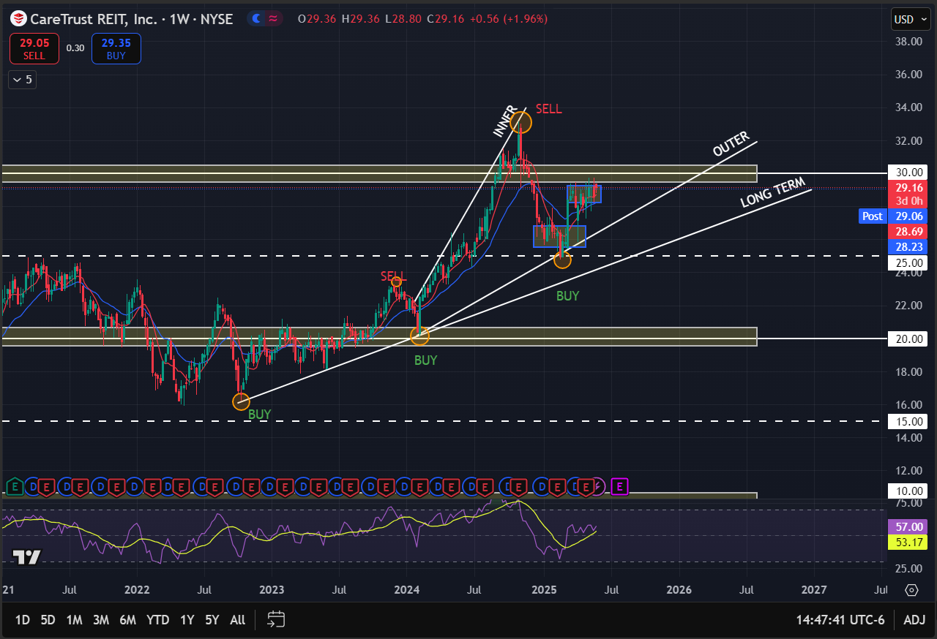
Weekly chart

Slide 7
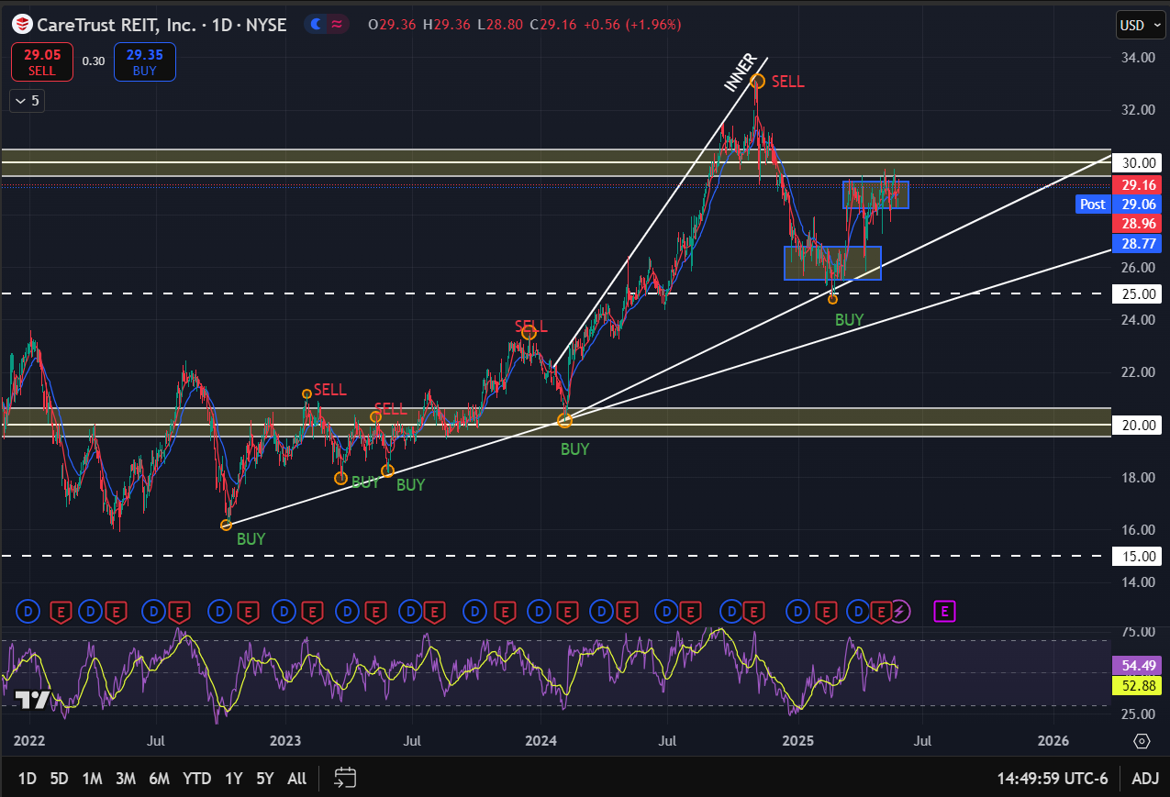
Daily chart
Higher highs and higher lows, following an upward trend for the long run
Key observations:
Consolidation right below the 30$ monthly resistance level
Bounced from the point where the outer upward trend line and the 25$ weekly support level intersect, great buying opportunity
8 SMA cross above 21 EMA, bullish signal
RSI in the high 50s area, not overbought yet, enough space for the upside

Slide 8
Qualitative analysis
News Headlines
Economic situation and Industry
CareTrust REIT Announces $55 Million Acquisition of Two California Facilities in Separate Transactions
“the healthcare sector is relatively immune to the macroeconomic problems faced by office … This is because even amid tough economic conditions, consumers need to spend on healthcare services while curtailing discretionary purchases.”
CareTrust REIT boosts dividend to 33.5c per share from 29c
By 2030, the entire baby boomer generation will have reached retirement age, increasing the U.S. population’s share of senior citizens (age 65+) to 20% (70 million) from 17% (61 million) in 2024. Seniors are expected to increase total outpatient healthcare spending by 31% over that time to nearly $2 trillion.
CareTrust REIT Receives Investment Grade Rating Upgrade from Fitch Ratings

Slide 9
Investment recommendation
Fundamentals:
P/FFO = 16.6 → At the lower end of the fair range for healthcare REITs (typically 15–20), suggesting slight undervaluation
AFFO payout ratio = 78% → Well below the danger zone, indicating dividend safety
Strong revenue (36%) and earnings growth (56.9%) YY → This is unusually strong for a REIT
Low debt-to-equity (0.28) and solid current ratio (3.33) → Financially conservative and liquid
BUY
Technicals:
Bullish structure across monthly, weekly, and daily charts.
The price is retesting a key breakout zone (~$28–30) with signs of accumulation.
RSI and trend lines suggest the stock is rebounding from a higher low, pointing toward continued upward movement.
Macro & Industry:
Favorable industry backdrop: The aging U.S. population and stable demand for senior housing make healthcare REITs resilient
Recent upgrades: Fitch’s investment-grade rating upgrade boosts investor confidence
Dividend increase to $0.335/share is a strong bullish signal from management.
Acquisition of new facilities supports long-term FFO growth.

Slide 10

Fundamental Analysis
Stock overview
Stock Ticker | AMT
Company name | American Tower
Industry | REIT - specialty
Current stock price | 212.34
Market Cap | 99.27 B
Financials | In thousands
Revenue (Last year) | 10,127.20
Net Income (Last year) | 2, 255.00
EPS | 3.90
Dividend Yield | 3.09
Real state sector key ratios
Price/ FFO | 20.4
AFFO payout ratio | 61.8%
Key Financial Ratios
P/E | 54.42
P/B | 28.08
D/E | 12.56
ROE | 80.05%
Company Growth
Revenue Growth Rate (YoY) | 1.15%
Earnings Growth Rate (YoY) | 34.99%
Valuation = slightly overvalued

Slide 11
Quantumvest Key Financial Ratios
Financial Ratios
EPS Growth Next 5 Years – Over 10% | 16.59%
Return on Equity – Over +15% | 80.05%
Debt/Equity – Under 1 | 12.56
Sales Growth Past 5 Years – Over 10% | 6.31%
Return On Investment – Over +15% | 4.10%
Current Ratio – Over 1 | 0.45
EPS Growth Past 5 Years – Over 10% | 2.60%
Price target = 432.25

Slide 12
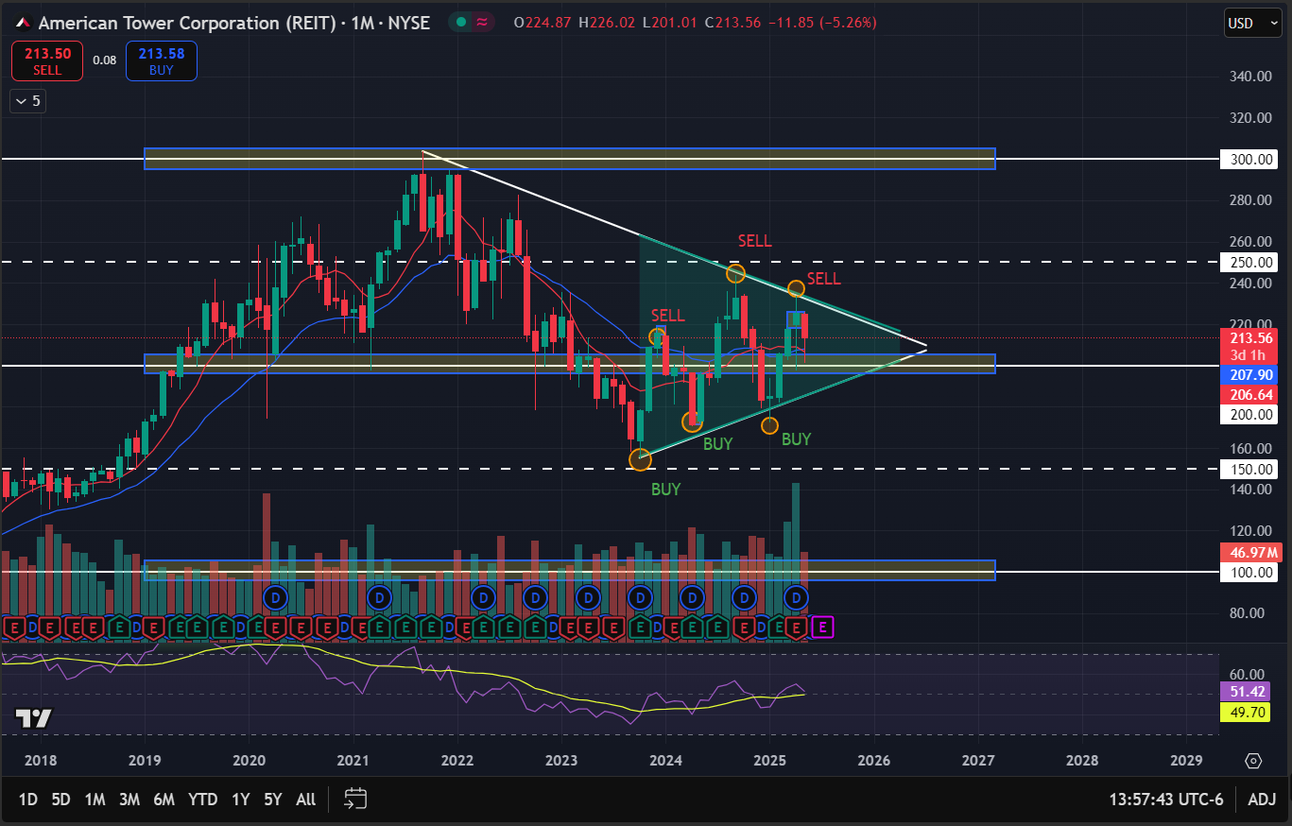
Monthly chart

Slide 13
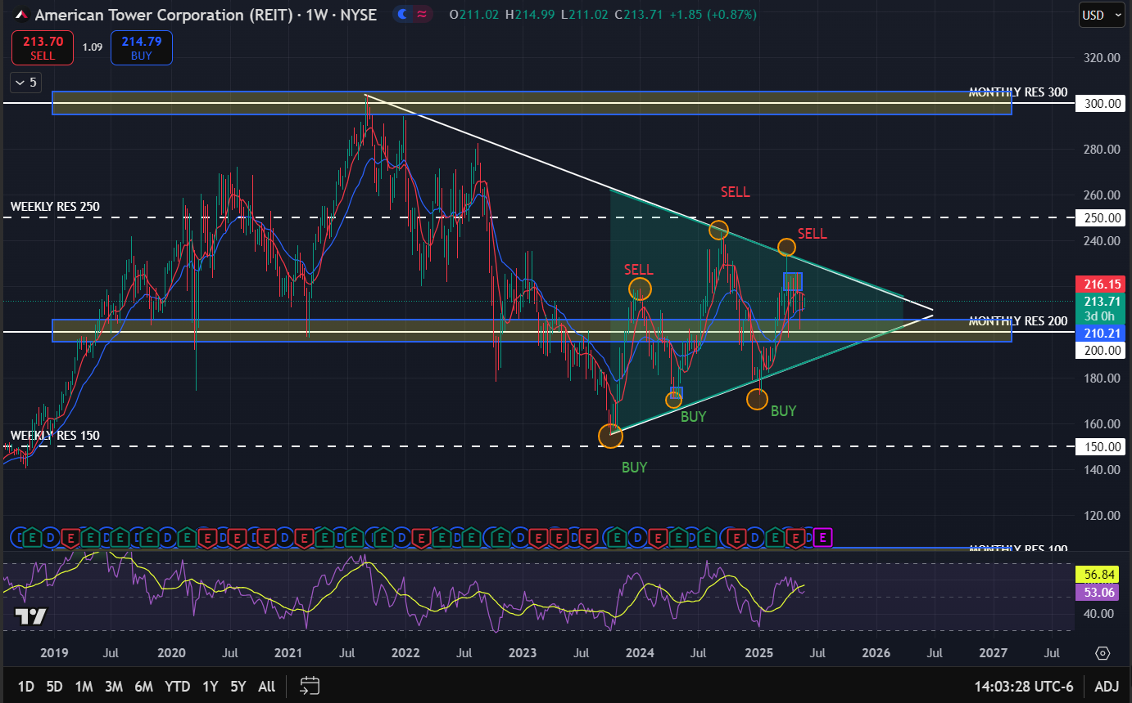
Weekly chart

Slide 14
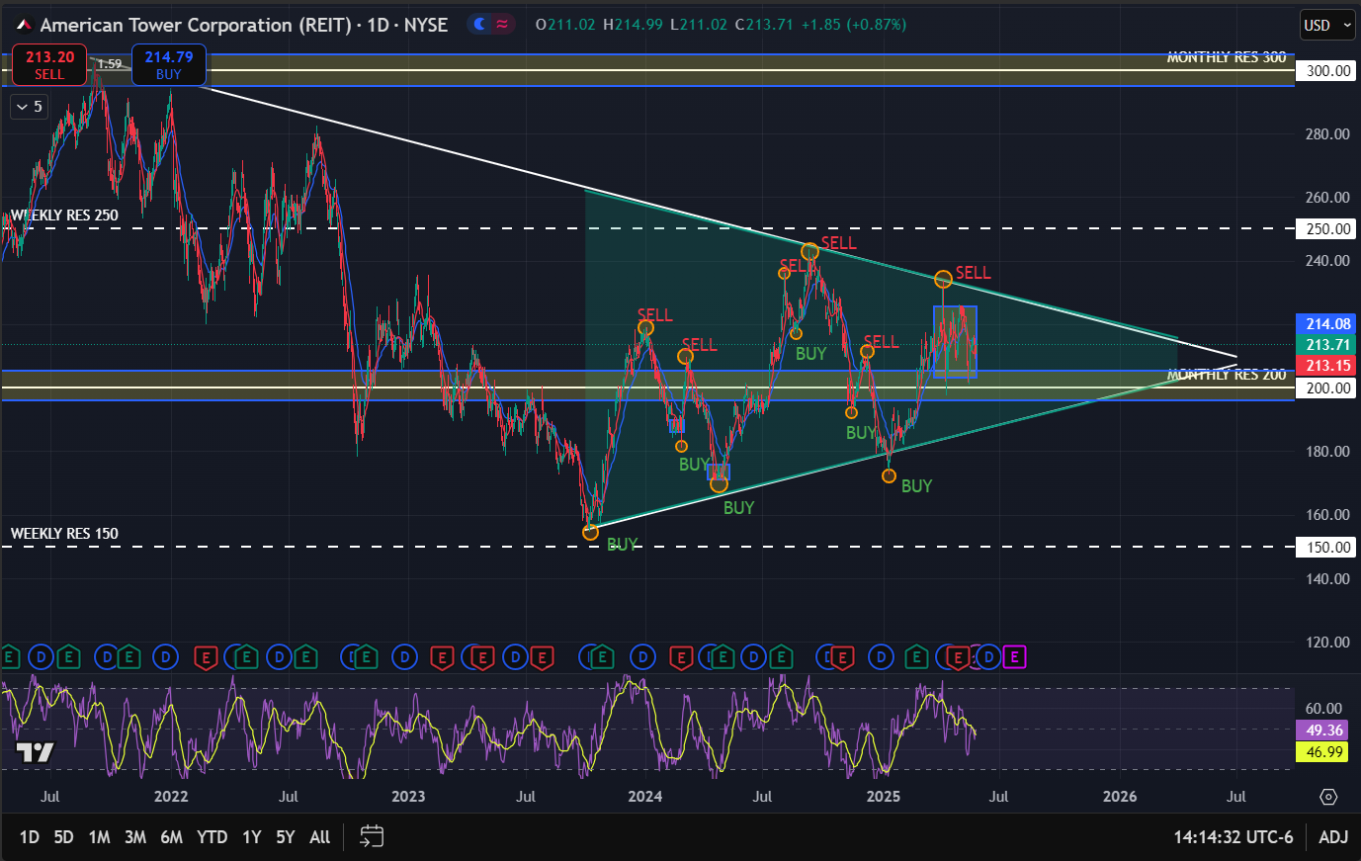
Daily chart
Higher lows with lower highs, stock is trading in a narrower space, getting ready for a further breakout
Key observations:
Stock trading above 200$ monthly support level
In a consolidation phase
8 SMA crossover 21 EMA, mid march, bullish signal
RSI low 50s area, enough space for a breakout either way

Slide 15
Qualitative analysis
News Headlines
Economic situation & Industry
American Tower Corporation (AMT) Underpinned by Strong Demand Driven by Secular Growth in Mobile Data
Fed Funds Rate sits at 5.25%–5.5%, pressuring capital-intensive sectors like REITs
Markets pricing in a potential rate cut in late 2025, which would support REIT valuations
Implied Volatility Surging for American Tower (AMT) Stock Options
Specialty REITs are more resilient than office or residential REITs in high-rate environments due to long-term contracts

Slide 16
Investment recommendation
Fundamentals:
P/FFO = 20.4 → Slightly above sector average (15–20), indicating mild overvaluation.
ROE = 80.05% → Excellent profitability; AMT generates significant return on equity.
P/E = 54.42 → High multiple; market pricing in long-term growth and quality.
D/E = 12.56 → Very high leverage; risk increases in rising-rate environments.
HOLD
Technicals:
Symmetrical triangle forming across daily, weekly, and monthly charts — price is coiling at the apex, suggesting a breakout is coming.
Lower highs, higher lows
Found consolidation above the 200$ level
RSI is neutral indicating not overbought nor oversold, enough space to move towards any side
Macro & Industry:
Interest Rates: Fed Funds Rate around 5.25%–5.5%; market expecting potential cut late 2025, which could favor REITs.
Real Estate Market: Office REITs remain weak, but infrastructure and specialty REITs like AMT are stable due to secular mobile demand.
Implied volatility in options market is surging — suggests investor uncertainty or major move incoming

Slide 17

Fundamental Analysis
Stock overview
Stock Ticker | MITT
Company name | AG Mortgage Investment Trust Inc
Industry | REIT – Mortgage
Current stock price | 6.86$
Market Cap | 203.58 M
Financials | In thousands
Revenue (Last year) | 413.19
Net Income (Last year) | 36.38
EPS | 1.31
Dividend Yield | 11.22%
Real state sector key ratios
P/FFO | 8.75
AFFO payout ratio | 100%
Key Financial Ratios
P/E | 7.73
P/B | 0.63
D/E | 12.39
ROE | 8.55%
Company Growth
Revenue Growth Rate (YoY) | 50.41%
Earnings Growth Rate (YoY) | 94.87%
Valuation = Undervalued

Slide 18
Quantumvest Key Financial Ratios
Financial Ratios
EPS Growth Next 5 Years – Over 10% | 14.33
Return on Equity – Over +15% | 8.55%
Debt/Equity – Under 1 | 12.39
Sales Growth Past 5 Years – Over 10% | 50.37%
Return On Investment – Over +15% | 0.41%
Current Ratio – Over 1 | -
EPS Growth Past 5 Years – Over 10% | -29.65%
Price target = 9.65

Slide 19
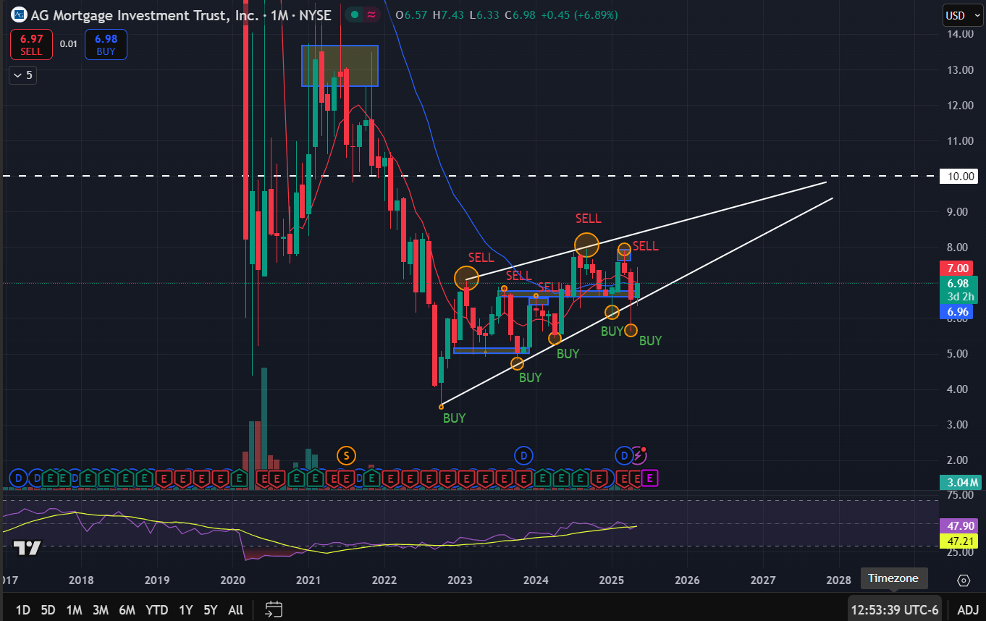
Monthly Chart

Slide 20
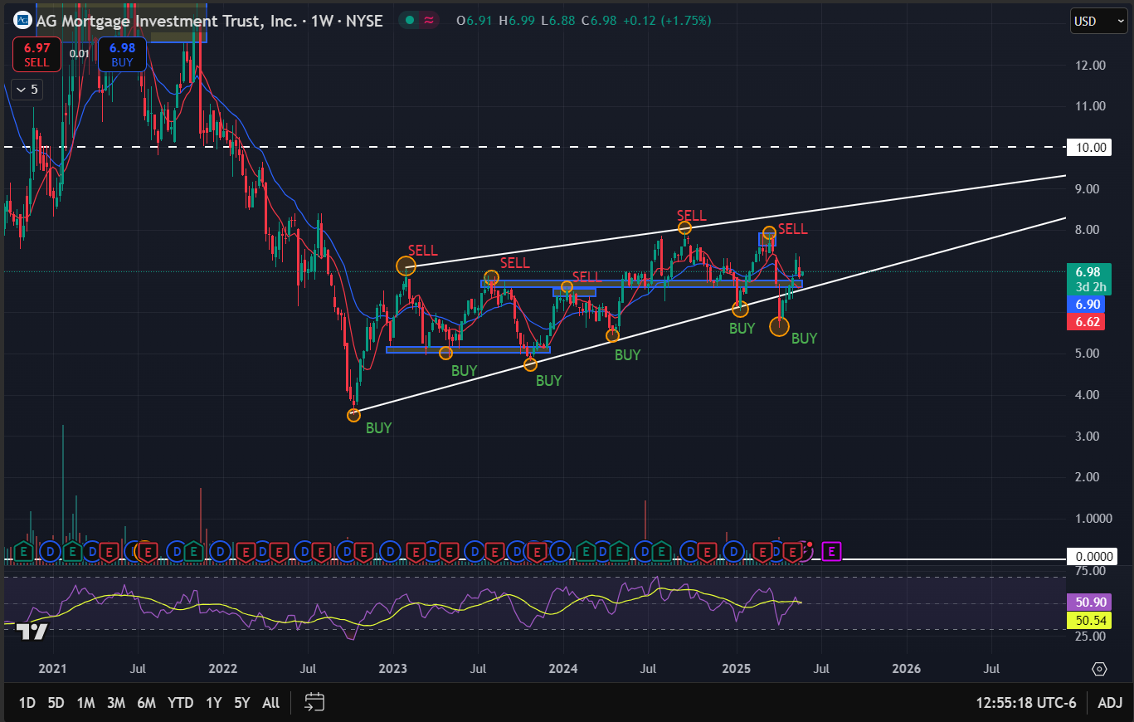
Weekly Chart

Slide 21
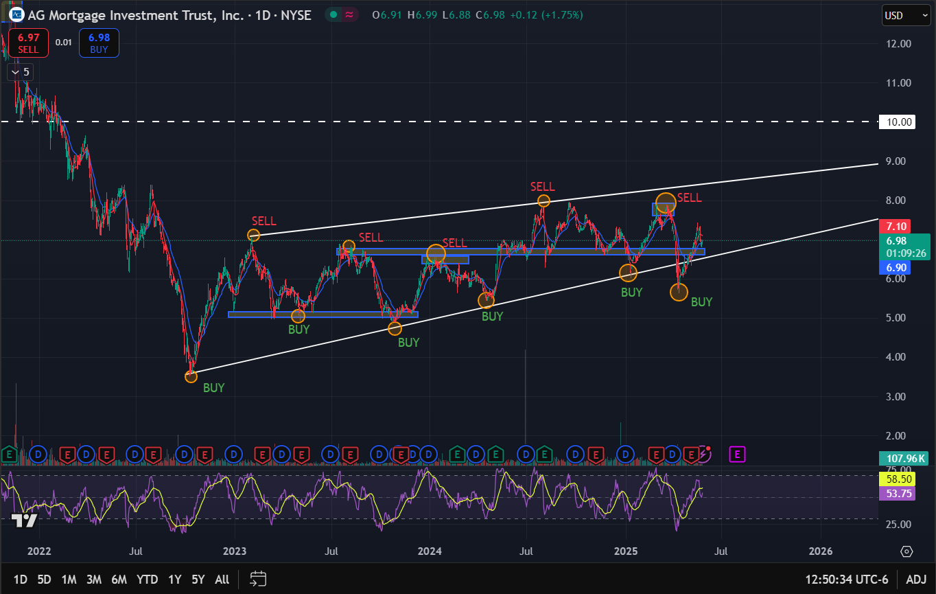
Daily Chart
Stock in a clear uptrend, higher lows and somewhat higher highs
Key observations:
8 SMA looking to cross over 21 EMA
Found support at the uptrend, good buying opportunity
RSI in the 50 are, enough space for a further uptrend rally
Not as a steep of an uptrend, indicates the move upward is going to be in the very long term

Slide 22
Qualitative Analysis
News Headlines
Economic situation & Industry
AG Mortgage Investment Trust Inc (NYSE:MITT) reported a stable book value with a slight increase of 0.1% to $10.65 per share.
The company achieved a 2% economic return on equity for shareholders, supported by a newly increased dividend of $0.20 per share.
The move in 30yr mortgage rates back to over 7% has not surprisingly led to homebuilder sentiment retesting recent lows. Amid a drop in first-time home buyers in particular, according to the WSJ, homebuilders now have more completed but unsold homes on their lots than at any time since 2009
The 10-year Treasury yield is expected to remain elevated in 2025, fluctuating between 3.5% and 4.0%, barring shifts in growth, inflation, or capital flows. While this level may not significantly boost commercial real estate valuations, it should still support reasonably priced refinancing and steady transaction activity. Mortgage rates are projected to stay high, ranging from 6.5% to 7.5% for a 30-year fixed loan.
Mortgage Applications Continue Downward Trend as 30-Year Conforming Loan Rate Rises

Slide 23
Investment Recommendation
Fundamentals:
P/FFO: 8.75 → Undervalued relative to sector average (15–20)
AFFO payout: 100% → Fully distributed income
Dividend Yield: 11.22% → Very attractive but reflects risk premium
D/E: 12.39 → Highly leveraged; sensitive to rate hikes
EPS Growth (5Y): +14.3% (future) vs. -29.6% (past) → Turnaround potential
BUY
(High risk)
Technicals:
Strong uptrend channel on all timeframes
Price rebounded off lower trendline (~$6.00), potential towards the upper trend line
Closely following moving averages towards the upside
RSI low 50’s, space for the uptrend
Macro & Industry:
10-Yr Treasury yield expected to stay elevated (3.5–4.0%)
Mortgage rates (6.5%–7.5%) limit housing activity & refinancing
mREITs benefit from: Book value stability & Dividend increases
But face: Spread compression, Rate & credit risk, Leverage sensitivity

Slide 24

Fundamental Analysis
Stock overview
Stock Ticker | RYN
Company name | Rayonier Inc
Industry | REIT - Specialty
Current stock price | $23.31
Market Cap | 3.63 B
Financials | In thousands
Revenue (Last year) | 1,263.00
Net Income (Last year) | 359.15
EPS | 2.39
Dividend Yield | 1.17%
Real state sector key ratios
P/FFO | 13.74
AFFO payout ratio | 63%
Key Financial Ratios
P/E | 10.02
P/B | 1.90
D/E | 0.55
ROE | 18.78%
Company Growth
Revenue Growth Rate (YoY) | 19.50%
Earnings Growth Rate (YoY) | 30.56%
Valuation = undervalued

Slide 25
Quantumvest Key Financial Ratios
Financial Ratios
EPS Growth Next 5 Years – Over 10% | 6.40%
Return on Equity – Over +15% | 18.78%
Debt/Equity – Under 1 | 0.55
Sales Growth Past 5 Years – Over 10% | 9677.38%
Return On Investment – Over +15% | 11.91%
Current Ratio – Over 1 | 1.12
EPS Growth Past 5 Years – Over 10% | 39.31%
Price target = 5.34

Slide 26
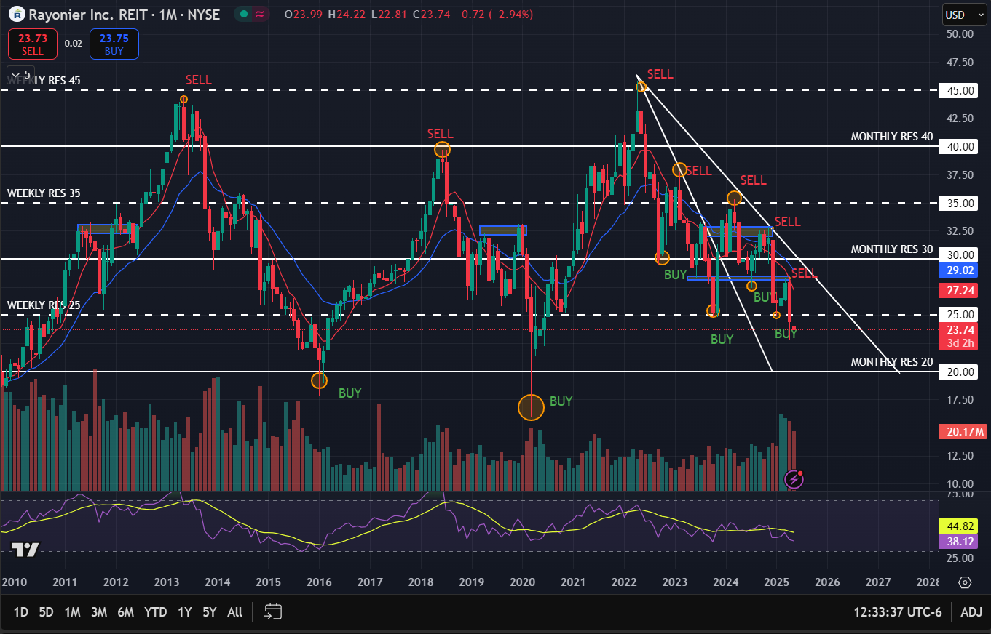
Monthly Chart

Slide 27
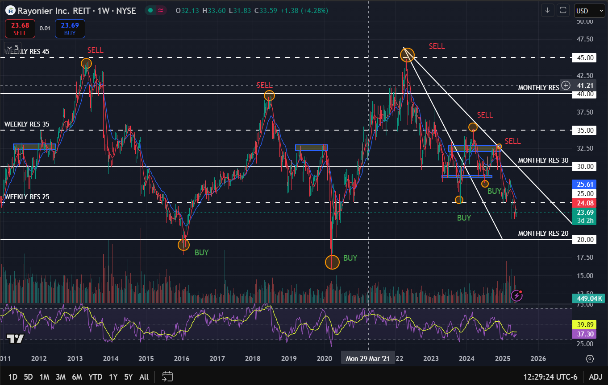
Weekly Chart

Slide 28
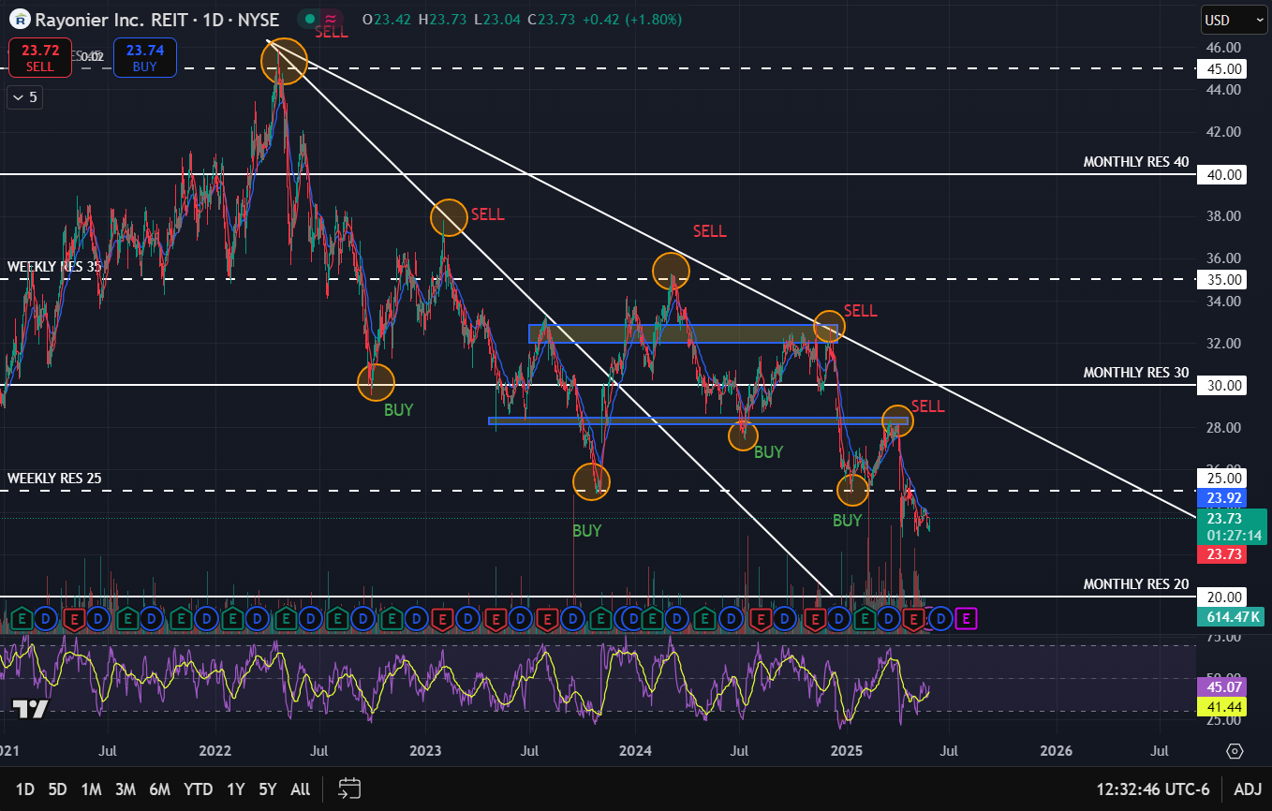
Daily Chart
Stock following a clear downtrend, with lower highs and lower lows
Key observations:
Found a little bit of a consolidation level between the 35 weekly resistance level and 28 price level
Broke weekly support level of 25
Closely following the moving averages towards the downside
RSI in the mid 40s not yet oversold, enough space for further downside
May find support at he monthly 20 resistance

Slide 29
Qualitative Analysis
News Headlines
Economic situation & industry
Fed Funds Rate sits at 5.25%–5.5%, pressuring capital-intensive sectors like REITs
Rayonier Inc (NYSE:RYN) reported a 39% decline in adjusted EBITDA compared to the prior year, primarily due to lower results in its southern timber and real estate segments.
Markets pricing in a potential rate cut in late 2025, which would support REIT valuations
WILDLIGHT, Fla., May 16, 2025--(BUSINESS WIRE)--Rayonier Inc. (NYSE:RYN) announced today that the Company’s board of directors has declared a second quarter cash dividend of $0.2725 per common share. The dividend is payable on June 30, 2025, to shareholders of record on June 16, 2025.
Specialty REITs are more resilient than office or residential REITs in high-rate environments due to long-term contracts
Real estate segment adjusted EBITDA was down $3 million from the prior year period due to fewer acres sold.

Slide 30
Investment Recommendation
Fundamentals:
Dividend yield: 6.45% – attractive for income investors
P/FFO = 11.84 and P/B = 0.99 – near fair value
Revenue YoY slightly negative (-1.16%) but stable EPS and AFFO payout ratio (75.5%)
Healthy D/E ratio of 0.44
Technicals:
Following a downtrend with some lower lows and lower highs
Closely following the moving averages towards the downside
Found some clear resistance at the 25$ mark
Stock moving towards major support level at the monthly 20 level. May find some buying pressure there and start a reversal towards the upside
Macro & industry:
Positive demographic tailwind: aging population → higher healthcare demand
Acquired a healthcare facility + authorized dividend → confidence in cash flows
Healthcare REITs are recession-resistant
HOLD

Slide 31

Fundamental Analysis
Stock overview
Stock Ticker | OPEN
Company name | Opendoor Technologies Inc
Industry | Real Estate Services
Current stock price | 0.6860
Market Cap | 500.02 M
Financials | In thousands
Revenue (Last year) | 5,153.00
Net Income (Last year) | -392.00
EPS | -0.53
Dividend Yield | -
Key Financial Ratios
P/E | -
P/B | 0.77
D/E | 3.92
ROE | -47.67%
Valuation = Overvalued
Company Growth
Revenue Growth Rate (YoY) | -25.81%
Earnings Growth Rate (YoY) | -33.33%

Slide 32
Quantumvest Key Financial Ratios
Financial Ratios
EPS Growth Next 5 Years – Over 10% | 26.03%
Return on Equity – Over +15% | -47.67%
Debt/Equity – Under 1 | 3.92
Sales Growth Past 5 Years – Over 10% | 35.58%
Return On Investment – Over +15% | -16.55%
Current Ratio – Over 1 | 2.99
EPS Growth Past 5 Years – Over 10% | 33.36%
Price target = ?

Slide 33
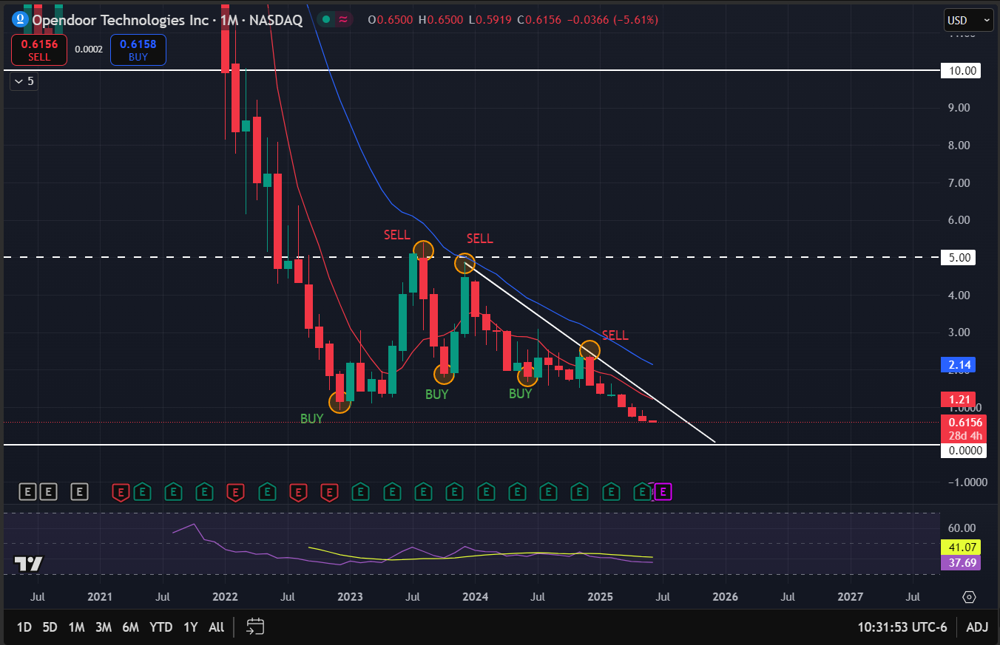
Monthly Chart

Slide 34
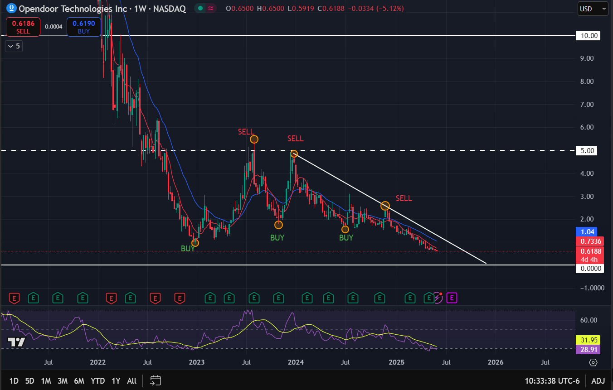
Weekly Chart

Slide 35
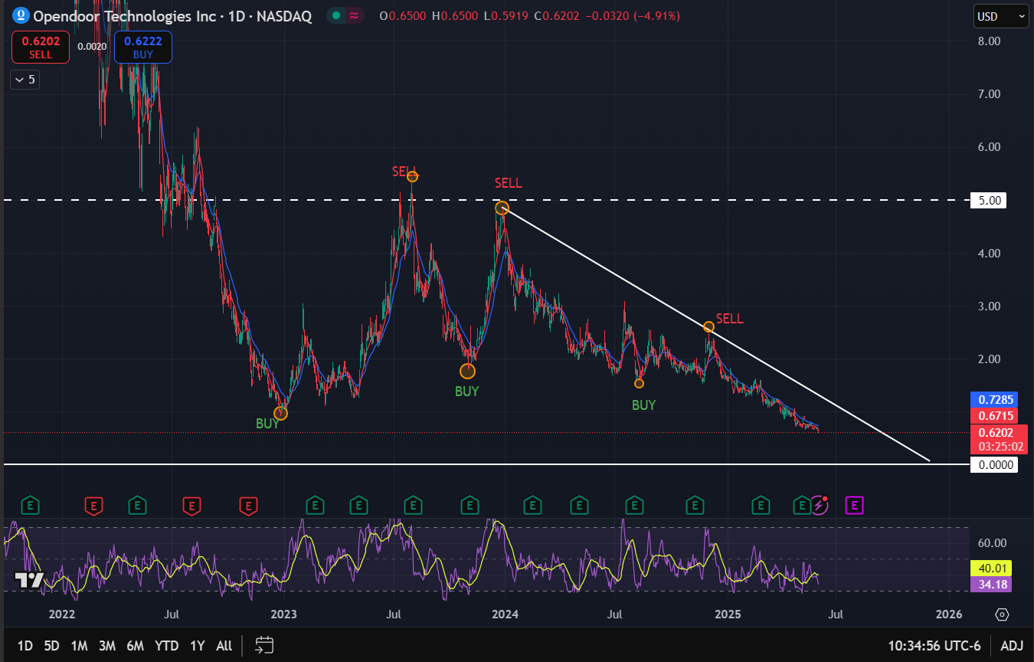
Daily Chart
The stock is clearly following a downtrend, lower highs and lower lows. We even se a double top chart pattern
Key observations:
Closely following the 8 SMA towards the downside
RSI in the mid 30s area, still not oversold, space for more downside
Broke the neckline of the double top pattern, another signal of bearish

Slide 36
Qualitative Analysis
News Headlines
Economic situation & industry
Opendoor agrees to pay settlement to $OPEN investors following allegations of misleading statements, raising concerns about corporate governance.
Opendoor announces closing of convertible notes exchange and new issuance, signaling efforts to manage its capital structure amid financial pressure.
Opendoor cuts workforce again as part of cost-reduction strategy, highlighting operational challenges in the high-interest rate environment.
Company shifts toward partnerships and referral-based model (e.g., with Zillow), signaling a pivot from capital-heavy home flipping.
30-year mortgage rates hovering between 6.5–7.5%, sharply reducing affordability and slowing home sales, directly impacting iBuyer transaction volumes.
Consumer sentiment remains cautious, especially among first-time homebuyers, decreasing deal flow for platforms reliant on quick transactions.
Inventory shortages in some regions keep home prices high, limiting Opendoor’s ability to acquire undervalued assets for flipping.
Emerging tech-enabled competition (e.g., Redfin, Zillow) offers less capital-intensive models, increasing pressure on Opendoor to adapt.

Slide 37
Investment Recommendation
Fundamentals:
Negative net income (-$392M), negative EPS (-0.53), and ROE of -47.67% show serious profitability issues.
Revenue and earnings growth both sharply declining YoY (-25.81%, -33.33%).
Debt-to-equity ratio of 3.92 is extremely high for a real estate platform, signaling balance sheet risk.
Technicals:
Long-term downtrend on monthly, weekly, and daily charts with no reversal confirmation.
Price forming a descending triangle, near all-time lows, and trading below resistance.
Macro & Industry
Legal settlements, workforce cuts, and pivoting away from core model reflect strategic instability.
Macro headwinds: High mortgage rates (6.5–7.5%), poor consumer sentiment, and rising competition from leaner models like Redfin/Zillow.
SELL

Slide 38

Fundamental Analysis
Stock overview
Stock Ticker | AKR
Company name | Acadia Realty Trust
Industry | REIT - Retail
Current stock price | 19.37
Market Cap | 2.57 B
Financials | In thousands
Revenue (Last year) | 359.69
Net Income (Last year) | 20.46
EPS | 0.20
Dividend Yield | 3.94%
Real state sector key ratios
P/FFO | 13.5
AFFO payout ratio | 55.6%
Key Financial Ratios
P/E | 116.46
P/B | 1.10
D/E | 0.78
ROE | 0.92%
Company Growth
Revenue Growth Rate (YoY) | 4.06%
Earnings Growth Rate (YoY) | 5.60%
Valuation = Slightly overvalued

Slide 39
Quantumvest Key Financial Ratios
Financial Ratios
EPS Growth Next 5 Years – Over 10% | 29.08%
Return on Equity – Over +15% | 0.92%
Debt/Equity – Under 1 | 0.78
Sales Growth Past 5 Years – Over 10% | 4.62%
Return On Investment – Over +15% | 0.52%
Current Ratio – Over 1 | -
EPS Growth Past 5 Years – Over 10% | -21.23%
Price target = 45.82

Slide 40
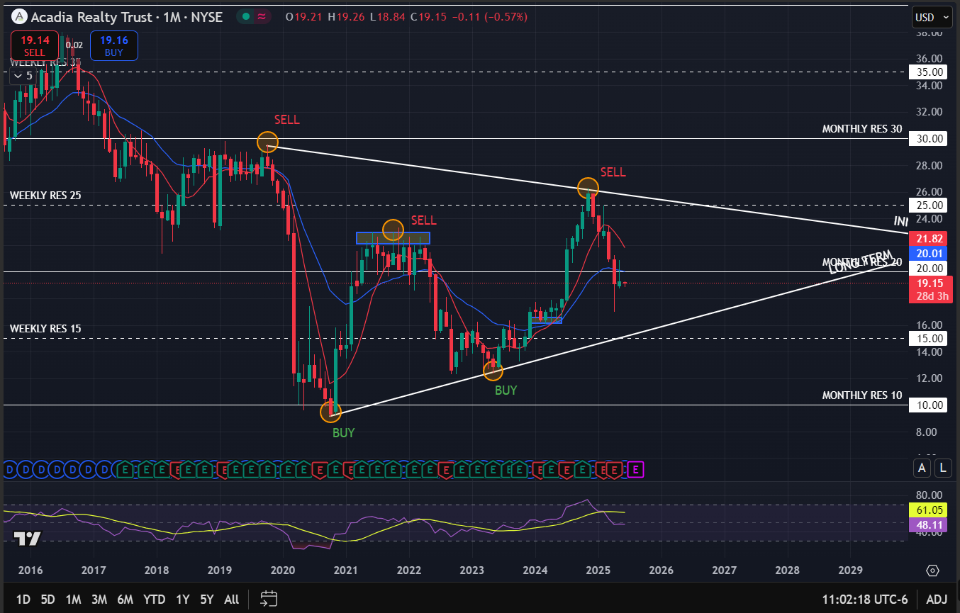
Monthly Chart

Slide 41
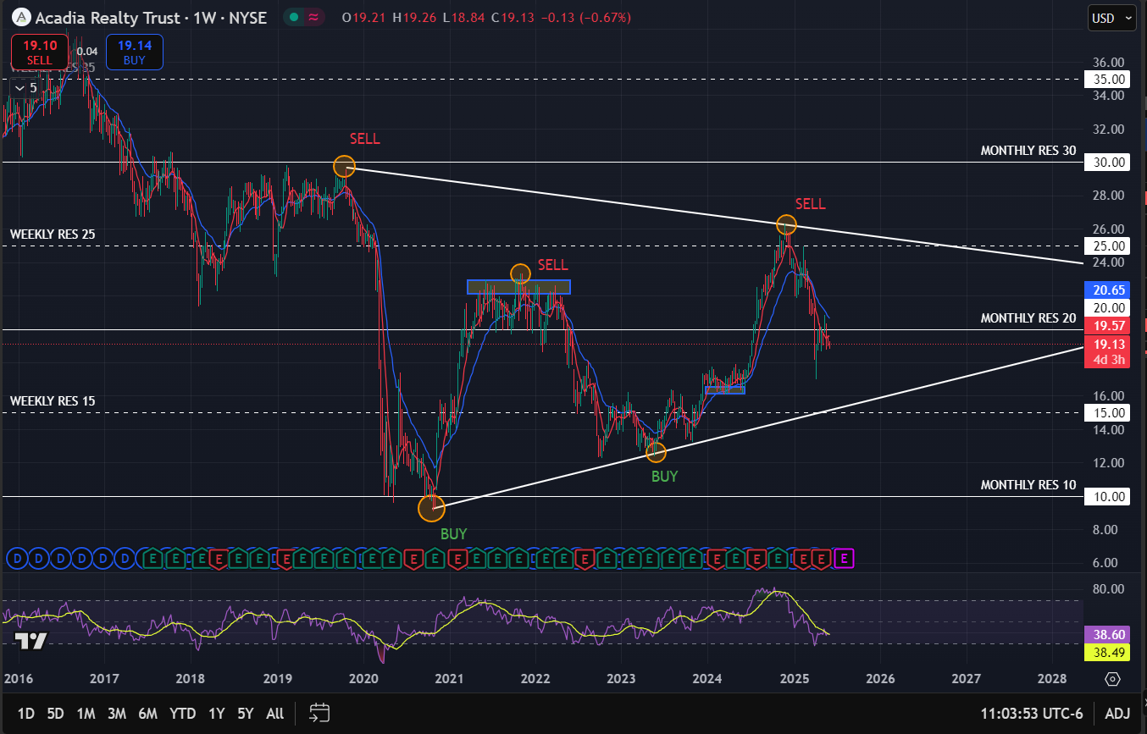
Weekly Chart

Slide 42
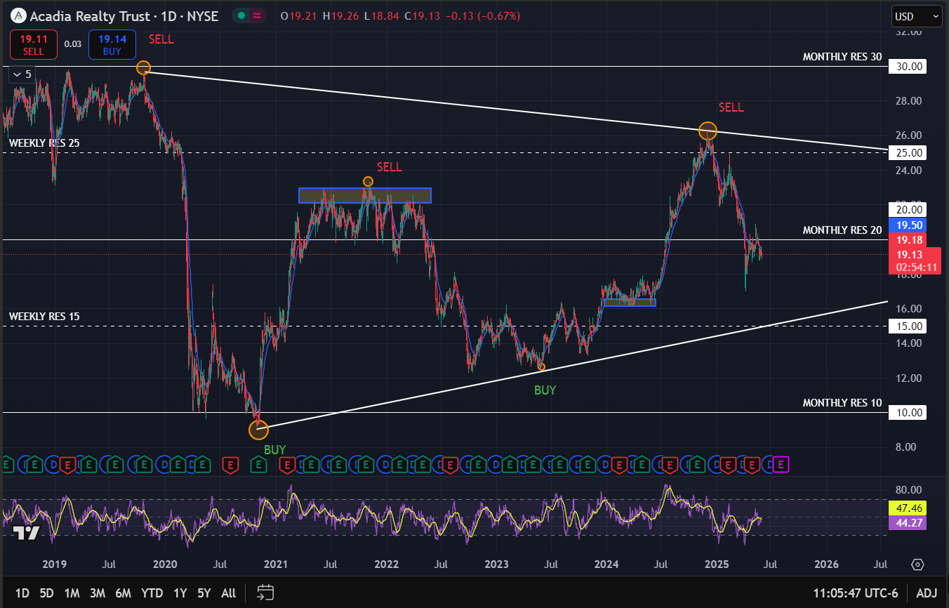
Daily Chart
Triangle channel pattern, narrowed space. Lower higher highs and higher lower lows
Key observations:
Inverted Hammer candlestick in the monthly chart, may indicate a reversal towards the upside
The stock is finding resistance at the 20$ monthly resistance level
The 8 SMA crossed below the 21 EMA on the daily chart indicating it may move towards the downside
May find support at the upward trend line

Slide 43
Qualitative Analysis
News Headlines
Economic situation & industry
Acadia Realty Trust Announces $0.20 Per Share Quarterly Dividend
Retail REITs face pressure from persistent inflation and high interest rates, which impact consumer spending and raise borrowing costs.
Fed interest rates between 5.25%–5.5% challenge REITs’ refinancing and acquisition strategies, especially in competitive urban markets.
Retail foot traffic stabilizing in urban corridors like NYC and Chicago provides a tailwind to AKR’s leasing outlook.
Retail bankruptcies and tenant turnover remain a risk, although Class A assets have outperformed in terms of rent collection and occupancy.
Company maintains stable dividend despite macro uncertainty, reflecting confidence in rental income from core properties.
Acadia continues to focus on high-density urban retail centers, especially in tier-1 cities, aligning with post-COVID consumer traffic patterns.

Slide 44
Investment Recommendation
Fundamentals
P/E of 116.46 is significantly high, indicating an overvalued stock relative to earnings.
P/FFO of 13.5 is at the upper end of REIT averages, suggesting limited immediate upside.
Low ROE (0.92%) and ROI (0.52%) reflect weak profitability despite a moderate revenue base.
EPS Growth (Next 5 years): 29.08%, indicating strong forward potential.
Technical Analysis
Bullish, following the long-term uptrend line, with higher highs and lower lows
Facing some selling pressure at the 20-month resistance level
Closely following the moving averages to the downside
Wait to see if it breaks above resistance level or finds support at the trend line around 15 - 16
RSI in neutral zone, plenty of space for a further rally
Macro & Industry:
AKR is well-positioned in high-density, urban retail centers—an advantage in post-COVID traffic recovery.
Maintains dividends in spite of macro pressures, reflecting management’s confidence.
However, persistent inflation and high interest rates continue to pressure refinancing and acquisition strategies for retail REITs.
HOLD

Slide 45

Fundamental Analysis
Stock overview
Stock Ticker | SILA
Company name | SILA Realty Trust Inc
Industry | REIT – Healthcare facilities
Current stock price | 24.80
Market Cap | 1.37 B
Financials | In thousands
Revenue (Last year) | 186.86
Net Income (Last year) | 42.41
EPS | 0.77
Dividend Yield | 6.45%
Key ratios for Real state sector
P/FFO | 11.84
AFFO payout ratio | 75.5%
Key Financial Ratios
P/E | 39.02
P/B | 0.99
D/E | 0.44
ROE | 2.39%
Company Growth
Revenue Growth Rate (YoY) | -1.16%
Earnings Growth Rate (YoY) | -
Valuation = slightly overvalued

Slide 46
Quantumvest Key Financial Ratios
Financial Ratios
EPS Growth Next 5 Years – Over 10% | 13.62%
Return on Equity – Over +15% | 2.39%
Debt/Equity – Under 1 | 0.44
Sales Growth Past 5 Years – Over 10% | -1.83%
Return On Investment – Over +15% | 1.73%
Current Ratio – Over 1 | -
EPS Growth Past 5 Years – Over 10% | 56.56%
Price target = 41.6

Slide 47
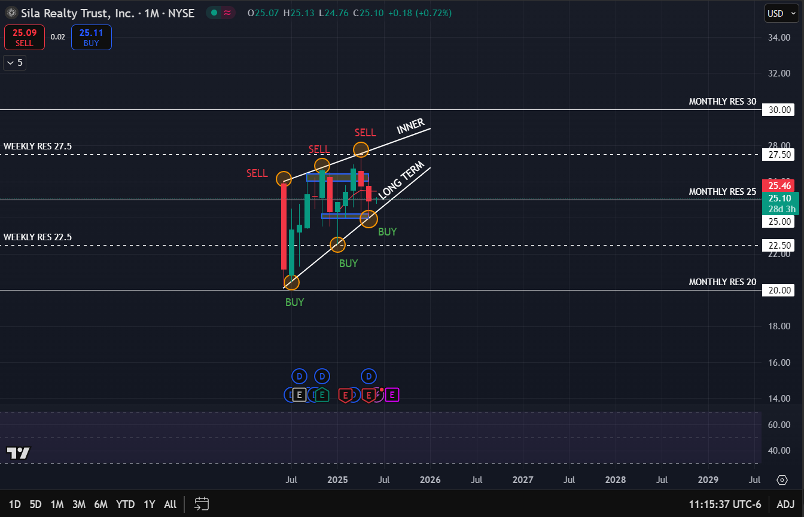
Monthly Chart

Slide 48
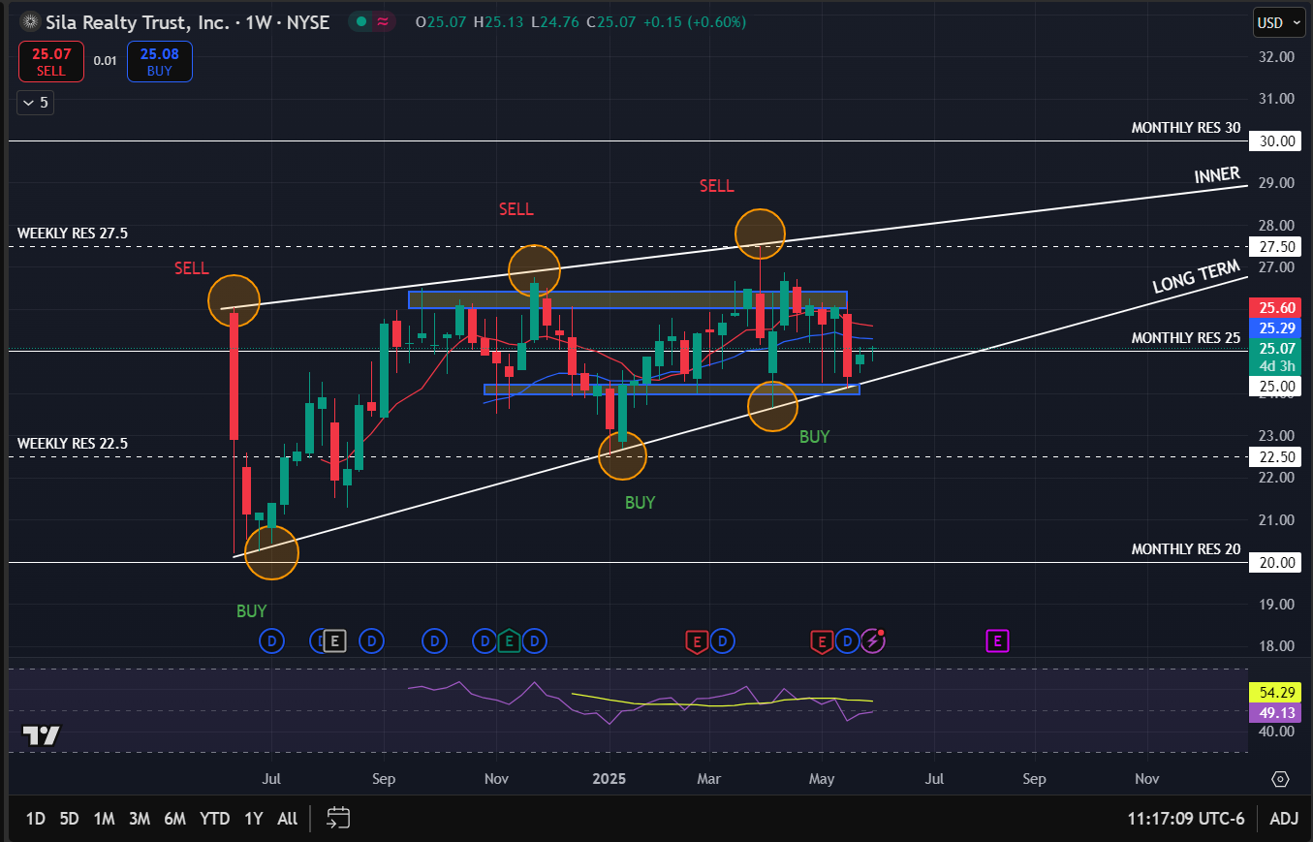
Weekly Chart

Slide 49
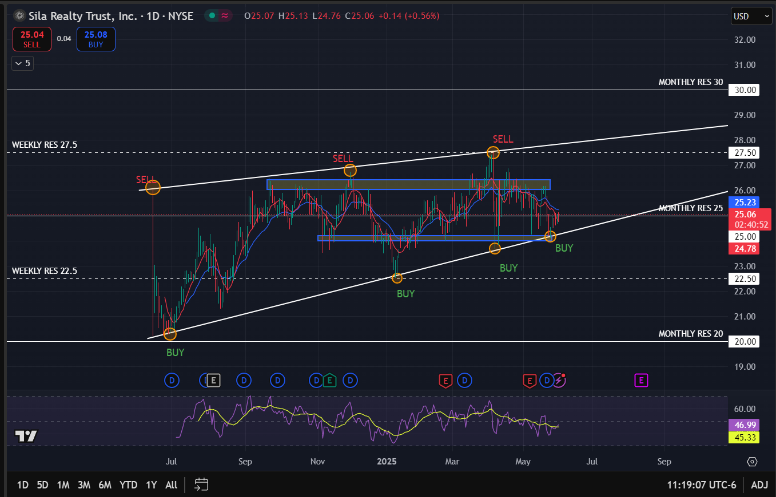
Daily Chart
The stock is clearly following an uptrend in the long term, with higher highs and lower lows
Key observations:
Testing the 25$ monthly resistance level
Found support at the upward trend line
Moving averages indicate in the weekly chart indicate more of a sideway movement, uptrend for the stock takes time to develop (slow growth)
Sort of trading within a channel, marked by the blue rectangles in the weekly chart

Slide 50
Qualitative Analysis
News Headlines
Economic situation & industry
By 2030, the entire baby boomer generation will have reached retirement age, increasing the U.S. population’s share of senior citizens (age 65+) to 20% (70 million) from 17% (61 million) in 2024. Seniors are expected to increase total outpatient healthcare spending by 31% over that time to nearly $2 trillion.
Sila Realty Trust Closes $23.5 Million Acquisition of Dover Healthcare Facility
On May 6, 2025, the Company's board of directors, or the Board, approved and authorized a quarterly cash dividend of $0.40 per share of common stock payable on June 4, 2025, to the Company's stockholders of record as of the close of business on May 21, 2025
“the healthcare sector is relatively immune to the macroeconomic problems faced by office … This is because even amid tough economic conditions, consumers need to spend on healthcare services while curtailing discretionary purchases.”

Slide 51
Investment Recommendation
Fundamentals:
EPS Growth (5Y): +56.56% (very strong historical growth)
ROE: 2.39% and ROI: 1.73% → low profitability
Dividend Yield: 6.45% → attractive for income investors
P/FFO: 11.84 → reasonable valuation
AFFO Payout: 75.5% → sustainable dividend policy
Revenue Growth: -1.16% (slight recent decline)
Technicals:
Following an uptrend in the three charts
Will need to break monthly resistance at 25
RSI stable, no sign of extreme overbought/oversold, much space for it to move towards the upside
Macro & Industry:
Healthcare REITs are defensive and resilient in high-rate or recessionary environments
Demographics (aging population) drive long-term demand
Recent acquisition shows growth activity
Dividend increase supports shareholder value
HOLD

