Slide 1


By: Paolo Hernandez
September 30, 2025
Investments I
Peckham

Slide 2
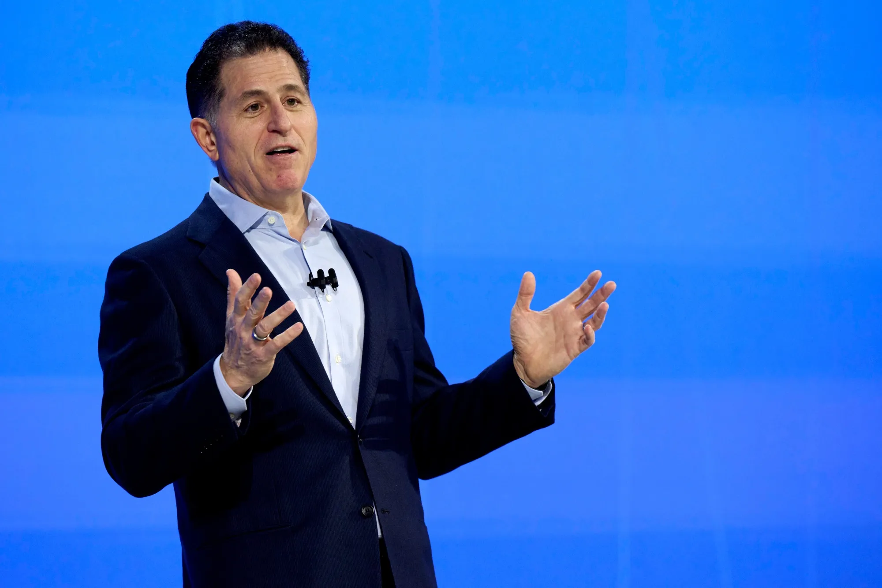

History
1984: Founded by Michael Dell with $1,000 in Austin, Texas, focusing on PCs sold directly to customer
1985- released the Turbo PC, the first Dell designed computer
1988- IPO as Dell Computer Corporation
1990s-2000- Become global Leader in PCs
2013- Michael Dell and Silver Lake take Dell private for $25 billion
2016- EMC acquisition for $60 billion, creating one of the largest enterprise tech firm
2018- Dell returns to public markets
2020- Focus shifts to AI infrastructure, multicloud solutions, and edge computing
Key Details
NYSE: DELL
CEO: Michael Dell
-Founded Dell in 1984 at Age 19
-Took Dell private in 2013 and relisted to NYSE in 2018
-Holds majority voting power via Class C shares
M&A Activity
Perot Systems (2009)
-IT services and consulting firm
-Helped Dell move beyond hardware into IT outsourcing and professional services
Quest Software (2012)
-IT management, database tools, and software
-Expanded Dell’s software portfolio into security, monitoring, and systems management
EMC Corporation Acquisition (2016)
-Created Dell EMC, expanding into storage, virtualization, and enterprise infrastructure

Slide 3
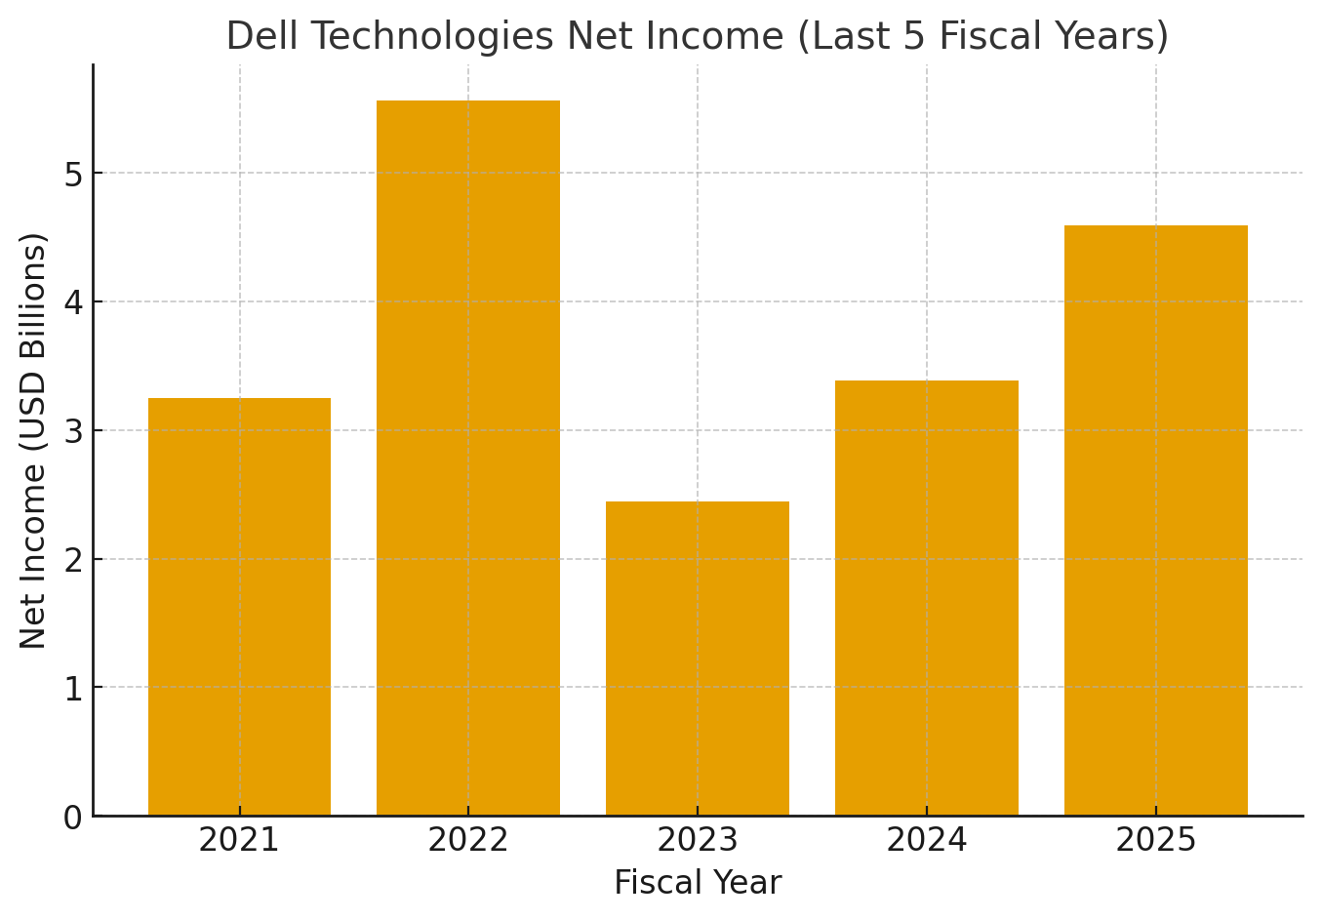
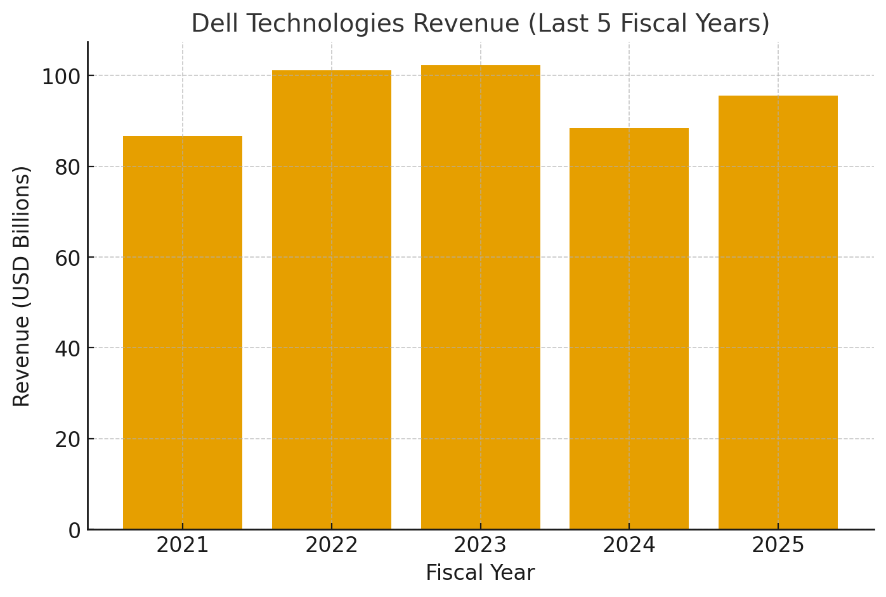
Quantitative
Revenue (2024): $88.4B
Net Income (2024): $3.2B
$2.42B Net Income in 2023, Net gain of $780M in 2024
Net Profit Margin: 3.62%, driven by ISG Growth (AI/data center growth), efficiency improvements, and reduced financing costs (2.35% NPM in 2023)
Free Cash Flow (TTM): $4.59B, 2030 Projection: $8.52B
Qualitative
Client Solutions Group (CSG)
PC, laptops, workstations
Strong brand recognition and global market share in PCs
Consumer and Commercial markets, emphasizes enterprise/commercial side (corporations, governments, schools)
Infrastructure Solutions Group (ISG)
Servers, storage, networking solutions
Core to Dell's AI + data center strategy
Partnerships with Nvidia, AMD, Intel, for AI infrastructure
Competes with HPE, Lenovo, Cisco
Services
Deployment, support, consulting, cybersecurity
Growing recurring revenue stream
End-to-end services that cover entire lifespan for enterprise clients
Challenges in CSG (PCs, laptops, desktops)
Weaker performance
ISG (servers, storage, data center) strong demand

Slide 4
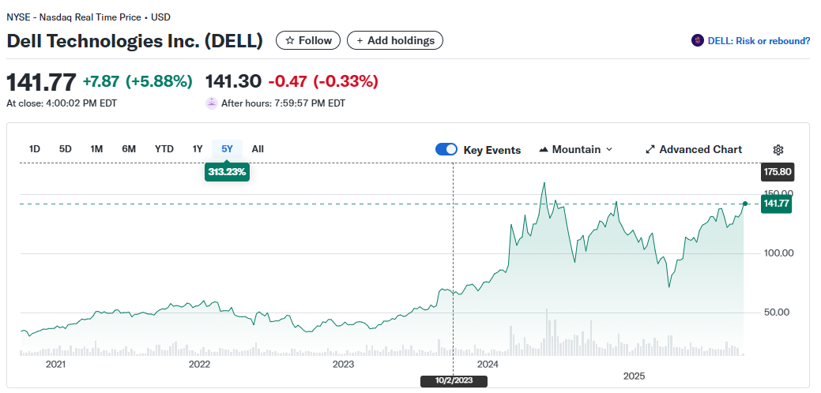
Stock Classification
Market Cap: 92.786B, Large-cap stock, Value & Growth
Traded on: NYSE
Five-Year Growth: +313.23%
One-year Growth: +19.60%
Dividends: $2.10 per share, Yield (1.61%)
Valuation
Avg EPS since 2021: 5.04
Earnings Growth Rate: 8.62%
Future Value of EPS in 5 years: 10.61
P/E Ratio: 20.20 (lower than Information
Technology sector average of 37.97x)
Beta: 1.08
Current EPS (TTM): 7.02
Forecasted Price Targets:
High: $180
Mid: $149.95
Low: $104
Introduced Power Edge XR8720t server
Reduce costs, power use, deployment complexity

Slide 5
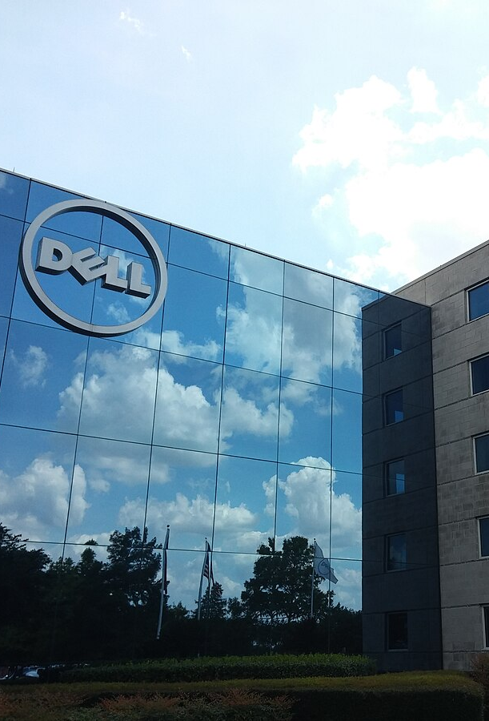
Recommendation
Buy
Pros
Attractive valuation
Strong EPS and Cash Flow Growth
AI and Infrastructure demand drive growth
Diversified Business Model
Returning capital (Dividends and aggressive buybacks)
Cons
PC market dependance
Thin Margins
High competition in Growth areas
Growth uncertainty (if AI infrastructure demand slows)
Tech Sector Volatility

Slide 6
Sources
Dell Technologies Inc. Form 10-K: Annual Report for the Fiscal Year Ended January 28, 2022. U.S. Securities and Exchange Commission, 24 Mar. 2022, https://investors.delltechnologies.com/static-files/de73a7a0-e961-4391-962e-0e67a37ccb02
Dell Technologies Inc. Form 10-K: Annual Report for the Fiscal Year Ended February 2, 2024. U.S. Securities and Exchange Commission, 25 Mar. 2024, investors.delltechnologies.com/sec-filings/sec-filing/10-k/0001571996-24-000036.
“DELL (Dell Technologies Inc.) Stock Price & News.” Yahoo Finance, finance.yahoo.com/quote/DELL/. Accessed 25 Sept. 2025
The Editors of Encyclopedia Britannica. “Dell.” Encyclopedia Britannica, Encyclopedia Britannica, Inc., 2025, www.britannica.com/money/Dell-Inc.
“Dell Stock Climbs on Server Demand” Yahoo Finance, Yahoo, [date published if available], finance.yahoo.com/news/dell-dell-stock-climbs-server-190647501.html.

